Slide 1
Senate Budget Committee Report Tim Kidd (chair), Adam Butler, Frank Thompson, Bill Callahan, Hans Isakson
Non-Inflation Adjusted Dollars
Big Cuts to State Appropriations
Impact:
Academics
Auxiliaries
Support
Students
Tuition increased 1.4x (no infl.)
Inflation increases impact 33%!

Slide 2
Near Term Outlook
 | FY14 Budget | Change 14-15 | FY15 Budget | Change 15-16 | Estimate for 2016
state base | $83,222,819.00 | $5,953,913.00 | $89,176,732.00 | $0.00 | $89,176,732.00
state 1 time | $6,000,000.00 | ($2,000,000.00) | $4,000,000.00 | $(4,000,000.00) | $0.00
Interest | $821,000.00 | $0.00 | $821,000.00 | $0.00 | $821,000.00
tuition UR | $57,550,029.00 | $0.00 | $57,550,029.00 | $0.00 | $57,550,029.00
tuition UNR | $12,333,414.00 | $308,335.00 | $12,641,749.00 | $0.00 | $12,641,749.00
tuition GR | $5,414,771.00 | $108,295.00 | $5,523,066.00 | $0.00 | $5,523,066.00
tuition GNR | $763,422.00 | $19,086.00 | $782,508.00 | $0.00 | $782,508.00
new student | $0.00 | $392,232.00 | $392,232.00 | $0.00 | $392,232.00
Total Tuition | $76,061,636.00 | $827,948.00 | $76,889,584.00 | $0.00 | $76,889,584.00
Indirect | $1,316,649.00 | $0.00 | $1,316,649.00 | $0.00 | $1,316,649.00
Sales | $483,393.00 | $0.00 | $483,393.00 | $0.00 | $483,393.00
total revenue | $167,905,497.00 | $4,781,861.00 | $172,687,358.00 | $0.00 | $168,687,358.00
personnel expenses | $133,836,989.00 | $3,296,802.00 | $137,133,791.00 | $3,296,802.00 | $140,430,593.00
non-personnel expenses | $12,589,462.00 | $0.00 | $12,589,462.00 | $0.00 | $12,589,462.00
financial aid | $13,692,016.00 | $9,149.00 | $13,701,165.00 | $9,149.00 | $13,710,314.00
institutional accounts | $8,041,397.00 | $313,604.00 | $8,355,001.00 | $313,604.00 | $8,668,605.00
Contingency Fund | $0.00 | $1,329,600.00 | $1,329,600.00 | $0.00 | $1,329,600.00
total expense | $168,159,864.00 | $4,949,155.00 | $173,109,019.00 | $3,619,555.00 | $176,728,574.00
Net | ($254,367.00) | ($167,294.00) | ($421,661.00) | ($167,294.00) | ($8,041,216.00)
2001 Appr. = $96.8M
Infl. Adj. = $129.2M
2015 Appr = $89.2M
44% effective reduction
Impacts ALL areas of UNI
Base increase for FY15 = $6M
Needed increase in FY16 ~ $8M
Loss of 1 time $ and raises/etc…
Legislature cut ~ $1.4M from governors proposal FY15
Clearer picture this fall
Efficiency study
Performance Based Funding
Financial reserves ~ $2M
No signs of sneaky money transfers
Numbers complex
“Unrestricted Funds” NOT unrestricted

Slide 3
Funding Priority Shifts: Faculty Numbers
178 Asst. Prof. in 2001
119 Asst. Prof in 2013
Drop of ~ 30%
Part Time Adjuncts
Increased
Hard to tell FTE impact
Overall Student-Faculty ratio not overly changed
Serious impact on students – adjuncts don’t provide extra-curricular opportunities in research/outreach/independent study.
Service load of faculty increases & less long term investement by faculty in UNI

Slide 4
Auxiliary Units: General Ed Fund
 | 2009-2010 | 2010-2011 | 2011-2012 | 2012-2013
General Educational Fund Revenue | 172,120,593.85 | 161,704,799.10 | 161,486,788.60 | 167,114,885.32
Auxiliary Enterprises GEF Received
Residence | - | - | - | -
Athletics | 4,449,174.00 | 4,559,447.00 | 4,323,026.00 | 4,198,513.00
Mauker Union | 619,837.00 | 598,286.00 | 603,570.00 | 676,292.00
Field House | 750,464.40 | 0 | 0 | 0
GBPAC | 851,328.00 | 848,739.00 | 812,802.00 | 828,011.00
WRC | 874,692.00 | 782,274.00 | 766,716.00 | 781,150.00
Student Health System | 420,411.00 | 188,213.00 | 197,469.00 | 200,554.00
Miscellaneous | - | - | - | -
Total Auxiliary Enterprises – Field house | 7,215,442.00 | 6,976,959.00 | 6,703,583.00 | 6,684,520.00
% of GEF that go to Aux. Enterprises | 4.63 | 4.31 | 4.15 | 4.00
% of GEF that go to Athletics | 2.58 | 2.82 | 2.68 | 2.51
Have not looked closely into other areas such as foundation, OSRP, centers, etc…

Slide 5
Funding Priority Shifts: Salaries (with Fringe) as % of overall salaries
Auxiliary and administration
Salary % have increased since 2003
Large increase in athletics
Instruction
Salary % has decreased since 2003
Effectively adjusted for inflation trends
For comparison purposes
Caveats
2010-2011 have some anomalies
Work with finance to get clearer picture
Not all auxiliary revenues from Gen fund
Athletics has done great job with ext. funding

Slide 6
Financials in Athletics
Great overall job – External funding
Work well with foundation also
$ to athletics from donor intent
One concern – Net liability >$700k
Majority unpaid vacation/leave
GEF support reduced since 2008
Still 7% higher than 2003
Auxiliary units charged new costs in past 5 years
Overhead and partial utilities
Consider ten year cuts to instruction and academic areas
Staffing, overall salary comparison, S&S budgets stagnant
Long term – cuts to instruction/academics larger

Slide 7
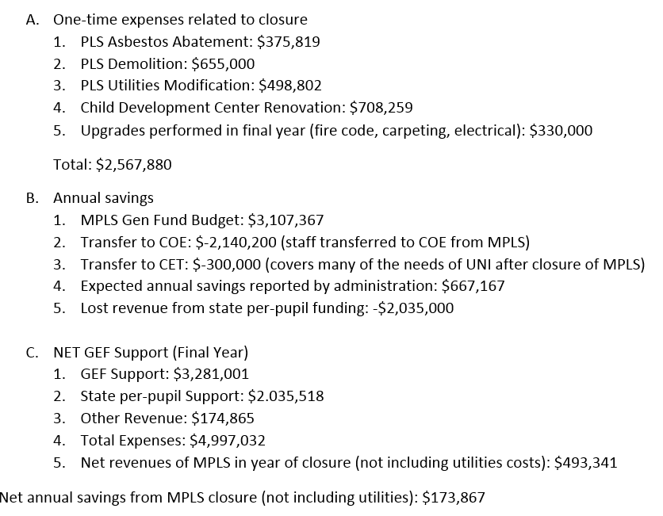
MPLS Closure
Complex Financials
Uncounted Impacts:
Deferred maintenance
Need for new building
State per-pupil funding
MPLS Enrollment
UNI enrollment
Saved millions in building costs
189 less UNI education majors (8%)
Impact on enrollment in millions?
Net result: reallocation of resources

Slide 8
Specific Cuts – Unintended Consequences
Also examined donations to foundation
No impacts seen
Large single year variations
Baseball cut in 2009 (Fall 2009)
Resource reallocation in response to budget cuts
MPLS / Program Closures in 2012 (Fall 2012)
Most faculty felt no consultation
Seemed fast response to big cuts
Big drop in enrollment / tuition revenue
Efficiency Study / FY16 Funding
Need to prepare, prioritize
Be ready to respond to suggested cuts
Preparation may help mitigate unintended consequences
UNI is running very lean in all areas after big cuts, should be prepared for future

Slide 9
Suggestions Future Thoughts
Have had success working with administration / finance
Over past year administration is very interested in transparency
And improvement in faculty-administration relations
We should work as partners to enhance institution
Budget Prioritization
Current Budget committee looks at history / health / trends
Expand mandate? Would need more members, preferably 2 senators
Need to make better model for assessing current priorities
Consult with finance / administration and report to senate on priorities
Curriculum / Program Review – Prepare to Defend, Justify, and Promote
Efficiency study (maybe?)looks only at undergrad programs on academic side. Urgency?
Will be looking at numbers – retention, grad rates, class size, student credit hours, etc…
Need to be aware of what they will be looking at. Identify at-risk departments.
Identify other important metrics? – placement after graduation, student opportunities, education quality, research, outreach, external funding, etc….
Questions:
Should senate budget committee be involved with financial planning?
Are there areas of interest that we should look at this year (performance based funding?)

