Slide 1
End of bias
Part 1

Slide 2
Overall impressions
What do you think of this book?
How does it compare to the other books we’ve read?

Slide 3
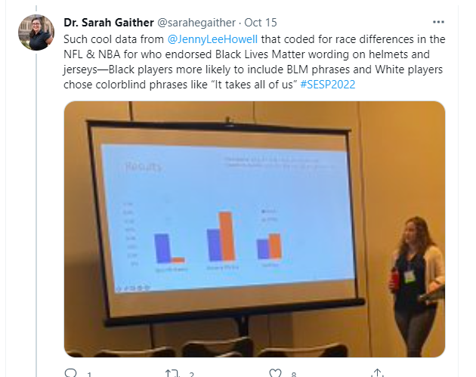

Slide 4
WW2
How did WW2 affect research, bias, and social psychology more generally?

Slide 5
Implicit bias
Does everyone have biases?
Why do people stereotype?
What determines what categories we pay attention to and stereotype on?
Where do we learn stereotypes from?
How are they perpetuated?
If culture affects implicit bias, can people be held accountable?

Slide 6
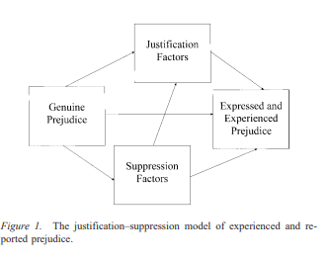
Some Theories of prejudice
Devine’s two process model (Devine, 1989)
Justification-suppression model (Crandall & Eshleman, 2003)
Integrated model of Prejudice (Dovidio & Gaertner, 1988)
Modern/symbolic (McConahay, 1986; Kinder & Sears, 1981)
Aversive (Gaertner & Dovidio, 1986)
Social dominance theory (sidanius et al., 1992)

Slide 7
What are the effects on the stereotyped?
What are microaggressions?
What are critiques of the concept?
Is it better to notice or not notice discrimination? (Barreto & Ellemers, 2015)
What effects does it have?
What determines whether we notice it?
Does it matter if it’s a concealable stigma? An impermanent one?
What are the long-term effects of bias?
Computer simulation

Slide 8
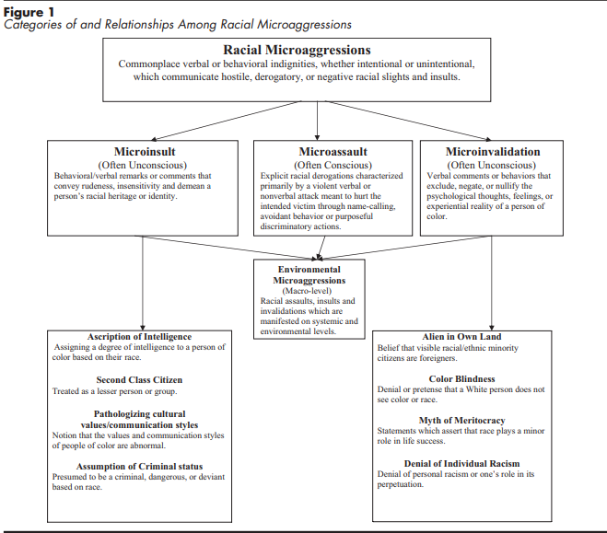
Microaggressions

Slide 9
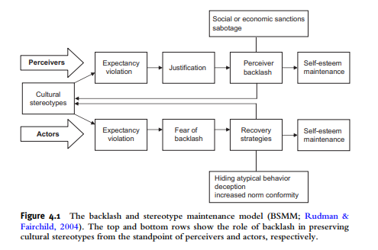
Iterative effects
How is bias interactive?
Stereotype threat (steele & Aronson, 1995)
Self-fulfilling prophesy (Rosenthal &
Jacobson, 1968)
Intersectional?
backlash and stereotype
Maintenance model (Rudman et al., 2012)

Slide 10
What is the problem with just getting rid of group boundaries or being “color blind”?
Vs. multiculturalism
Vs. common in-group identity model (Gaertner & Dovidio, 2000)
Is noticing gender, sex, ethnicity, age, etc. inevitable?

Slide 11
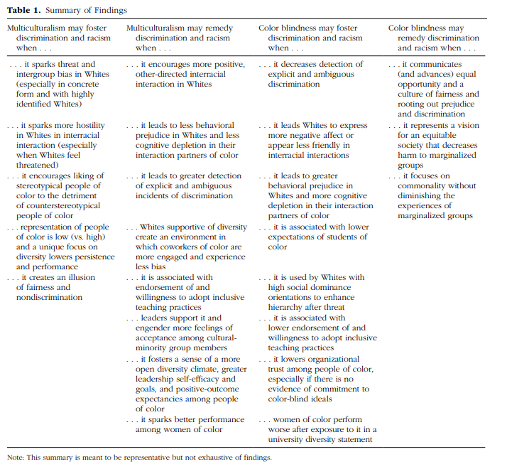
Plaut et al., 2018

Slide 12
Understanding history
What are some structural and institutional factors that affect stereotypes?

Slide 13
We are what we study
How does bias, bias research?

Slide 14
Interventions to reduce prejudice
What was Devine and cox’s workshop approach?
What are your experiences with bias?
Do diversity trainings work?
What are some problems with these trainings?
Why has there been a backlash against certain types of diversity training?
https://www.legis.iowa.gov/legislation/BillBook?ga=89&ba=HF802

Slide 15
Bezrukova et al., 2016 meta-analysis

Slide 16
Policing applications
Effects of race and threat
Shooting research (Correll)
Is the problem one of policy or basic mission?
Banning Warrior trainings, other maneuvers
Revamping training
Having police live in the neighborhood they patrol
Have separate agencies for traffic stops
rebuild police unions
Completely rethink the police

Slide 17
Empathy and Mindfulness
How does the “toxic drip” of police culture affect officers?
What is mindfulness, and how might that help, according to nordell?
Is mindfulness the same thing as meditation? What is it really doing?
https://www.harvard.edu/in-focus/mindfulness-meditation/
https://ggia.berkeley.edu/practice/loving_kindness_meditation
Does mindfulness reduce bias?

Slide 19
What are other major approaches to understanding prejudice?
What impact might they have on implicit bias?
Social learning theory (Bandura & Walters, 1963)
Evolutionary approaches (Neuberg & Cottrell, 2006)
Social identity theory (Tajfel & Turner, 1986)
Self-categorization theory (turner et al., 2017)
Realistic group conflict theory (Sherif, 1966)
Integrated threat theory (Stephan & Stephan, 2000)

Slide 20
interventions
Imagine that you get to meet with Kim Reynolds or another local, regional or world leader to talk about how to decrease bias
How would you approach the issue?
What would you suggest as far as solutions?

Slide 21
Coming up
Paper due today
Finish book for next week
Get ready for group presentations and meet with me, especially if you’re going on Nov. 9

