Slide 1
The power of norms

Slide 2
overview
What was similar about the approaches you read about today?
What was different?
What is (and isn’t) a norm?

Slide 3
Evolution of norms
Where do social norms come from?
Bottom up approaches (Sherif, Berger, Latané)
Ecological approaches (Schaller, Oishi, Gelfand)
How do norms help and hurt us?
How do they change over time?
Vandello & Cohen 4 stage model:
Adapt to environment
Norms develop to support behaviors
Behaviors become internalized, lose adaptive value
Compliance persists—cultural lag

Slide 4
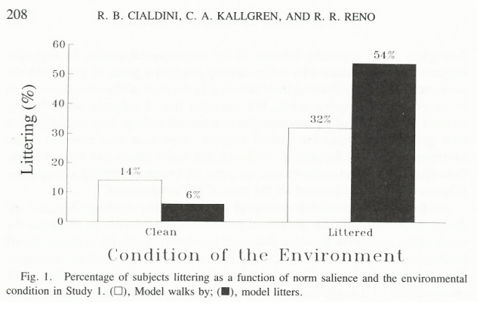
Social norms and influence
Focus theory of normative conduct (Cialdini et al., 1991)
Injunctive vs. descriptive norms
Attention/salience
Social identities
Social marketing campaigns
When is the descriptive norm not useful?

Slide 5
Goldstein et al., 2008
Which do you think would be most effective and why?
Help save the environment
Join your fellow guests in helping to save the environment (75% of guests…)
Join your fellow guests in helping to save the environment (75% of people in this room)
Join your fellow citizens in helping to save the environment
Join the men and women who are helping to save the environment

Slide 6
Tankard & Paluck, 2017
What is the take home message of this article?
What did Tankard and Paluck do?
Study 1 (Figure 1; Means; Moderators)
Study 2 (Figure 2; Means; Moderators)
Why might institutions affect beliefs?
Are pluralistic ignorance or narratives implicated here?
Would you expect similar effects after the Dobbs ruling? Why or why not?
https://www.pewresearch.org/religion/fact-sheet/public-opinion-on-abortion/
https://news.northeastern.edu/2022/07/27/abortion-support-post-dobbs/

Slide 7
Bursztyn et al., 2020
What is the take home of this study?
What did Bursztyn et al. do?
Outcomes:
Perceptions of attitudes (Figure 2)
Job app (Figure 3; Table 2)
Follow ups (Figure 4)
Later impression of others’ opinions
Study 2
Study 3

Slide 8
Pluralistic ignorance
Why do people misperceive norms?

Slide 9
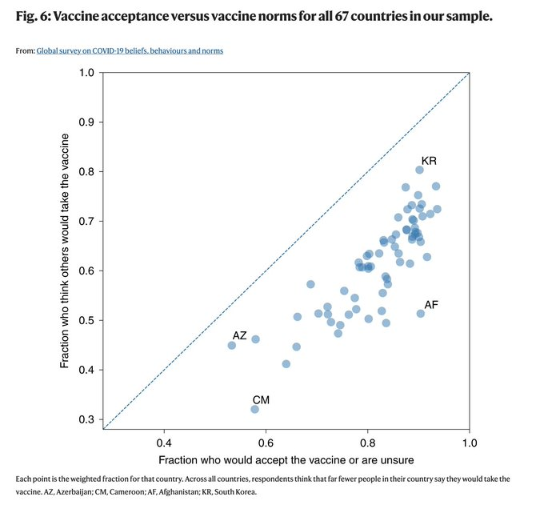
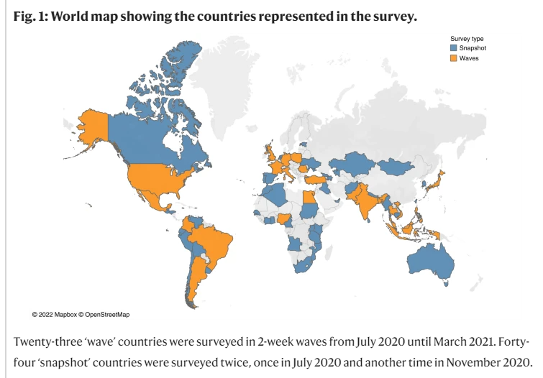
Collis et al., 2022
https://www.nature.com/articles/s41562-022-01347-1?utm_source=nathumbehav_etoc&utm_medium=email&utm_campaign=toc_41562_6_9&utm_content=20220921

Slide 10
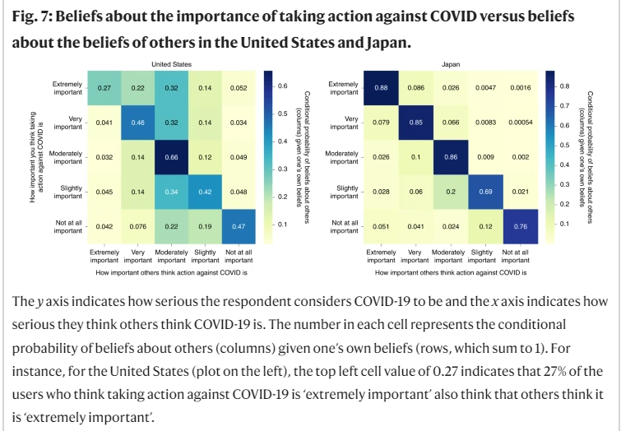

Slide 11
Bilali, 2022
What is the take home message of this article?
What did Bilali do?
How it is similar and different from other research we’ve talked about this semester?
Why are narrative interventions useful?
Would the effects be different in a less controlled environment?
To what extent were the effects likely due to listening to the show vs. the discussions about it?
What other problems could be addressed through narrative approaches? Are there any concerns or caveats?

Slide 12
Bilali, 2022 results
What is the intent-to-treat approach, and was that the best to use here?
What about the use of imputed vs. nonimputed data?
Were the covariates appropriate?
What does Table 3 show?
Control means
Model 1 vs. 2
B’s and p.s

Slide 13
Other examples
US radio programming on people in Mali, Chad, and Niger--+ behaviors, but no effect on attitudes (Aldrich, 2012)
DRC radio drama---mixed effects—felt closer to other side but also less belief that contact will help (Bilali & Vollhardt, 2015)
Video dramas in Uganda led to more willingness to report and violence toward women and less of it in the communities (Cooper et al., 2020)
Rwanda radio soap opera for 12 months changed perceived norms of open expression and local responsibility changed, attitudes not so much (Paluck, 2009)
Royal Pains and more supportive attitudes toward transgender individuals and policies (Gillig et al., 2018)
Watching positive sitcom of Muslim Canadians less prejudiced toward Muslims 4 weeks later (Murrar & Brauer, 2018)
Telemundo soap opera scenes positive toward the census affected attitudes of US Latinos (Trujillo & Paluck, 2010)
Mexican government educational soap opera in 70s led to millions of illiterate adults going back to school

Slide 14
Narrative effects
How do official narratives (e.g., from government, from schools) affect norms and/or attitudes?
Are there other examples of narrative effects you can think of?
Why do narratives seem to have more effect on norms than attitudes? Does that matter?
How do narratives have an effect?

Slide 15
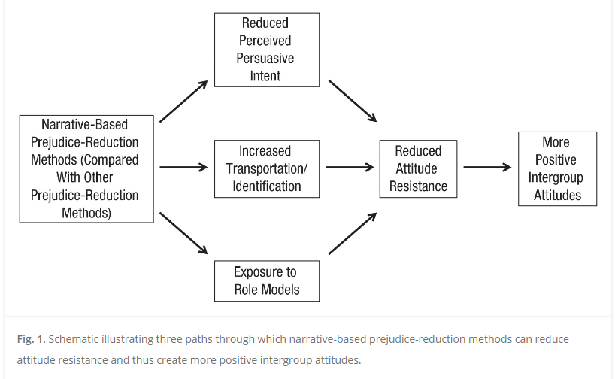
Murrar & Brauer, 2019

Slide 16
Using norms to change behaviors
Narratives
Making people aware of others’ attitudes
Governmental changes
Get people to stop using their phones when they drive
Get people to have their children vaccinated for HPV
Get people to wear masks

Slide 17
Paper notes
“Solve” a societal problem
Not a rough draft—10% of grade
APA style format (10 pts)—
Professional cover page
Begin page 2 with title
Sections should be given real heading names (not “section 1”)
References must match up and be in APA style 7 and be primary sources
APA style reference section should only contain references cited in the paper you turn in
Headings, margins, etc. should be APA style 7

Slide 18
First section (20 pts)
Do you have a clearly defined, specific problem?
Do you provide evidence for how common it is?
Do you provide evidence that it is a problem (e.g., linked to negative outcomes)?
Do you clearly set up the paper and its organization?
Should have several references and be around 2 pages

Slide 19
Second section (30 pts)
Do you accurately describe at least 2 social psychological theories that relate to the problem (and your approach to solving it)?
Do you provide support for these theories?
Do you clearly explain how these theories relate to your problem and what they would suggest as a solution?
Should have at least a paragraph describing each theory, 1-2 paragraphs on support for the theory, and at least 1 paragraph each linking the theory to your problem
Should have several references about be about 3 pages

Slide 20
Third Section (30 pts)
Do you give a balanced and accurate review of other approaches to solving your problem?
Do you provide evidence for several approaches?
Do you provide a critical review of this evidence, culminating with a clear description of what does and does not seem to help?
Should contain many references and be around 3 pages (more if you’re not concise)
Sub headings should be used within this section

Slide 21
Composition/Grammar (10 pts)
Is research reviewed accurately, cited correctly, and presented with the right amount of detail (e.g., avoid lots of detail on most studies, focus on relevant findings and elements of the method)?
Is the writing grammatically correct, clear, and easy to follow?
Did you use good scientific writing (concise, precise)?
Are there appropriate transitions both within and between paragraphs?
Do you use good topic sentences?
Is the focus on the findings rather than the researchers?
Do you use appropriate headings and subheadings throughout the paper to help with organization?

Slide 22
General
Paper should describe a research-based intervention
This is not a research proposal
Page numbers and number of references are general guides to give you an idea of where the focus should be—they are not absolutes, and a good paper may have fewer or more pages

Slide 23
Other sections (due later)
Revise first sections based on feedback
Summarize previous research approaches and provide a rationale for what you think is the best approach (your approach; 2 pages; not many new references)
Describe your approach in sufficient detail that I could follow it (3+ pages; not many new references; maybe reference appendices)
Describe how you would know if your approach was effective (what you could look at, what comparisons would be made, etc.) and strengths and limitations of your plan (3 pages, few new references)
Give your conclusions

Slide 24
Next week: Start The End of Bias

