Slide 1
The Power of Us
Jay Van Bavel and Dominic Packer

Slide 2
General impressions
What do you think of this book?
How is it similar to and different from Grant’s and Bohn’s books?

Slide 3
20 statements test (Kuhn & McPartland, 1954)
Who am I?
20 times “I am…”

Slide 4
Coding
Code your statements
Do you think these codes accurately describe your sense of self?
What individual difference factors do you think might help explain people’s scores?

Slide 5
Percentage of responses of each type

Slide 6
Independent vs. interdependent
My happiness depends on the happiness of those around me.
I will sacrifice my self-interest for the benefit of the group.
If my brother or sister fails, I feel responsible.
I am comfortable with being singled out for praise or rewards.
I enjoy being unique and different from others.
Being able to take care of myself is a primary concern for me.

Slide 7
Groups vs. identities
What is a group?
What do you need to have a group?
What makes a group more groupy (entitativity)?
They start out talking about how our groups affect us, but they also talk about our social identities. Are groups=social identities?
What are the implications of minimal groups research?

Slide 8
Social identity theory (Tajfel & Turner, 1978)
Psychological processes
Social categorization
Social comparison
Social identification
Group distinctiveness
How do people deal with devalued identity? Depends on
Permeability
Stability
Legitimacy

Slide 9
More social identity
How do our social identities affect us?
What are the steps to social identification?
What determines which identities we will take on?
What are our strongest IDs, and why?
How do we signal our IDs?
Are there individual differences that affect who we identify with or how strongly we identify?

Slide 10
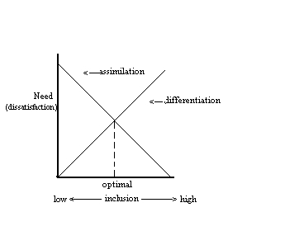
Optimal distinctiveness theory (Brewer, 1991)
2 needs:
Belonging
Distinctiveness

Slide 11
Social comparison theory (Festinger, 1954)
When/why do we compare to others?
To whom do we compare?
Upward
Downward
Lateral

Slide 12
Biased fans and the smell of chocolate
What have studies shown about rival fans’ perceptions of games?
Does this happen in other areas of life?
What affects what we notice?
How does our identity affect preferences and tastes?

Slide 13
Replication crisis
How do these theories (social identity, social comparison, and optimal distinctiveness) and ideas (groupthink) relate to the replication crisis?
What do they suggest about how we should fix it?
What does this research suggest about what we study and how we interact with other scientists?

Slide 14
Harton & Gordon, 2019
Likelihood of QRPs
Demographic factors:
Gender
Year of PhD
Age
Institutional factors:
Type of school
Department
Experience factors:
IRB experience (# protocols)
Internal factors:
Anticipated shame
Perceived harm
Moral judgment
Acceptability
Peer behavior
External factors:
Moral judgment matters more when sanctions are low (sometimes)

Slide 15
Cognitive dissonance theory (Festinger, 1957)
Conflict between our view of ourselves and a thought or behavior
When we surprise ourselves, feel stupid, or feel guilty
Motivated to
Change behavior
Change thoughts
Justify the behavior (add other thoughts)
Decrease how important the discrepancy is

Slide 16
Planet Clarion (Festinger, Riecken, & Schachter, 1964)
What happened in this study?
How are identities implicated in it?
How would you explain this study with cognitive dissonance theory vs. social identity theory? Are there differences?

Slide 17
Cults
Who falls prey to cults?
What defines a cult?
Are there other groups with “cult-like” aspects?
Is it a category or a continuum?

Slide 18
Gibson & Haritos-Fatouros, 1986
Binding (initiation, segregation, in-group language)
Personal factors (normal, intelligent, not sadistic, believers)
Torture
Strain reduction (dehumanize victim, modeling, desensitization, reward/punishment, harassment

Slide 19
Groupthink (Janis, 1952)
strong group cohesion
insulation from outside infl homogeneity of attitudes
a directive leader
high stress
poor decision-making procedures
low situational member SE
illusion of invulnerability
belief in the moral correctness of group
stereotyped views of out-group
self-censorship
direct pressure on dissenters to conform
illusion of unanimity
mindguards
incomplete survey of alts
failure to examine risks of the favored alternative
poor info search
failure to develop contingency plan
biased assessment of risks, costs, benefits, and moral implications
failure to reconsider later

Slide 20
Baron’s (2005) ubiquity approach
Only antecedents are:
Sense of social identity
Salient norms
Low situational self-efficacy
Symptoms:
Conformity
Suppress dissent
Pluralistic ignorance
Ingroup favoritism
Group polarization
Hidden profile effect

Slide 21
Conformity
Why do we conform?
Normative influence
Informational influence
Express valued identities
https://twitter.com/RuidoEnLaRed/status/1573326290438033408

Slide 22
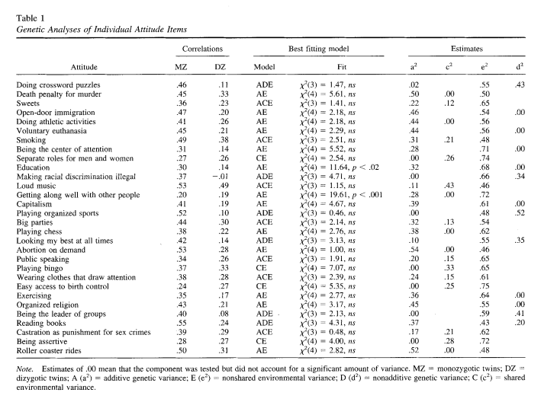
Biological factors
What evidence is there for a genetic component to attitudes?
What are some critiques of this area of research?
Olson et al., 2001 potential mediators

Slide 23
Social media
What elements led tweets to be more shared?
Are Democrats and Republicans equally bad at spreading misinformation?

Slide 24
COVID
What factors affected COVID attitudes and behaviors?

Slide 25
How would each book explain
Why people spread misinformation
How to reduce the spread of misinformation
Why there is increased political affective polarization
How to reduce affective polarization
And which explanation do you think is best?

Slide 26
Next week
Class will be online through Blackboard
Post and comment on thought papers
Come up with group thought paper
Watch short video and answer discussion questions
Post on your project and provide feedback to classmates

