Slide 1
Bias interventions

Slide 2
Group presentations--Presenter
Talk to me two weeks ahead of time about your topic and your proposed article
Article and topic must be approved by at least the class before, and article distributed at least a week before
Assign one article that you will lead a discussion of—most of the class should be that discussion, and you should bring in at least 5 other sources to supplement that discussion
The topic needs to be related to influence and social psychology and have a proscriptive element
All presenters must do some of the talking
Sample = every class you’ve sat in here so far
One grade per group
Upload slides to one account in Bb before class

Slide 3
Group presentations—rest of class
You’ll still write and turn in a thought paper on the articles assigned (I’ll share them with the presenters before class anonymously)
Participate as usual during class (same grading scale)

Slide 4
Individual presentations
12-15 presentation (so no more than 15 slides max)
Cover all sections of your paper
Answer questions from the audience (who will make suggestions to help improve your final paper)
Grade based on presentation style (including oral style and slides—I’ll post some resources in Bb), content, and ability to answer questions

Slide 5
Possible breakdown
Title = 1 slide
Section 1=1 slide
Section 2 = 2 slides (1 per theory)
Section 3 = 1 slide
Section 4 = 1 slide
Section 5 = 2 slides
Section 6 = 1-2 slides
Section 7 = 1 slide
You don’t need slides for organization or references
See Resources in Bb!

Slide 6
Implicit Association Test
What did you think when you did the IAT?
What is it measuring?

Slide 7
Implicit bias
What is implicit bias? How does it differ from other concepts?
Explicit bias
Prejudice
Unconscious bias
Systematic bias
How is it measured?
IAT (which did you do?)
AMP
Other measures?

Slide 8
IAT
What is it? What does it measure?
Is it reliable and valid?
Is it stable?
What does it mean to show bias, or no bias?
Does it relate to explicit attitudes?
Does it relate to behavior?
What does it tell us, if anything, that is useful?

Slide 9
Gawronski et al., 2022
Special issue of Psych Inquiry

Slide 10
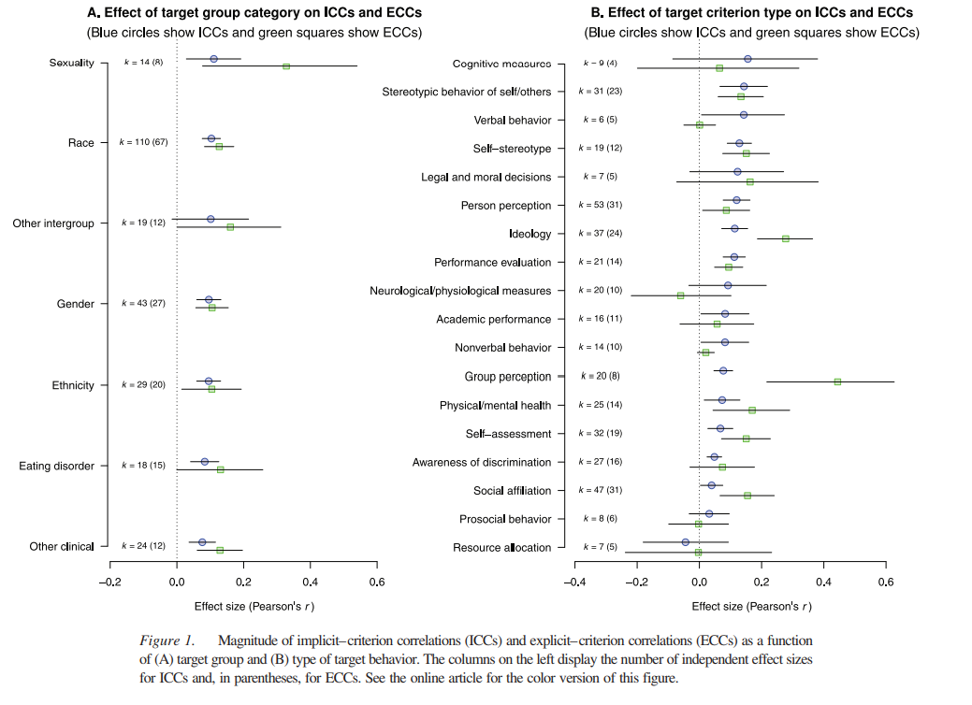
Kurdi et al., 2019

Slide 11
implicit bias
How is the concept useful for research?
For public consumption?
Are people aware of their biases?
Is it an individual difference or a social/cultural variable?
What is balanced identity theory?
Greenwald’s questions (p. 18)
And how you could test them

Slide 12
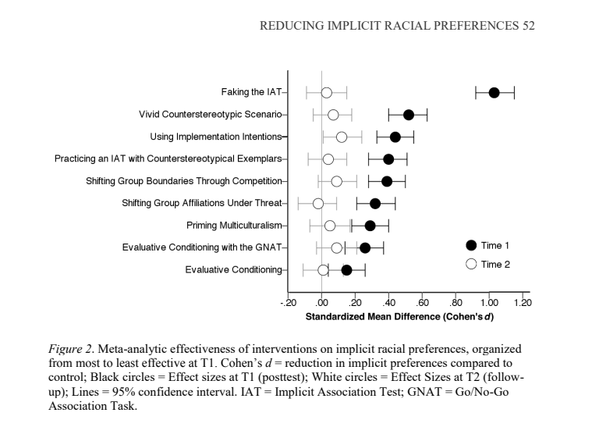
Implicit bias interventions
Lai et al., 2016
Imagined contact
Roommates (Shook &
Fazio, 2008)
Workshops
Field interventions
Clinical interventions

Slide 13
Public health approach
What do Greenwald et al. (2022) mean when they say we should treat implicit bias as a public health problem?
What are examples of interventions that are a) preventative; b) governmental; c) reparative; and d) curative?

Slide 14
Schmader et al., 2022
Table 1—evaluate trainings you’ve been a part of in light of these pitfalls
What is their BIAS model?
Figure 1. What are examples of each type? Are there any that are left out?
avoiding-racial-bias-in-reference-writing.pdf (wordpress.com)

Slide 15
Importance of norms
Why does changing norms seem to work better than changing attitudes?
What groups is it okay to be prejudiced against?
Crandall and Eshleman (2003) Justification Suppression Model—express when you can justify doing so, but otherwise suppress (or try to)
Relate JSM and norms to the Integrated Model of Prejudice (Dovidio & Gaertner, 1998)

Slide 16
How do targets of bias deal?
Don’t know if it was intentional or not
Why do targets of bias sometimes deny structural bias?
Are there any types of interventions or suggestions mentioned in the article that we haven’t talked about yet?
What advice would you give to organizations who are trying to reduce bias?

Slide 17
Next week
Read two articles
Be working on final exam (look at information in Bb resources)
Be working on paper and preparing for presentations
November 16: Rishika, Ian, Elene, Aubrey, Taylor, Daria

