Slide 1
End of bias
Part 2

Slide 2
overview
LAPD redux
Other Chapter 6 examples? Which stories had the most impact on you from this week’s readings?

Slide 3
Contact hypothesis (Allport, 1954)
What were allport’s conditions for contact?
Are they necessary? Are any others necessary?
Northern vs. Southern race relations
Why does contact have a positive effect?
Does it have the same effects on both groups?
Ben franklin effect

Slide 4
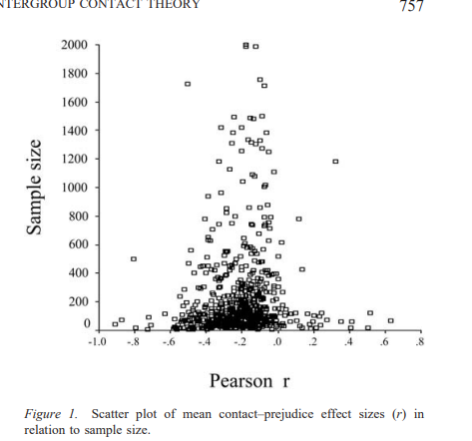
Pettigrew & Tropp, 2006
515 studies, 250K Ps, 38 countries
Conclusions:
Criteria not necessary
Not a matter of self-selection
Similar results for race/ethnic and other differences

Slide 5
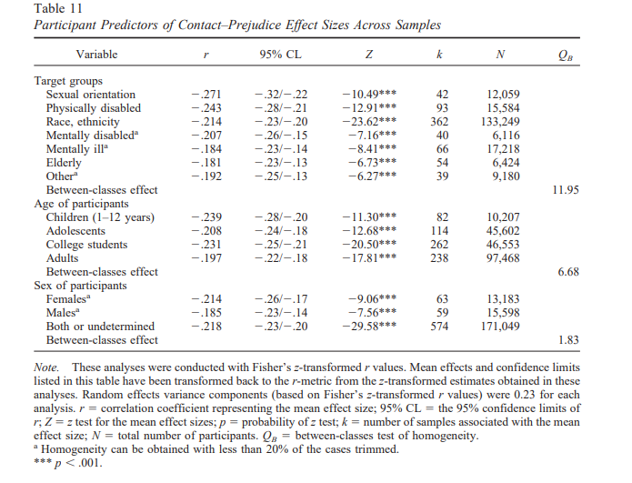
Pettigrew & Tropp, 2006

Slide 6
Levy Paluck & Green, 2019

Slide 7
Jigsaw classroom (Aronson, 1978)
What is the jigsaw classroom idea?
What effects does it have?
IF it works, why aren’t we doing it more?

Slide 8
Cross-race effect (Malpass & Kravitz, 1969)
What is the cross-race effect?
Why does it occur?
How supported is this concept?

Slide 9
Health disparities
What types of disparities does Nordell discuss?
Why do these occur?
What are some ways to try to make things better?
What are challenges to these approaches?

Slide 10
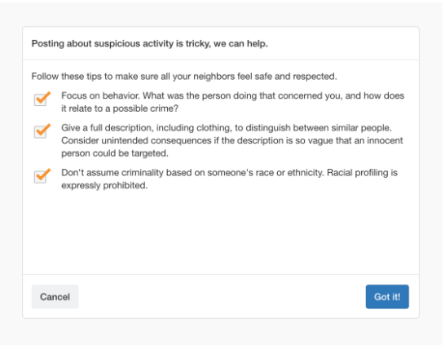
Racism on Nextdoor
Research by Jennifer Eberhardt and others
Resulted in 75% decrease in racial profiling
https://www.shortform.com/blog/nextdoor-racism/

Slide 11
Racism in health insurance (Obermeyer et al., 2019)

Slide 12
Is diversity good?
What are the benefits?
Are there any drawbacks?
What are challenges to getting more diverse settings?
How can these challenges be addressed?
What roles do role models serve?
How does this relate to concepts from the other books?
How can you encourage diversity without making the dominant group feel left out?

Slide 13
Levels of addressing bias
How can we Change worlds (Adams) rather than just individuals?
How can we change as individuals and leaders?

Slide 14
Comparisons and themes
What advice did each book give for change?
Which book do you think gave the best advice for change?
What are 2 themes of this book?

Slide 15
Side notes
Is book more palatable to some because it talks about gender bias?
Why is gender such a central category?
How have the ways children have been treated across generations affected their attitudes and behaviors?

Slide 16
Improving things
How would you improve graduate admission criteria to be less biased?
How would you improve classrooms to be less biased?
How would you improve hiring practices (e.g., for faculty position) to be less biased?

Slide 17
Coming up
Be making notes for the final and your paper
Next week three articles
This week—talk to me about your group presentation
Assign one reading
Lead a discussion of that reading where you also present additional information (sample = all the classes you’ve done so far)
Social psych/influence—need proscriptive element
One grade per group—content and style. Both of you have to lead
Nov 9—Aubrey and Kalsang; Daria and Jamisia

