Slide 1
Special Topics in Social Psychology
Influence

Slide 2
Introductions
Your name
Something interesting (or not) about you

Slide 3
Syllabus
www.uni.edu/harton/SYLL22.htm
How to take notes
How to do well in the course

Slide 4
Questions
On syllabus or about me

Slide 5
Critical thinking
What is critical thinking?
Why is it important to think critically?
How do we think critically?
Why do we do logical fallacies, or not think critically?
What do we need to think critically about?

Slide 6
True or False?
Being placed in daycare has negative effects on children’s development.
Eyewitness testimony is the most reliable type of evidence in a criminal trial.
People learn better when they are provided information in a format that fits their learning style.
People only use about 10% of their brains.
It takes 7 years to digest chewing gum.
The Great Wall of China is the only man-made structure visible from space with the naked eye.
Vikings wore horned helmets in battle.
The seasons are determined by the Earth’s distance from the sun.

Slide 7
Associations
Urban violence tends to increase in the summer.
Juvenile delinquents tend to watch more TV, especially violent TV.
Higher amounts of antibiotic use is associated with a greater risk of breast cancer.
Bar employees are more likely than other employees to have alcohol abuse problems.
Women who say that their house isn’t cluttered report less stress and anxiety.

Slide 8
Fallacies search/interpretation
Confirmation bias
Assimilation bias
Belief perseverance/Sleeper effect
Naïve realism

Slide 9
Fallacies Interference
Non sequiter
Zero-sum or fixed pie
Invalid disjunction
Argumentum ad verecundium/ad hominem (halo)
Naturalistic
Ad notivatem/ad antiquitatem
Bandwagon (ad populum)
Ignorance (ad ignoratiam)
Composition
Availability heuristic
Representativeness heuristic
Gambler’s fallacy
Regression fallacy
Conjunction fallacy

Slide 10
Other critical thinking problems
Overinference from small samples
Correlation<>causation
Magical thinking
Law of similarity
Hindsight bias
Curse of knowledge
Sunk costs

Slide 11
Others
Just world hypothesis
Placebo effect
Bystander effect
Spotlight effect
In-group bias
Barnum effect
Groupthink
Negativity bias
Anchoring
Declinism
Framing effect
Fundamental attribution error
Dunning-Kruger effect
Optimism/
pessimism bias
Self-serving bias
Backfire effect

Slide 12
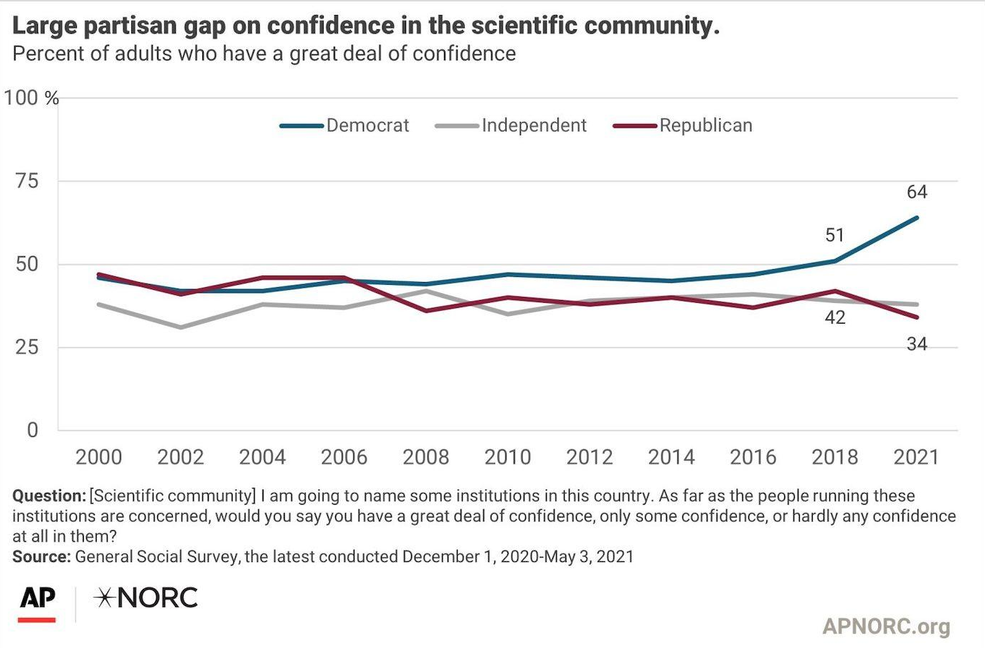
Do people trust science?
Do people trust science?
https://news.gallup.com/poll/352397/democratic-republican-confidence-science-diverges.aspx

Slide 13
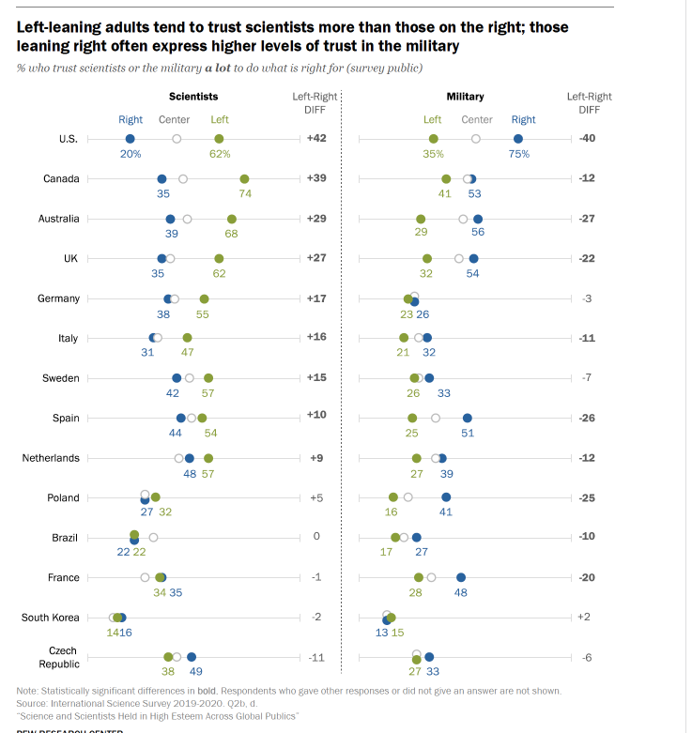
Pew research survey

Slide 14
Should people trust science?

Slide 15
Open Science
What have you heard about the replication crisis/renaissance?
Which do you think it is?

Slide 16
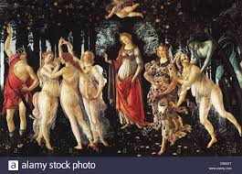
The Renaissance
What is the problem?
2011: Bem article
2012: Stapel fraud
2011 p-hacking (Simmons et al., 2011)
2012 Doyen et al. failure to replicate Bargh et al., 1996
2011-2012 Nosek developed OSF
2013 Center for Open Science

Slide 17
Problems
Why doesn’t peer review fix the issue?
What are some examples of problematic issues?

Slide 18
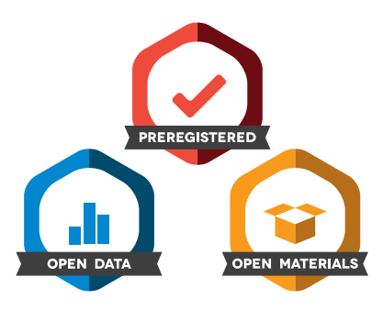
Solutions
What are some solutions they offer to this problem, and how do they address it?
What are some things to look for in articles that might clue you in to p-hacking?
What does a failure to replicate mean?
What does this suggest for whether we should trust science?

Slide 19
Why do people not trust science?
Why are there political differences in trust in science?
What are possible relationships between political orientation and trust in science?
Why would those relationships have emerged? (what is the rationale for them?)

Slide 20
Nisbet et al., 2015
What did they do in this study?
What were some strengths and limitations?
What did they find led to less trust in science?
Tables 1 and 2
Figure 1
What are the implications of their findings?

Slide 21
Pennycook, Bago, & McPhetres, 2022
4 rationales:
Politically motivated reasoning
Identity-protective cognition
Knowledge-deficit
Analytic thinking
What would each of these predict? (measuring political orientation, accuracy of beliefs, and cognitive sophistication)

Slide 22
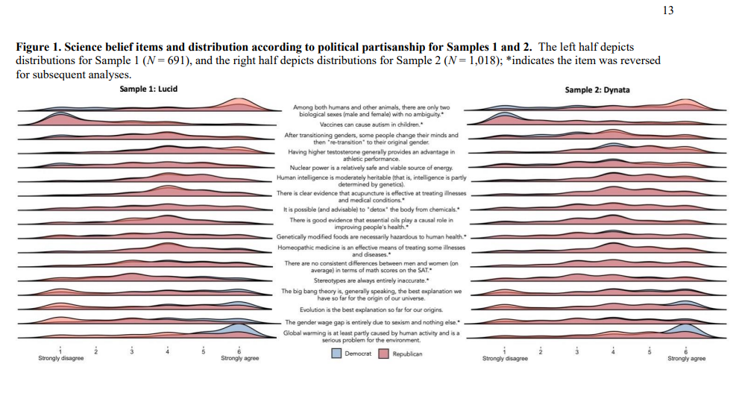

Slide 23
Findings
For “liberal” issues, PO was more related to beliefs than was knowledge
For “conservative” issues, it was opposite
Cognitive sophistication (+) and PO were correlated with beliefs on most issues, but cognitive sophistication only led to more polarization for climate change, big bang, and evolution
Their interpretation—political orientation matters, but basic knowledge and cognitive sophistication matter (maybe more?)

Slide 24
Light et al., 2022

Slide 25
Garrett and Bond, 2021

Slide 26
Misinformation more broadly
Is it worse now?
How has social media affected misinformation and its spread?
Why do people accept misinformation? (give example of each)
What solutions are supported by research?

Slide 27
Crazy Uncle COnvo
Pick a misbelief
Describe why he might believe it
Explain how you would try to convince him of the truth (be specific)

Slide 28
For next week
First half of Think Again
Submit up to 3 ideas for your project issue

