Slide 1
The self

Slide 2
Who am I? 20 statements (Kuhn & McPartland, 1954)
A-mode responses are the type of physical characteristics found on your driver’s license: “I am a blonde”; “I am short”; I am a Wisconsin resident.”
B-mode responses describe socially defined statuses usually associated with group membership of some sort: “I am a college student”; “I am a Catholic”; I am an African American.”
C-mode responses describe styles of behavior or emotional states: “I am a happy person”; “I am a country music fan”; “I am a fashionable dresser.”
D-mode responses are more general than individual: “I am part of the universe”; “I am a human being.”
You may have some difficulty deciding how to categorize some of your responses—for example, where does “I am an American” go—in A, B, or D? Use your best judgment. Count the number of each type of response.

Slide 3
What is a self?
Festinger, 1957, social comparison theory
Baumeister definition
Reflexive consciousness
Interpersonal relations
Making choices and exerting control
Components (Sedikides)
Individual
Relational
Collective

Slide 4
How does a “self” come to be? And why?
How do we develop a sense of self? How do we know who we are?
How does the self concept differ across cultures?
What are the functions of a self?
What is a self-concept vs. self-schema?
How can you measure self-concept?

Slide 5
How does our self affect our thoughts and behaviors?
Anonymity
Attributions

Slide 6
What is self esteem?
Rosenberg (1965) scale
What are some issues in studying SE?
What is it good for?
Sociometer theory (Leary, 1995)
Is high SE always good?

Slide 7
Terror management theory
Greenberg, Pyszczynski, & Solomon, 1986
www.flightfromdeath.com
How is this theory similar or different to other theories? What kind of theory is it?
What are the main questions the theory addresses?
What is the “terror”?
Why do we need SE, according to TMT?
How do we buffer anxiety, according to TMT?

Slide 8
More on TMT
What is TMT’s dual defense model (proximal vs. distal)?
Basic tenets
Mortality salience hypothesis
Anxiety buffering hypothesis
DTA hypothesis

Slide 9
Application to COVID
Proximal vs. distal defenses
What does it tell us that’s new/different?

Slide 10
What are critiques of this theory?
MS manipulations/controls and measures of DTA
How common is MS?
Is death really the issue? What else could it be?
Does it matter that most of the supportive research is with Western student samples?
Other critiques?

Slide 11
How would TMT explain
Why women and (usually not men) wear makeup
Why people believe in religions
Why people go to tanning booths even though they are harmful
Why people suffer from anxiety disorders and phobias
Why there are birth booms after wars
Suicide
Creativity
Judgements of those who do immoral things that don’t affect us (e.g., cheating on spouse)

Slide 12
Self-presentation
Strategies:
Ingratiation
Intimidation
Exemplification
Supplication
Self-promotion
Self-handicapping
Self-monitoring
Narcissism

Slide 13
Other self-theories
Self evaluation maintenance theory (Tesser, 1988)
Reflect vs. compare
Closeness, relevance, performance
Self-discrepancy theory (Higgins, 1987; actual, ought, and ideal selves)
Social comparison theory (Festinger, 1957)
Lateral
Upward
Downward

Slide 14
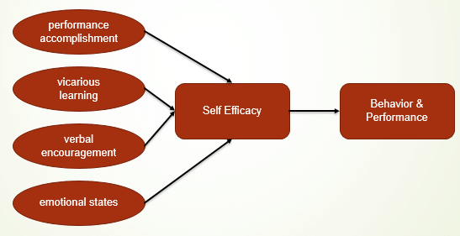
Bandura’s self-efficacy theory

Slide 15
Hamann et al., 2023
What is their critique of Bandura’s concept/theory?
How is it similar to or different from other concepts?
What does this article remind us about measurement in general?
What is the triple A model? What does this add to SE theory?
What are examples of each link?
What section did this article have that many others don’t?
Are there cultural differences in SE?

Slide 16
Friese et al., 2018
What is ego depletion?
Is it a thing?
Are there any other critiques of the concept/area?
How can research in the area be improved?
p-hacking effects: https://shinyapps.org/apps/p-hacker/

Slide 17
Arguments they consider:
Limitations of the meta-analysis and RRR
Issues with IVs and DVs
Mediators and moderators
Not many studies showing opposite effects
Estimations of file drawer size
But it seems real (and field studies)

Slide 18
Next week
Culture
2 modules in one of the textbooks (culture, culture and emotion)
2 articles related to interdependence

