Slide 1
Aggression and Rejection

Slide 2
Definitions
What is aggression?
Violence?
Antisocial behavior?

Slide 3
Types of aggression
Physical vs. verbal (incl. relational, and ostracism)
Direct and indirect
Active vs. passive
Reactive vs. proactive
Impulsive or instrumental
Displaced

Slide 4
Operational definitions
Aggression questionnaire (Buss & Perry, 1972)
Conflict Tactics Scales (Straus et al., 1996)
Olweus Bullying and Victimization Questionnaire (Olweus, 1996)
Peer nominations
Experimental manipulations
Other methods?
What is the best way to measure aggression?

Slide 5
Theory | Re-searcher | Cause of agg | When more/less | Types of agg | How reduce | Type | Can’t explain
Frustration-aggression | Dollard et al., 1939 | frustration | Anger/important goal/blocked more | reactive | Reduce frustration | motivatioal | Instrumental aggression
Excitation transfer | Zillman et al., 1972 | Misattribution of arousal | Arousal without explanation | Reactive | Reduce arousal/make correct attrib | Motivational | instrumental
Cognitive neoassociation
Evolutionary
Social learning
Social information processing
General aggression model
Culture of honor
https://docs.google.com/document/d/18piE1ESGvpS-fysdBbsZpDiPVRvTJE0DVGir_xrNWHo/edit?usp=sharing

Slide 6
Theories
Who is the theory/theories associated with?
What does it say causes aggression?
When will there be more/less aggression?
Which types of aggression does it mostly deal with?
How would you reduce aggression, according to this theory?
What type of theory is it? (cognitive, evolutionary, motivational, etc.)
What is an example of aggression it can’t explain?

Slide 7
Gul et al., 2021
Culture types:
Dignity
Honor
Face
What are other things they don’t talk about in the article that might be affected by being in an honor, dignity, or face culture?

Slide 8
Culture of honor
What is new about culture of honor in this article?
What are some critiques of the culture of honor research/idea?
What do they suggest to reduce violence?
Gun violence by state
Suicide rates by state
IPV by state

Slide 9
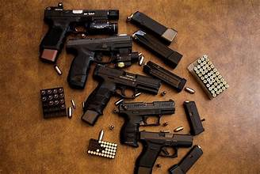
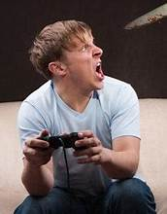
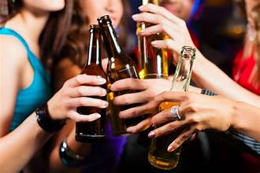
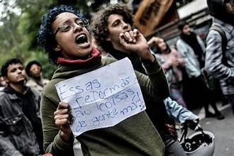
What other factors influence aggression?
Individual differences
Situational influences

Slide 10
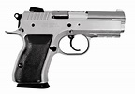
What about guns/mass shootings?
What did you learn in Warner-Nanney, 2021?
What factors are related to more gun violence? To more positive gun attitudes?
Dickey amendment
Mass shootings in the US
Cultural comparisons
American attitudes on guns
What can be done to reduce gun violence?

Slide 11
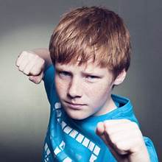
Reducing aggression
What doesn’t work? Why?
What does work? Why?
What should we do as parents? Individuals? Society?

Slide 12
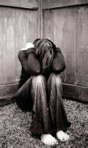
Rejection
How has rejection been studied? Are these equivalent?
https://vimeo.com/62789770

Slide 13
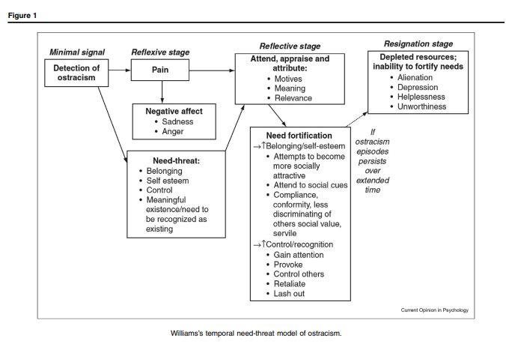
Williams, 2009

Slide 14
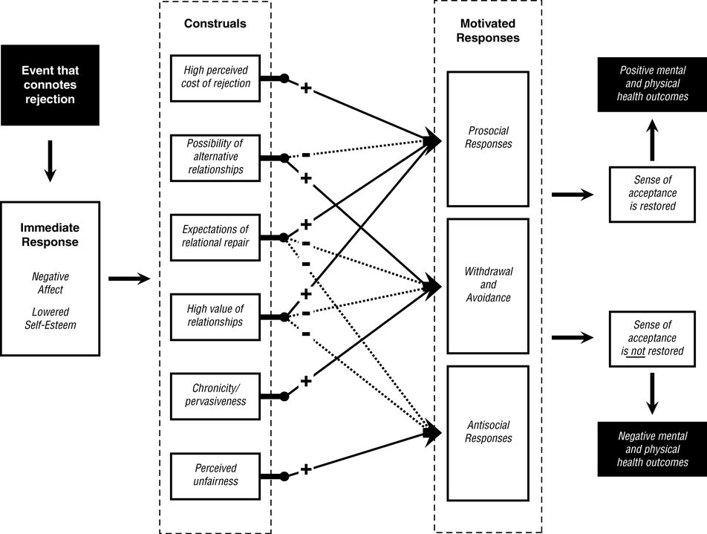
Multimotive model of reactions to interpersonal rejection experiences.
Smart Richman, L., & Leary, M. R. (2009). Reactions to discrimination, stigmatization, ostracism, and other forms of interpersonal rejection: A multimotive model. Psychological Review, 116(2), 365-383. doi:10.1037/a0015250
© 2009 American Psychological Association

Slide 15
Coming up
Presentation (upload slides before class)
15 minutes presentation + 10 minute discussion
Needs to be complete
Paper
Due at noon on Dec. 4
For both—read the 2 documents for each linked off the syllabus
Terrorism and extremism (5 articles, no chapters)
Final exam (due 9pm, Dec. 13)

