Slide 1
Happiness and Helping

Slide 2
Positive psychology
History
http://ppc.sas.upenn.edu/
What is it?

Slide 3
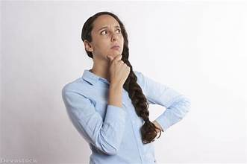
Oishi & Westgate, 2021
Happy life
Meaningful life
Psychologically rich life

Slide 4
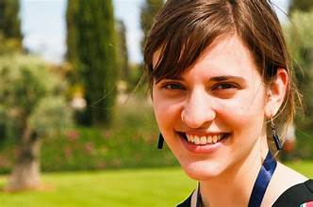
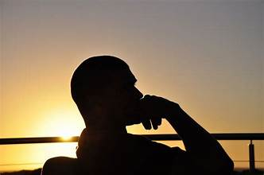
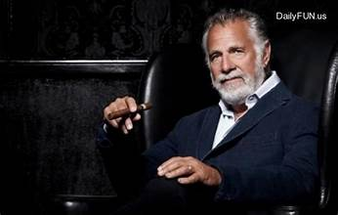
Table 1

Slide 5
Measurement
Happiness:
SWLS: http://labs.psychology.illinois.edu/~ediener/SWLS.html
PA-NA: https://ogg.osu.edu/media/documents/MB%20Stream/PANAS.pdf
Meaning:
http://www.michaelfsteger.com/wp-content/uploads/2012/08/MLQ.pdf
Psychologically rich:
In article

Slide 6
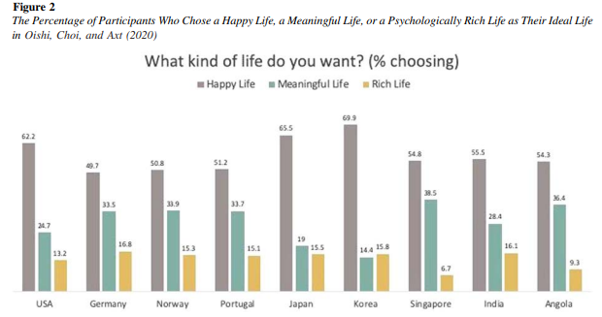
Country differences

Slide 7
Happiness ratings of countries
https://worldpopulationreview.com/country-rankings/happiest-countries-in-the-world

Slide 8
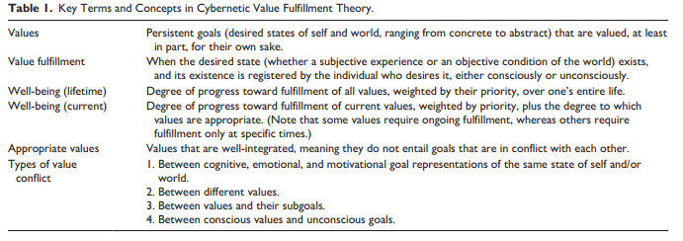
Cybernetic value fulfillment theory (DeYoung & Tiberius, 2022)
How does this differ from Oishi and Westgate’s (2021) approach?
How do they define hedonic and eudaimonic?
What do they mean by “goal”?
What is the difference between personality traits and characteristic adaptations, and why does it matter?

Slide 9
What do you think of their definition of psychopathology?
What should this type of well-being be related to (personality, situation, etc.)?
How would you measure well-being using this approach?

Slide 10
Increasing well-being
How would you increase well-being using each approach?
Happiness
Meaning in life
Psychologically rich life
Cybernetic value fulfillment theory

Slide 11
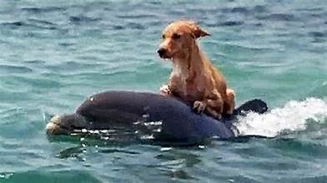
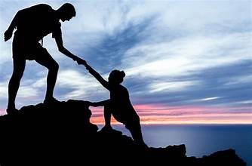
Prosocial behavior
What is prosocial behavior? Altruism?
Do animals show prosocial behavior?

Slide 12
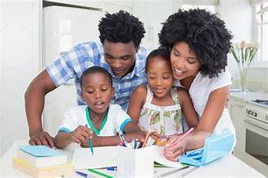
Why do people help? (biological)
Evolutionary roots
Kin selection
Reciprocal altruism
Signaling theory
Neuro structures
Neural structures, mirror systems, oxytocin
Genetic influences

Slide 13
Why do people help? (motivational)
Egoistic reasons
Negative state relief model (Cialdini et al., 1973)
Arousal: Cost-reward model (Piliavin et al., 1981)
Empathy-altruism model (Batson, 2011)
Paradigm
Manipulation of empathy
Costs and benefits of
altruism

Slide 14
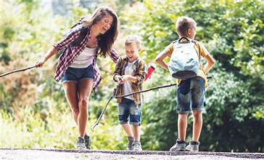
Why do people help? (relational)
Development
Temperament
Socialization
Social/cognitive development
Attachment/Relationships

Slide 15
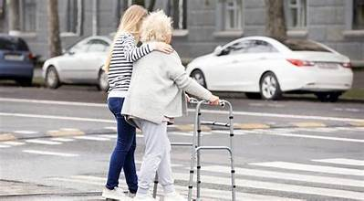
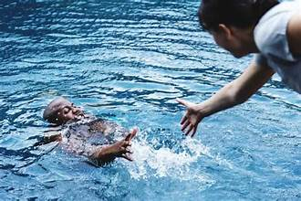
Why do people help? (individual differences)
Gender
Agreeableness (Graziano et al., 2007)
Penner Prosocial Personality Battery (Penner et al., 1985)
Other oriented empathy
Social responsibility
Empathic concern (Davis, IRI)
Perspective taking
Other-oriented reasoning
Mutual-concern reasoning
Helpfulness
Personal distress
Self-reported helpfulness

Slide 16
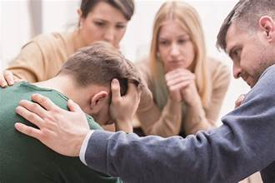
Why do people help? (situational)
Presence of others
Clarity of situation
Costs vs. rewards

Slide 17
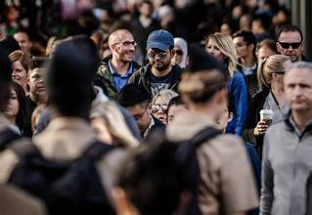
Bystander intervention (Latané & Darley, 1969)
What is the bystander effect?

Slide 18
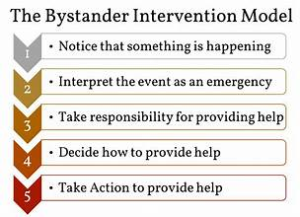
Steps to bystander intervention
Why do people think they’ll help more than they do?
Why do people underestimate others’ effects on their helping?

Slide 19
Three factors involved in decision to help
Social influence (pluralistic ignorance)
Audience inhibition
Diffusion of responsibility

Slide 20
Bystander processes
Latané & Rodin results
intervening % pairs intervening
Alone 70 91
w/Confederate 7 14
Two strangers 23 40
Two friend 45 70

Slide 21
Electrocuted experimenter
Condition Process Help rate (In %)
Alone None 95%
No contact DR 84%
Seen by other DR & AI 73%
See other person DR & SI 73%
See and be seen DR,AI,SI 50%

Slide 22
Revised version for Dateline
Latané, Harton, Bourgeois, Rockloff
Condition | Process
Alone | None
Back to Back | DR
Participant faces the confederate’s back | SI + DR
Confederate faces the participant’s back | AI + DR
Face to face | SI + AI + DR

Slide 23
Percentage helping

Slide 24
More bystander intervention research
Examples of other studies
What factors affecting helping?

Slide 25
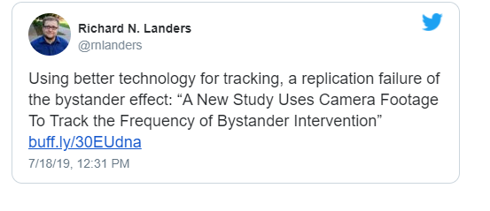
Philpot et al., 2019
What did they do in this study?
Do you agree or disagree with the tweet below?

Slide 27
Cultural differences in helping
See Table 2, Levine et al., 2001: http://www2.psych.ubc.ca/~ara/Manuscripts/Levine%20et%20al%20helping.pdf
Why?

Slide 28
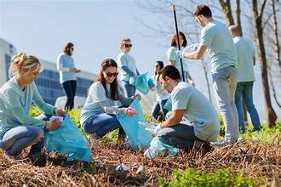
Volunteerism
How does it differ from other types of helping?
What leads people to volunteer?
Differences by country

Slide 29
How can you increase prosocial behavior?
http://heroicimagination.org/

Slide 30
Coming up
Aggression and rejection
Chapter
Culture of honor
Gun violence
Ostracism
Then after Thanksgiving—presentations and papers!

