Slide 1
Basics of research design

Slide 2
https://adfontesmedia.com/interactive-media-bias-chart/

Slide 3
Learning study
Dr. Jazz wanted to test the effects of music on learning in fourth grade children. He introduced music into the classroom every afternoon for one week. No music was played during the morning. The music was from familiar TV cartoons, and the loudness was moderate. After the week of music presentation, the students were given tests on the morning and afternoon material. Test scores for the morning material were much higher than the scores on the afternoon material. Thus, the experimenter concluded that cartoon music disrupted learning in the classroom.
How did he measure “learning”? (operational definition)
What was his hypothesis?
Do you trust his conclusion? Why or why not?

Slide 4
Some problems in research
Confounds
Ethics
Researcher bias
Expectancy effects

Slide 5
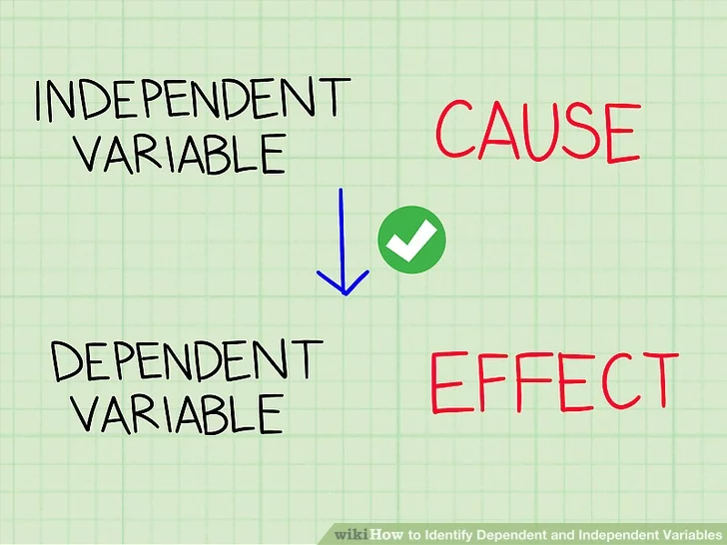
Basic research terms
Independent variable
Dependent variable
Control variable
Within- vs. between- designs

Slide 6
Example
A researcher had participants read about a person who became a doctor and a parent and then rate that person on how good of each they were. Some people read about “Robert” and others read about “Roberta.” People rated Roberta as a worse doctor and parent than Robert, so the researcher concluded that people are biased against professional mothers.
What was the IV/DV/control variable?
Any possible confounds?
Was it a between or within participants design?

Slide 7
Identify the IV, DV, CV, confound, op def, hypo
Participants read a story printed on either red, blue, or white paper. Afterwards, they were given a recall test.
Men who were either in a serious relationship or not dating at all participated in a study in which they rated the attractiveness of five women.
Six patients with obsessive compulsive disorder completed six weeks of drug therapy, while six other patients completed six weeks of group therapy. Their number of symptoms before and after therapy were measured and compared.
What was the IV/DV/control variable?
Any possible confounds?
Was it a between or within participants design?

