Slide 1
Logical fallacies

Slide 2
Fallacies of search/interpretation
It fits my beliefs, so it must be true!
Confirmation bias
Assimilation bias
Belief perseverance/Sleeper effect
Naïve realism

Slide 3
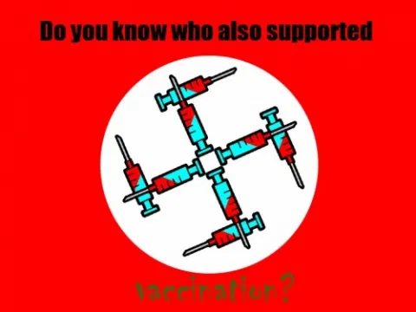
Fallacies of interference—Non sequitur
Zero-sum or fixed pie
Invalid disjunction
Argumentum ad verecundium/ad hominem (halo)
Naturalistic
Ad notivatem/ad antiquitatem
Bandwagon (ad populum)
Ignorance (ad ignoratiam)
Composition

Slide 4
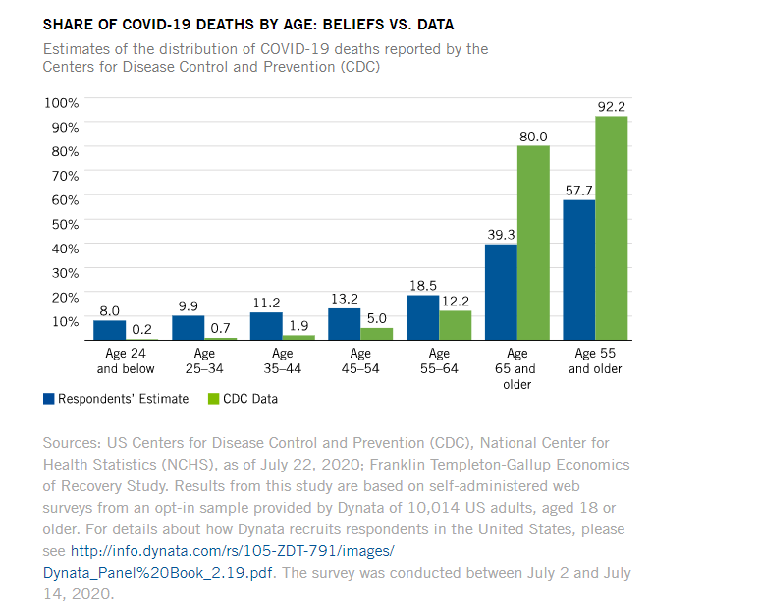
Problems with frequency estimation
Availability heuristic
Representativeness heuristic
Gambler’s fallacy
Regression fallacy
Conjunction fallacy
1. A massive flood in North America in which more than 1,000 people drown.
2. An earthquake in California that causes a flood in which more than 1,000 people drown.

Slide 5
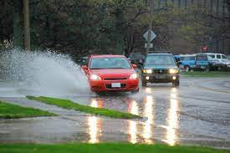
Inferences from samples and correlation
Over-infer based on small samples (or anecdotes)
Confuse correlation with cause
Magical thinking
Law of similarity
Image from Flickr. State Farm

Slide 6
Correlation <> Causation
Juvenile delinquents tend to watch more TV, especially violent TV.
Higher amounts of antibiotic use are associated with a greater risk of breast cancer.
Bar employees are more likely than other employees to have alcohol abuse problems.
People who eat breakfast tend to live longer.
Women who say that their house isn’t cluttered report less stress and anxiety.
A causes B
B causes A
Something else causes both

Slide 7
Post-conclusion fallacies
Hindsight bias
Curse of knowledge
Sunk cost fallacy
I paid $100 to see this concert, so I’m going to stay even though it sucks

Slide 8
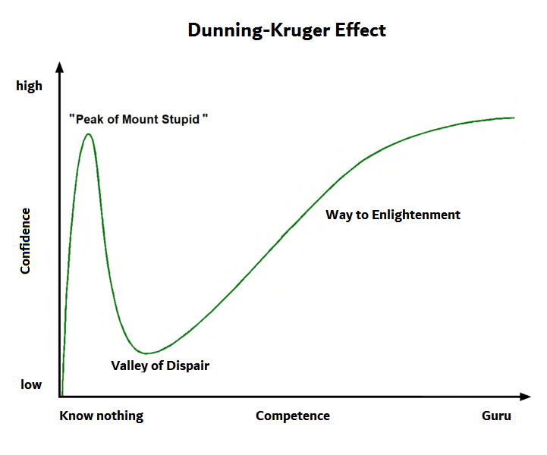
More biases
Just world hypothesis
Placebo effect
Bystander effect
Spotlight effect
In-group bias
Barnum effect
Groupthink
Negativity bias
https://yourlogicalfallacyis.com/
Anchoring
Declinism
Framing effect
Fundamental attribution error
Dunning-Kruger effect
Optimism/
pessimism bias
Self-serving bias
Backfire effect

