Slide 1
Main effects and interactions

Slide 2
Describing results of experiments
Main effect—one variable
Interaction—combination of variables

Slide 3
Examples in words
Females are less likely to conform than males on stereotypically female topics, whereas males are less likely to conform on stereotypically male topics.
The female leadership style is more relationship-oriented than the male leadership style.
People with secure attachments have longer lasting romantic relationships than people with insecure attachments.
Students preferred a highly attractive person to a less attractive person as a dating partner, but only if the highly attractive person was seen as available.
If a stimulus is initially positive, being exposed to it over and over makes us feel even more positive towards it. If it is initially negative, being exposed to it over and over makes us even less positive.

Slide 4
Examples with tables
Anxiety by type of passage and presence of trigger warning
 | Trigger warning | No warning
Upsetting passage | 10 | 8
Nonupsetting passage | 8 | 2

Slide 5
Examples with tables
Knowledge of consent information by type of consent form and recruitment method
 | Short consent | Long consent
Email | 7 | 4
In person | 8 | 5

Slide 6
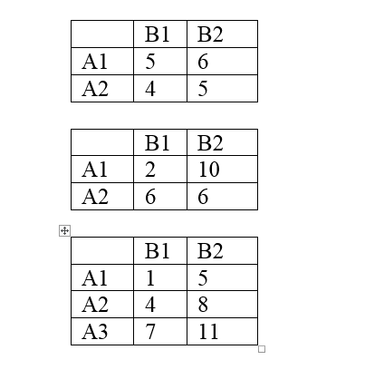

Slide 7
Examples with graphs

Slide 10
How many main effects and interactions are possible in a 2 (between) x 2 (between) x 3 (within) x 3 (within) design?
Count how many IVs you have to get possible number of main effects—b/c each main effect reflects 1 IV
Count how many combinations of IVs you have to get a possible number of interactions
How many people would you need to have 10 in each condition?
Count an extra 10 for each BETWEEN condition—within conditions are the same people, so you don’t need any extras

Slide 11
Test yourself
A researcher asks liberals and conservatives to read an article that has the header of either FoxNews or NBC (the article actually came from the AP). Participants then indicate how biased they think the article is against the liberal vs. conservative viewpoint (single item).
IV? DV? Confound? Type of design? How many people to have 10 per?
What if he found that liberals perceived the article as more biased, regardless of header?
What if he found that liberals perceived the article as more biased when they thought it came from Fox, and conservatives when they thought it came from NBC?

Slide 12
More table and figure practice
 | B1 | B2
A1 | 5 | 7
A2 | 2 | 4
 | B1 | B2
A1 | 10 | 5
A2 | 5 | 10

