Slide 1
Experiments

Slide 2
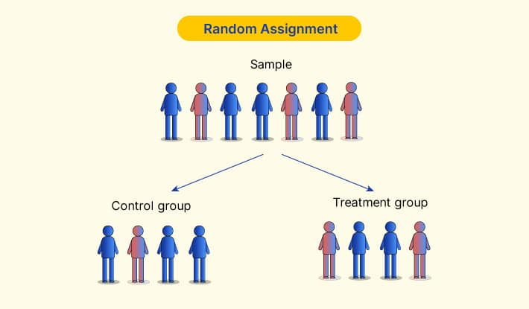
Two requirements--Experiments
At least one manipulated variable (IV w/2+ levels)
Random assignment to conditions

Slide 3
Experimental control
Experimental vs. control group
Control over the situation
Control variables

Slide 4
Other types of variables
Independent variable
Hot room
Cold room
Independent variable
Dependent variable
Confound
Confound: Do the rooms differ in humidity? In décor?
Aggression
Dependent variable

Slide 5
Examples
Testable hypothesis, independent variable, dependent variable,
control variable, confound
Children ages 8-10 complete measures of self-esteem and self-efficacy. Researchers then compare children whose parents have divorced and those whose parents are still married on the measures, as well as on grade point average.
College students read online information and reviews and made a decision for which set of headphones they would buy. Some participants were randomly assigned to read information and reviews for 5 products and others, for 15 products.

Slide 6
Example
Testable hypothesis, independent variable, dependent variable,
control variable, confound
A researcher tells participants that they will give a speech and then provide their attitudes on some scales. They are given 5 minutes to prepare their speech. Participants are randomly assigned to either be annoyed during their speech (i.e., they give it in front of another person who keeps interrupting them) or not (i.e., they give their speech in an empty room). It’s videotaped in both cases. Afterward, the participants complete measures about how they feel about a number of groups (e.g., immigrants, LGBT people, liberals, conservatives).

Slide 7
Types of validity
Internal (inside the study; causality)
External (generalize outside the study)
Mundane realism vs. Psychological realism
Construct (measures)
Conclusion (statistical conclusion)

Slide 8
Which type of validity do these relate to?
1. A fire alarm unexpectedly goes off in the middle of your study and people have to leave the room
2. You don’t have enough participants to show an effect in your study, according to your power analysis
3. You analyze your data the wrong way
4. You want to be able to generalize your results to all Americans
5. You’re not sure how good your measure of depression really is
6. Scores on your self-esteem measure seem to be affected by participant mood
7. In your experiment, people have to turn pegs over and over
8. You are interested in helping behavior, but only measure 1 type of helping (helping people pick up pens in an elevator)
9. Your experimenter times participants as they walk down the hall (DV), but the timing is unintentionally affected by the fact that they know which group the person is in and what the hypothesis is
10. You manipulate the ethnicity and type of crime in a study of juror decision making by having participants read a shortened description of the trial and make individual judgments.
11. Come up with one more example of a threat to each type of validity on your own.

Slide 9
Find the confound
You do a study examining the effects of political orientation on attitudes toward corporal punishment.
You do a study examining age effects (people who are in their 20s, 30s, 40s, 50s, 60s, and 70s) on intelligence, using a knowledge test as a measure of intelligence.
You do a study of helping behavior. A man or a woman asks for help from people as they come to their cars in a dark parking lot at night.
You randomly assign Iowa college students to read a syllabus that is the same except for the name and pronouns of the instructor: Harold (he/him), Kayleigh (she/her), or Wu (they/them)

