Slide 1
Review

Slide 2
Scales from Monday
Were there any problems you noticed?
What types of issues were they?
Social desirability
Things people might not know
Double barrel
Charged words
Things that have more than 1 meaning
Negatively worded
Problems with response options
Make sure you’re getting participants for your study

Slide 3
Updated syllabus
www.uni.edu/harton/rmsyll24s.htm
Exam 2 retake
Exam 3 timing

Slide 4
Reliability and validity from last class
What is reliability?
How can you show it?
What is validity?
How can you show it?
What were they for the scale you used?

Slide 5
Correlation practice
1. Imagine that researchers have found a correlation of .72 between the frequency of fights that couples have and how long they stay together. Based on this correlation, should you start picking fights with your significant other in order to sustain your relationship?
A. yes, because the correlation is positive
B. no, because the correlation is positive
C. no, because although the two may be correlated, causation has not been proved
D. no, because in your group of friends, the correlation is negative.
2. Which correlation shows the strongest relationship?
A. .56, p = .01
B. -.80, p = .05
C. .23, p = .10
D. –2.00, p = .001
3. Write an interpretation of the following correlations.
Correlations between physical attractiveness and popularity:
High school boys r = -.15, p = .14
High school girls r = .56*, p = .001

Slide 6
There is a correlation of -.34 between need for cognition and attitude change. This correlation means that
A. people who are higher in need for cognition show more attitude change
B. people who are lower in need for cognition show more attitude change
C. people who are higher in need for cognition have higher attitudes
D. people who are lower in need for cognition have lower attitudes.
E. you can’t say for sure
You are interested in the relationship between age and neuroticism. Which of the following samples is most likely to yield the strongest correlation? You record age and extraversion in
A. intro to psychology students at UNI
B. a large mega-church
C. residents of a retirement home
D. shouldn’t make much difference.
What effect do outliers have an on a correlation?
A. They make it stronger
B. They make it weaker
C. They make it less reliable
D. They make it more negative
E. They change it, but not always in the same way

Slide 7
Correlational tables
https://apastyle.apa.org/style-grammar-guidelines/tables-figures/sample-tables#correlation

Slide 8
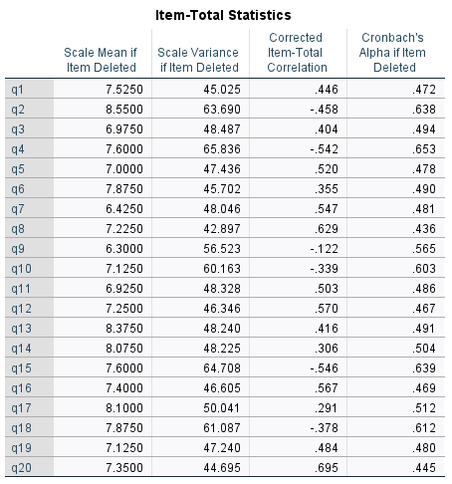
Reliability analysis

Slide 9
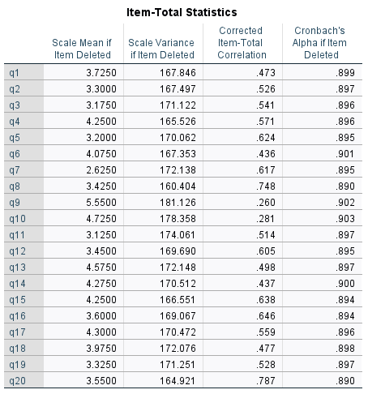
Part 2

