Slide 1
Scientific Writing

Slide 2
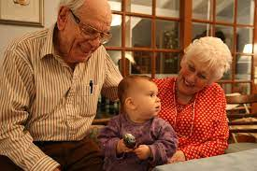
General information
Write in an hourglass
Write so your grandparents can understand it
Start strong—why this matters (cut first 2 sentences)
End strong—come back to how you started
Write, revise, write, revise…..

Slide 3
Parts of your paper
You’ll have these sections in your final paper, but
you’ll turn in portions of these ahead of time.
Section of paper | Time 1 | Time 2 | Time 3
Cover page | Yes | Yes | Yes
Abstract |  |  | Yes
Introduction (lit review) | Yes | Current study part | Yes
Method |  | Yes | Yes
Results |  | Yes | Yes
Discussion |  |  | Yes
References | Yes | Yes | Yes
Appendices |  | Yes | Yes

Slide 4
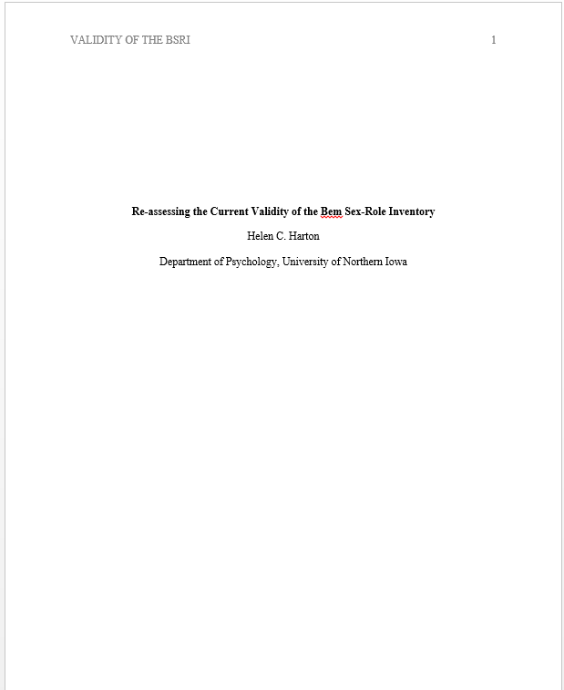
Cover page
10-12 word title
Get in IV and DV
Leave out words you don’t need
“Professional” cover page
https://owl.purdue.edu/owl/research_and_citation/apa_style/apa_formatting_and_style_guide/apa_sample_paper.html
No author note needed
See template in Bb

Slide 5
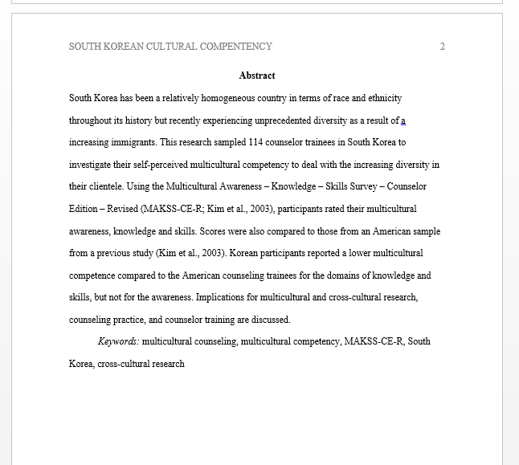
Abstract
<250 words
Problem statement
Who did what
Main findings
What they mean
Keywords
Word Abstract in bold,
No indents

Slide 6
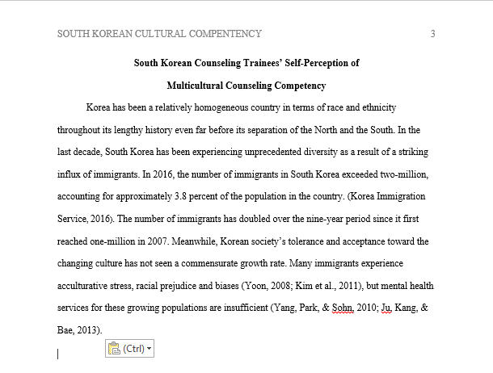
Introduction/Literature review
Explain the rationale for your topic/study in the first 1-3 paragraphs
Start strong
Tell why the topic matters without saying “it is important”
Set up the sections and study to come
Title centered and bold

Slide 7
Introduction/Lit review
Review the past literature
Use topic sentences
Organize by topic, not study
Explain studies without unneeded details
Keep the review balanced
Review “both” sides if there are two sides
Give an honest and accurate review

Slide 8
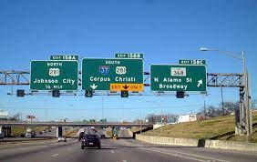
Give a roadmap
Set up sections to come
Organize by those sections
Summarize them at the end

Slide 9
Keep researchers in () when you can
NOT: “Smith and Jones (2000) found that people who chose experiences over material goods were generally happier with their decision.
INSTEAD: “People who choose experiences instead of material goods are generally happier (Smith & Jones, 2000)

Slide 10
Introduction paragraph format
Topic sentence—what does this paragraph add to our knowledge? Transition from previous paragraph
Summary of findings and relevant methodology of studies supporting your topic sentence
Sum it up with what this means or suggests

Slide 11
Transitions and flow
Use your topic sentence as your transition (e.g., “also”)
Make sure things flow within paragraphs and between them
Each paragraph is only about 1 thing—and that’s your topic sentence

Slide 12
“The social inhibition of responsible behavior is not limited to emergencies. Individuals become slower or less likely to pick up dropped objects in elevators (Latane & Dabbs, 1975), to answer the telephone (Levy et al., 1972), or even to respond to a knock on the door (Freeman, 1974, as cited in Latane, 1981), as the number of others able to respond increases. Even such a routine behavior as tipping in restaurants is an inverse function of group size: The larger the group that shares in the responsibility for coming up with a tip, the smaller the percentage contributed (Freeman, Walker, Borden, & Latane, 1975).”
Harkins & Latané, 1998

Slide 13
Several findings support the hypothesized link between boredom and attention. Hamilton et al. (1984) found that the ability to cope with boring activities is related to performance on behavioral measures of sustained attention as well as to the degree to which one finds events intrinsically interesting and enjoyable. On the other hand, susceptibility to boredom is related to one's need for novel stimulation and to rapid habituation to stimuli (Zuckerman, 1979). (See Hamilton, 1981, for a discussion of a possible link between attentional regulating systems and boredom.)
Although researchers have explored the physiological, dispositional, cognitive, affective, and behavioral concomitants of boredom on tedious tasks (O'Hanlon, 1981;Smith, 1981), little attention has been paid to boredom experienced as a result of interacting with others. The one exception involves a smattering of articles regarding therapist and client boredom in psychotherapeutic encounters, but these involve conceptual analyses based upon psychoanalytic perspectives (e.g., Altshul, 1977; Morrant, 1984)
Leary et al., 1986

Slide 14
Some constraints on the emergence of culture are implied by Dynamic Social Impact Theory. The dynamic process and its specific outcomes vary as a function of the number and proximity of individuals within any given population, as well as their potency as sources of social influence (Latan´e 1996). In addition, the operation of these processes is hypothesized to occur more readily among beliefs and behaviors that are more highly prone to social influence. Consistent with this analysis, attitudes that are highly heritable—and so are less amenable to social influence (for examples and empirical elaboration, see Tesser 1993)—are less likely to coalesce into distinct cultural clusters (Bourgeois 2002).
Lehman et al., 2004

Slide 15
Your lit review should
Define and clarify the problem
Summarize previous research
Identify inconsistencies, gaps, controversies
Keep your terminology consistent
Suggest the next steps (your study!)

Slide 16
Current study section
Last part of the introduction
Summarize the lit review briefly
Explain how your study adds to previous research (what’s new)
Explain rationale for your hypotheses
Introduce your study
End with your hypothesis

Slide 17
Method
Participants
Who you recruited, how you recruited them, demographics
Procedure
In “time” order
In enough detail that I could replicate it
For each measure, give what it measures, sample item, how many items, how answered, reliability and validity information
Think about possible confounds and other problems (and try to figure out a way to address them)
Measures, Apparatus, etc. (optional sections)

Slide 18
Results
Data cleaning or manipulations, manipulation checks, etc.
For each hypothesis, what you found
Likely at least 1 table or figure

Slide 19
Discussion
Summary of results
Possible reason for any surprising results
At least two limitations of your study
How these limitations could be addressed in future research (or other ideas for future research)
Implications of your study
Strong ending

