Slide 1
Why we act: Turning bystanders into moral rebels
Catherine Sanderson

Slide 2
General impressions
How is this book similar and different to the others so far?
What do you think of it?

Slide 3
Hell on the Hill in 1996
https://indexuni.library.uni.edu/page-image/ni199600000249jpg
https://www.chronicle.com/article/students-riot-after-homecoming-at-u-of-northern-iowa/

Slide 4
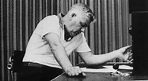
Classic studies redux
What does Sanderson suggest is the main factor in bad behavior?
How does she explain the Milgram study findings? (vs. the last book)
How do you explain this: https://en.wikipedia.org/wiki/Strip_search_phone_call_scam

Slide 5
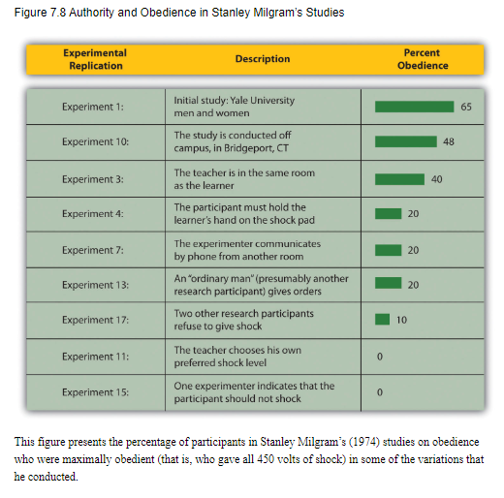
Milgram, 1963
https://video.search.yahoo.com/search/video?fr=mcafee&ei=UTF-8&p=milgram+video+clip&type=E210US91088G0#id=2&vid=e0438dcd3d9d168d1d418b158199693f&action=view

Slide 6
Bystander Intervention (Latané & Darley, 1969)
Notice event
Define as emergency
Take responsibility
Decide how to act
Act
Social influence
Diffusion of responsibility
Audience inhibition

Slide 7
Percentage helping (Harton et al., 1996)

Slide 8
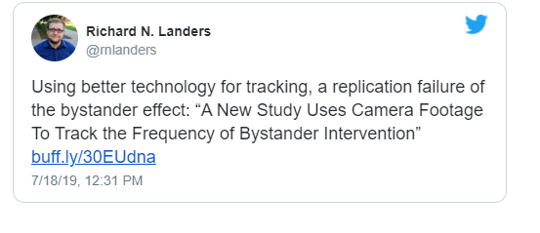
Philpot et al., 2019
What did they do in this study?
Do you agree or disagree with the tweet?
Why would this be different from the headline?

Slide 9
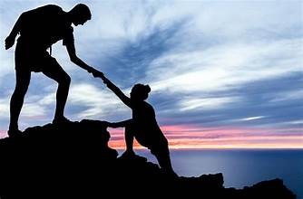
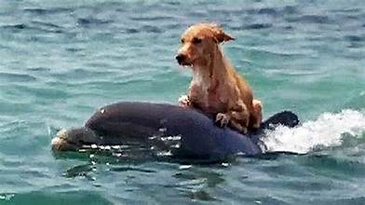
Why do people help others?

Slide 10
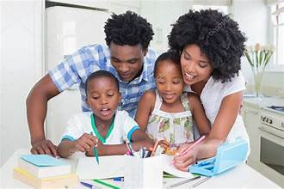
Why do people help? (biological)
Evolutionary roots
Kin selection
Reciprocal altruism
Signaling theory
Neuro structures
Neural structures, mirror systems, oxytocin
Genetic influences

Slide 11
Why do people help? (motivational)
Egoistic reasons
Negative state relief model (Cialdini et al., 1973)
Arousal: Cost-reward model (Piliavin et al., 1981)
Empathy-altruism model (Batson, 2011)
Paradigm
Manipulation of empathy
Costs and benefits of
altruism

Slide 12
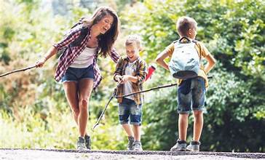
Why do people help? (relational)
Development
Temperament
Socialization
Social/cognitive development
Attachment/Relationships

Slide 13
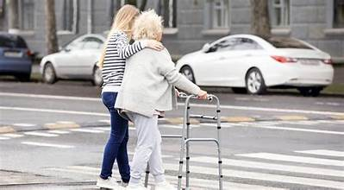
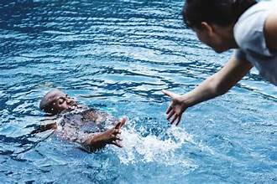
Why do people help? (individual differences)
Gender
Agreeableness (Graziano et al., 2007)
Penner Prosocial Personality Battery (Penner et al., 1985)
Other oriented empathy
Social responsibility
Empathic concern (Davis, IRI)
Perspective taking
Other-oriented reasoning
Mutual-concern reasoning
Helpfulness
Personal distress
Self-reported helpfulness

Slide 14
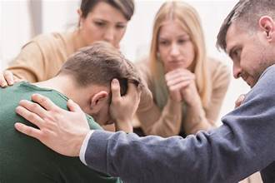
Why do people help? (situational)
Presence of others
Clarity of situation
Costs vs. rewards

Slide 15
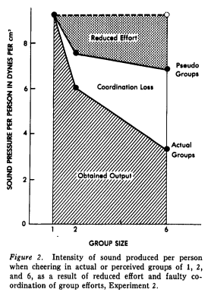
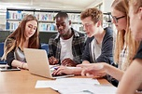
Social loafing
Why do people put in less work in groups?
How could professors better design group projects?

Slide 16
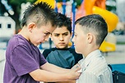
Bullying in K-12 schools
What types of programs/ideas does she suggest to stop bullying?
What are your experiences?

Slide 17
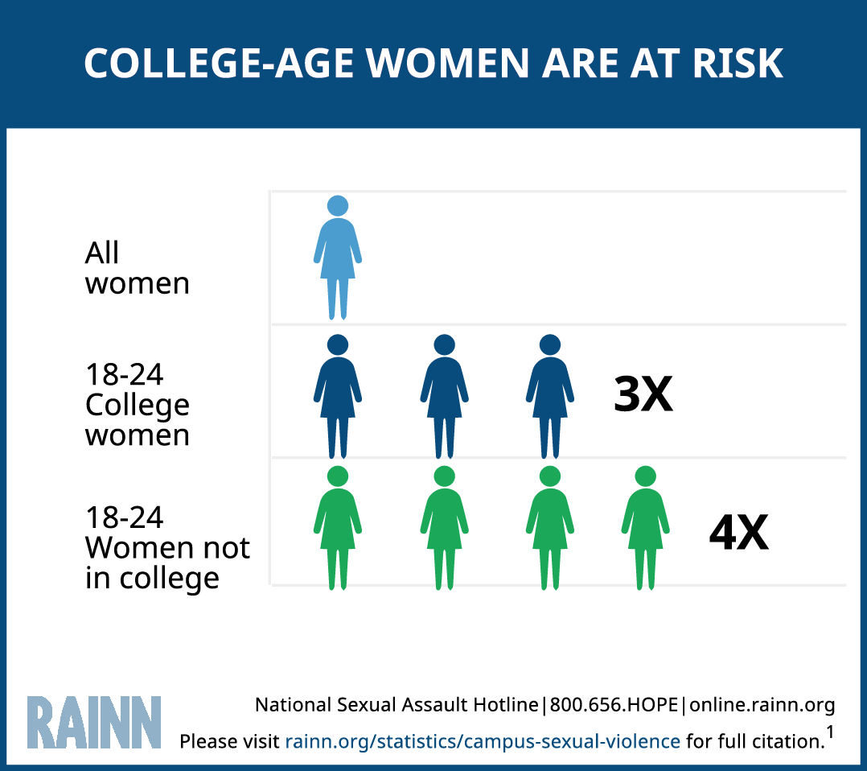
Sexual assault on campus
https://www.rainn.org/statistics/campus-sexual-violence
https://www.apa.org/apags/resources/campus-sexual-assault-fact-sheet
https://www.nsvrc.org/statistics
What types of programs/ideas does she suggest to reduce sexual assault?
What are your experiences?

Slide 18
Workplace dishonesty
What types of programs/ideas does she suggest to stop workplace dishonesty?
What are your experiences?
Psych examples—what would have helped here?
Dartmouth
https://www.science.org/content/article/after-honesty-researcher-s-retractions-colleagues-expand-scrutiny-her-work
https://datacolada.org/114

Slide 19
How to be a moral rebel
What does she suggest?
How do you go from reading to action?

Slide 20
Applications
Problem
Location
Plan

Slide 21
Dissent (based on Power of Us)
We like moral rebels unless they make us feel bad about our choices
We deviate b/c we want to be useful to our group
Dissent is more effective with
Strong ID
Persistent
Consistent
Shared goals and commitment to organization
More likely with openness to experience
Schachter and others’ research deviates suggests that first people try to convince deviates that they are wrong, but when that fails, they reject them

Slide 22
Leadership
How do leaders use identity?
Think of a leader who you believe was effective (whether for good or for bad) at bringing people together. Give examples of how they showed the characteristics that VB&P suggest good leaders will do.

Slide 23
Let’s rule the world

Slide 24
Post break
Paper due on Friday
First part of Belonging

