Slide 1
The Power of Us, Part 2
Jay Van Bavel and Dominic Packer

Slide 2
More commercials to bring people together
https://www.youtube.com/watch?v=z3a8MdloAAM

Slide 3
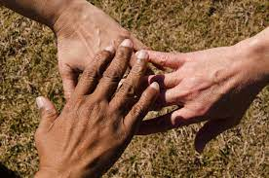
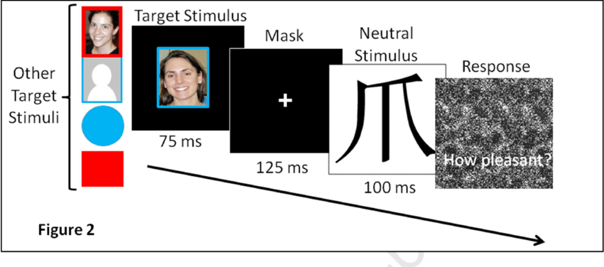
Implicit vs explicit bias
What is the difference?
Measurement of implicit bias
Implicit Associations Test
Evaluative priming/Affect misattribution procedure
Measurement of explicit bias
Feeling thermometers
Scales
Institutional bias
Iowa gender parity law
Who is our ingroup?

Slide 4
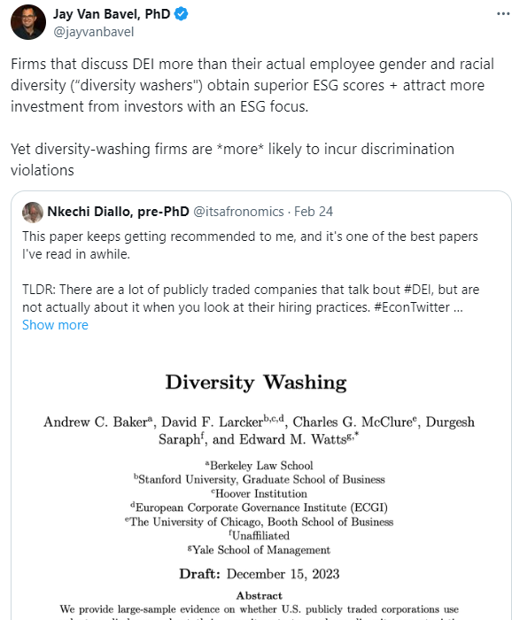

Slide 5
Crandall et al., 2002
Are there groups that is it okay to be biased against or times bias is okay?

Slide 6
Justification-suppression model (Crandall & Eshleman, 2003)

Slide 7
Integrated model of racism (Dovidio & Gaertner, 1988)
Liberals
Egalitarianism
Aversive racism
Conservatives
Protestant work ethic
Modern racism

Slide 8
Social dominance theory (Sidanius et al., 1992)
Legitimizing myths
Hierarchy-enhancing
Group-based hierarchies
Beliefs about groups
Hierarchy-attenuating

Slide 9
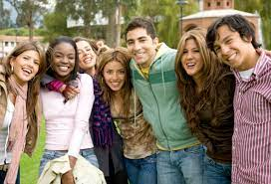
Is noticing gender, sex, ethnicity, age, etc. inevitable?
What is the problem with just getting rid of group boundaries or being “color blind”?
Vs. multiculturalism
Vs. common in-group identity model (Gaertner & Dovidio, 2000)

Slide 10
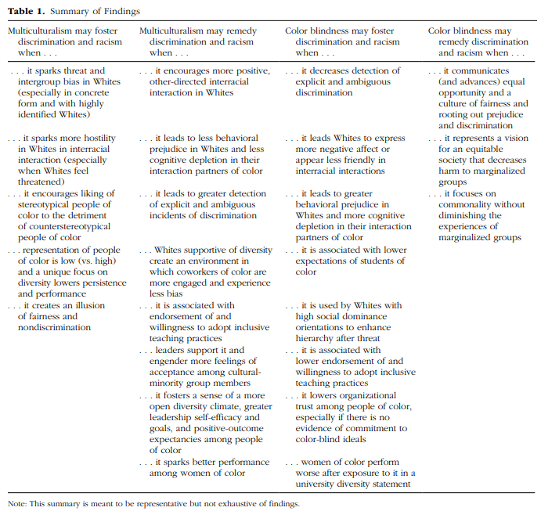
Plaut et al., 2018

Slide 11
Sneetches (Dr. Seuss)
https://www.youtube.com/watch?v=eBCUkdd57qc

Slide 12
Reducing bias

Slide 13
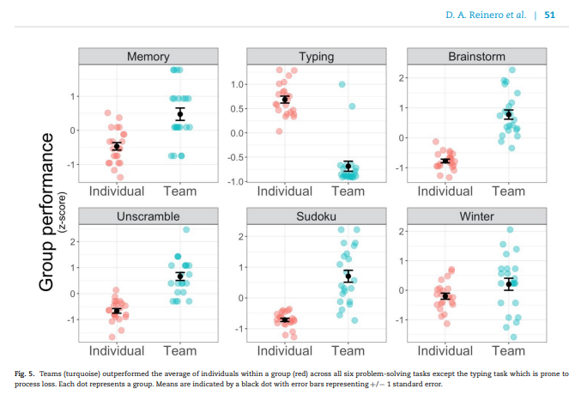
Groups vs. individuals
When will groups be better than individuals?
VB&P (Reinero et al., 2021) say that groups are better, but lots of research says groups are worse. Look at their results—why would this be?

Slide 14
Bystander Intervention (Latané & Darley, 1969)
Notice event
Define as emergency
Take responsibility
Decide how to act
Act
Social influence
Diffusion of responsibility
Audience inhibition

Slide 15
Percentage helping (Harton et al., 1996)

Slide 16
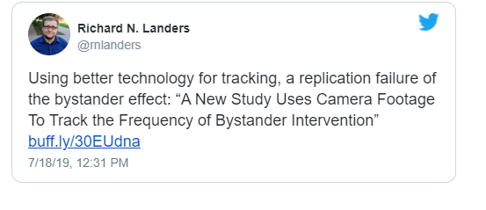
Philpot et al., 2019
What did they do in this study?
Do you agree or disagree with the tweet?
Why would this be different from the headline?

Slide 17
System justification theory (Jost & Banaji, 1994)
Motivated to defend the status quo
Epistemic motivation
Existential motivation
Relational motivation
Do more when status quo is
Inevitable
Threatened
Individual is dependent or feels powerless
System seems legit
Consequences
Decreases collective action
Good for high status (SE), but bad for low status (outgroup favoritism, low SE, depression)

Slide 18
Collective action
Create a movement

Slide 19
Dissent
We like moral rebels unless they make us feel bad about our choices
We deviate b/c we want to be useful to our group
Dissent is more effective with
Strong ID
Persistent
Consistent
Shared goals and commitment to organization
More likely with openness to experience
Schachter and others’ research deviates suggests that first people try to convince deviates that they are wrong, but when that fails, they reject them

Slide 20
Social impact theory (Latané, 1981)

Slide 21
Sherif, 1935 autokinetic effect

Slide 22
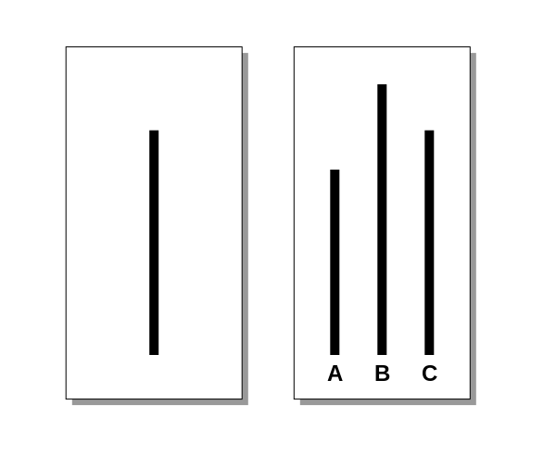
Asch, 1956 line study
https://www.youtube.com/watch?v=iRh5qy09nNw
Factors affecting conformity:
Group size
Presence of ally
Difficulty of task
Public vs. private answer
Individual differences

Slide 23
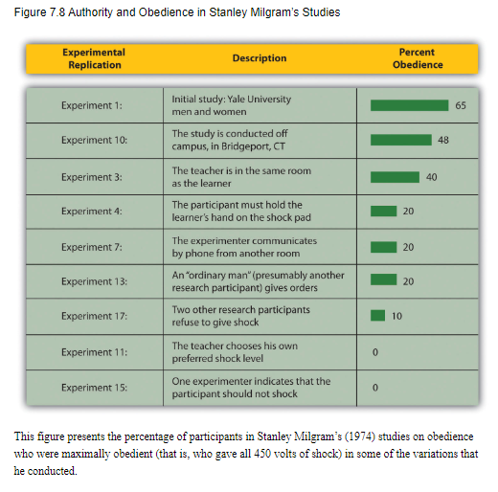
Milgram, 1963
https://video.search.yahoo.com/search/video?fr=mcafee&ei=UTF-8&p=milgram+video+clip&type=E210US91088G0#id=2&vid=e0438dcd3d9d168d1d418b158199693f&action=view

Slide 24
Zimbardo, 1971 SP Study
https://www.prisonexp.org/
Replications
Lovibond, Mithiran, & Adams, 1979
Haslam & Reicher, 2002
http://www.bbcprisonstudy.org/

Slide 25
Helping, line length, obedience, prison
Why are these studies talked about so much? (and criticized so much?)
How could you explain their results using social identity theory? Social impact theory?
What would women have done?
What do they tell us about how to be our better selves?

Slide 26
Leadership
How do leaders use identity?
Think of a leader who you believe was effective (whether for good or for bad) at bringing people together. Give examples of how they showed the characteristics that VB&P suggest good leaders will do.

Slide 27
Let’s rule the world

Slide 28
Next week
Paper due
All of Why We Act
Questions for Power of Us people

