Slide 1
The Power of Us
Jay Van Bavel and Dominic Packer

Slide 2
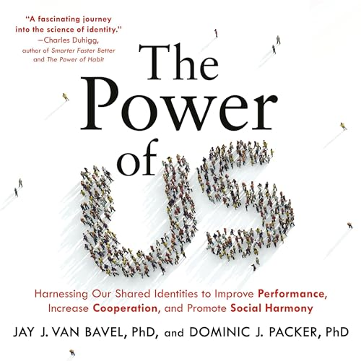
General impressions
What do you think of this book?
How is it similar to and different from Grant’s book?

Slide 3
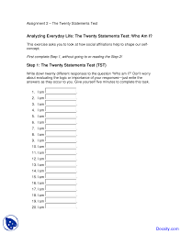
20 statements test (Kuhn & McPartland, 1954)
Who am I?
20 times “I am…”

Slide 4
Coding
A-mode responses are physical characteristics or attributes. Examples: “I am short”; “I am a Wisconsin resident”; “I am strong”; “I am tired.”
• B-mode responses describe socially defined relationships, roles and statuses usually associated with group membership of some sort. Examples: “I am a college student”; “I am a Catholic”; “I am an African American”; “I am a gamer”; “I am a daughter”; “I am a sales clerk.”
• C-mode responses reflect personal traits, styles of behavior, or emotional states. Examples: “I am a happy person”; “I am a country music fan”; “I am competitive”; “I am laid-back”; “I am a fashionable dresser.”
• D-mode responses are more general than specific; they may express an abstract or existential quality: “I am me”; “I am part of the universe”; “I am a human being ”; “I am alive.”

Slide 5
Percentage of responses of each type
Ma and Schoeneman, 2010

Slide 6
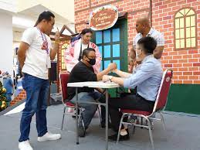
Independent vs. interdependent self-construal
My happiness depends on the happiness of those around me.
I will sacrifice my self-interest for the benefit of the group.
If my brother or sister fails, I feel responsible.
I am comfortable with being singled out for praise or rewards.
I enjoy being unique and different from others.
Being able to take care of myself is a primary concern for me.
Singelis, 1994

Slide 7
Groups vs. identities
What is a group?
What do you need to have a group?
What makes a group more groupy (entitativity)?
They start out talking about how our groups affect us, but they also talk about our social identities. Are groups=social identities?

Slide 8
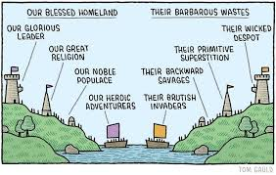
Social identity theory (Tajfel & Turner, 1978)
Psychological processes
Social categorization
Social comparison
Social identification
Group distinctiveness
How do people deal with devalued identity?
Depends on
Permeability
Stability
Legitimacy

Slide 9
More social identity
How do our social identities affect us?
What determines which identities we will take on?
What are the norms of UNI?
What are our strongest IDs, and why?
How do we signal our IDs?
Are there individual differences or situations that affect who we identify with or how strongly we identify?
What are the implications of minimal groups research?

Slide 10
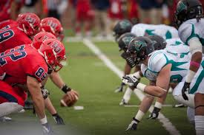
Biased fans and the smell of chocolate
What have studies shown about rival fans’ perceptions of games?
Does this happen in other areas of life?
How do these commercials prime IDs?
https://www.youtube.com/watch?v=pASE_TgeVg8
https://www.youtube.com/watch?v=wY8uajAm9N8

Slide 11
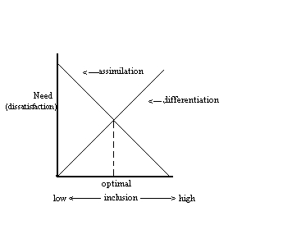
Optimal distinctiveness theory (Brewer, 1991)
2 needs:
Belonging
Distinctiveness

Slide 12
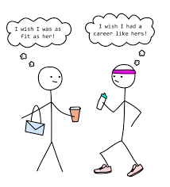
Social comparison theory (Festinger, 1954)
When/why do we compare to others?
To whom do we compare?
Upward
Downward
Lateral

Slide 13
Self-evaluation maintenance model (Tesser, 1988)
Closeness
Performance
Importance to self
Self-esteem
Comparison
Reflection
(BIRGing)

Slide 14
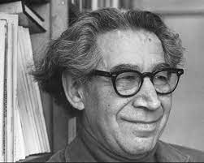
Cognitive dissonance theory (Festinger, 1957)
Conflict between our view of ourselves and a thought or behavior
When we surprise ourselves, feel stupid, or feel guilty
Motivated to
Change behavior
Change thoughts
Justify the behavior (add other thoughts)
Decrease how important the discrepancy is

Slide 15
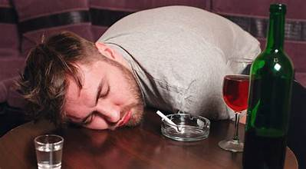
What would each theory predict?
Social identity theory
Optimal distinctiveness theory
Social comparison theory
Self-evaluation maintenance theory
Cognitive dissonance theory

Slide 16
Planet Clarion (Festinger, Riecken, & Schachter, 1964)
What happened in this study?
How are identities implicated in it?
How would you explain the findings of this study with cognitive dissonance theory vs. social identity theory? Are there differences?

Slide 17
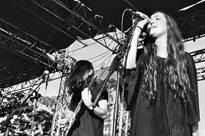
Cults
Who falls prey to cults?
What defines a cult?
Are there other groups with “cult-like” aspects?
Is it a category or a continuum?

Slide 18
Gibson & Haritos-Fatouros, 1986
Binding (initiation, segregation, in-group language)
Personal factors (normal, intelligent, not sadistic, believers)
Torture
Strain reduction (dehumanize victim, modeling, desensitization, reward/punishment, harassment

Slide 19
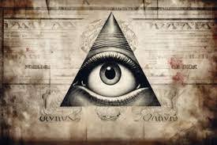
Who believes in conspiracy theories?

Slide 20
Groupthink (Janis, 1952)
strong group cohesion
insulation from outside infl homogeneity of attitudes
a directive leader
high stress
poor decision-making procedures
low situational member SE
illusion of invulnerability
belief in the moral correctness of group
stereotyped views of out-group
self-censorship
direct pressure on dissenters to conform
illusion of unanimity
mindguards
incomplete survey of alts
failure to examine risks of the favored alternative
poor info search
failure to develop contingency plan
biased assessment of risks, costs, benefits, and moral implications
failure to reconsider later

Slide 21
Baron’s (2005) ubiquity approach
Symptoms
Antecedents
Conformity
Suppress dissent
Pluralistic ignorance
Ingroup favoritism
Social identity
Salient norms
Low situational self-efficacy
Group polarization
Hidden profile effect

Slide 22
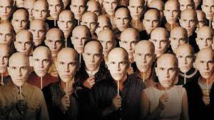
Conformity
Why do we conform?
Normative influence
Informational influence
Express valued identities
https://twitter.com/RuidoEnLaRed/status/1573326290438033408
https://www.youtube.com/watch?v=NyDDyT1lDhA

Slide 23
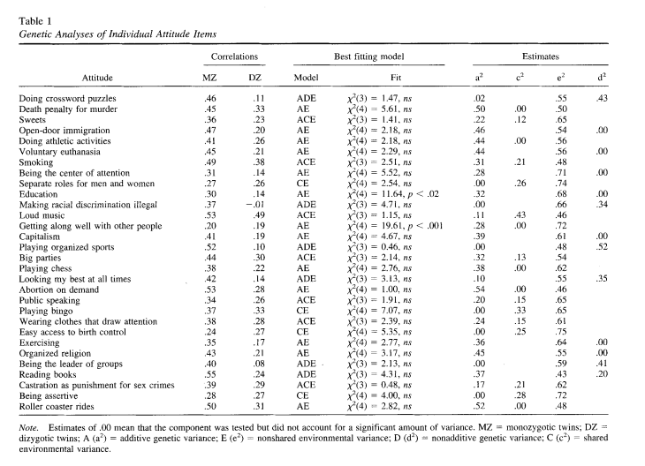
Biological factors
What evidence is there for a genetic component to attitudes/identities?
What are some critiques of this area of research?
Olson et al., 2001 potential mediators

Slide 24
Replication crisis
How do these theories (social identity, social comparison, and optimal distinctiveness) and ideas (groupthink) relate to the replication crisis?
What do they suggest about how we should fix it?
What does this research suggest about what we study and how we interact with other scientists?

Slide 25
Harton & Gordon, 2019
Likelihood of QRPs
Demographic factors:
Gender
Year of PhD
Age
Institutional factors:
Type of school
Department
Experience factors:
IRB experience (# protocols)
Internal factors:
Anticipated shame
Perceived harm
Moral judgment
Acceptability
Peer behavior
External factors:
Moral judgment matters more when sanctions are low (sometimes)

Slide 26
Solutions?
How can we use identities for good and decrease their use for bad?
Applications:
Create a viral tweet for UNI
Design a video that would encourage UNI ID
Design a plan to increase UNI students’ identification with the university

Slide 27
Next week
Finish Power of Us
Two weeks—Sections 1 through 3 of paper due
Define problem, apply theories, review research, THEN start thinking about your plan

