Slide 1
Misinformation and misperceptions

Slide 2
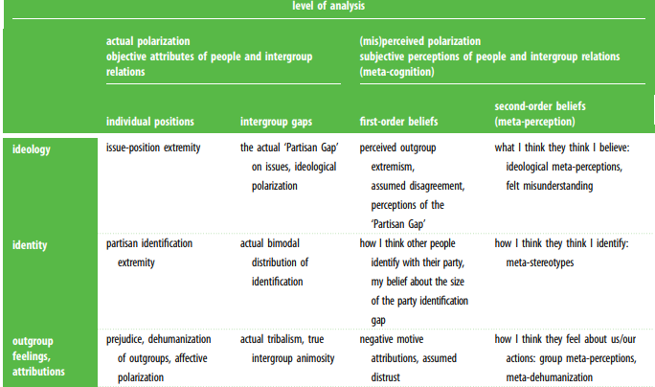
“the U.S. is polarized”
What is polarization?
Ideological
Affective
Perceived (or misperceived, or false)
Is the U.S. more polarized than it used to be?
Is this a U.S. phenomenon or more general?
Are the causes of these different types of polarization the same or different?

Slide 3
Fixing the world
Design an intervention to improve relations/decrease prejudice/get more compromise between:
1. Israelis and Palestinians
2. Iowa and Iowa State fans
3. People for and against the bill that banned transgender girls from participating in school sports with other girls
4. People for and against banning books in school libraries
5. Gun rights advocates and gun control advocates

Slide 4
Ideological polarization

Slide 5
Stern, 2020

Slide 6
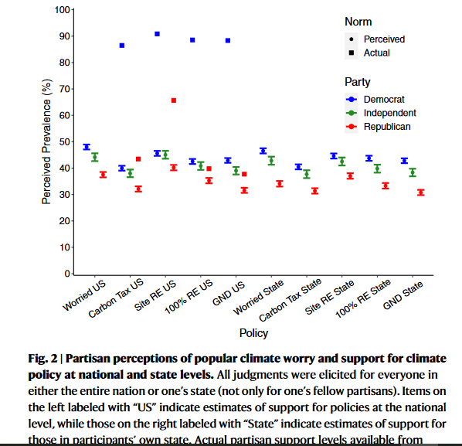
Sparkman et al., 2021

Slide 7
Pluralistic ignorance (Prentice and Miller)
People misperceive the norm, which leads them to act in accordance with the perceived norm
“I think college students drink a lot, so I drink a lot to fit in.”

Slide 8
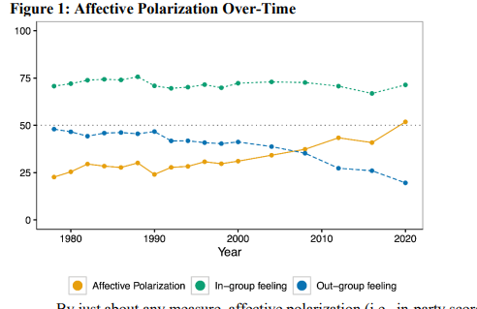
Affective polarization (Druckman & Levy, 2021)

Slide 9
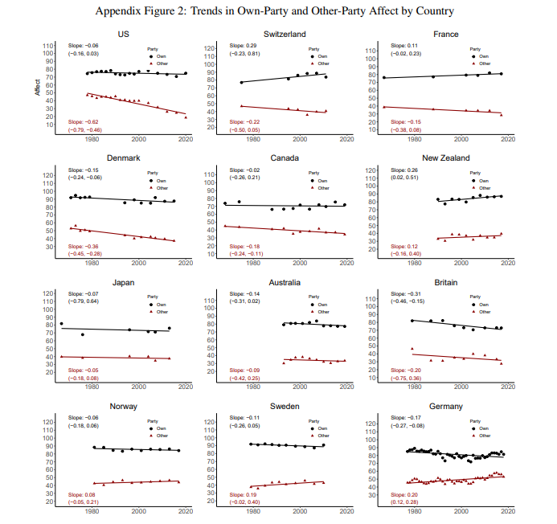
Boxell et al., 2021

Slide 10
Jaeger & Wilks, 2022

Slide 11
Social Identity theory (Tajfel)
What does social identity theory predict?
Why we categorize
Which identities we take on
How it affects perceptions of the in and out group
How does social identity theory explain affective polarization?
Social categorization
Social identification
Social comparison

Slide 12
Why has affective polarization increased?
Two party system (Boxell et al., 2021)
Nonwhite share of population (Boxell et al., 2021)
Elite polarization (Boxell et al., 2021)
Sorting of types of people (Iyengar et al., 2018)
Network homogeneity (Iyengar et al., 2018)
News media (Iyengar et al., 2018)
Social media (Iyengar et al., 2018)
Ideological polarization (Iyengar et al., 2018)
Perceptions of who “they” are (Ahler & Sood, 2018)
Not just partisanship as a social identity (West & Iyengar, 2022)
How do these relate to social identity theory?

Slide 13
Boxell et al., 2021 (Two-party system)
https://www.nber.org/system/files/working_papers/w26669/w26669.pdf

Slide 14
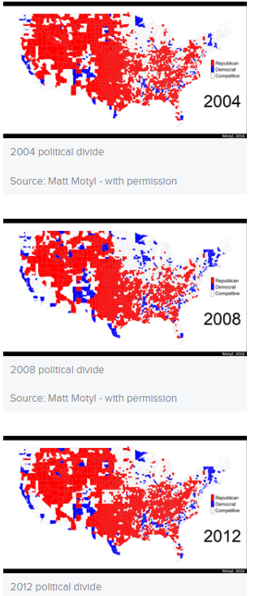
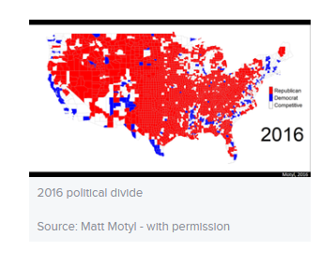
GeogrAphic sorting

Slide 15
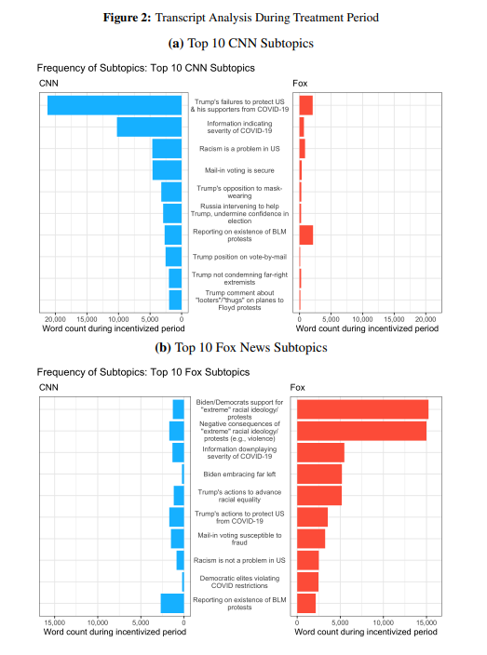
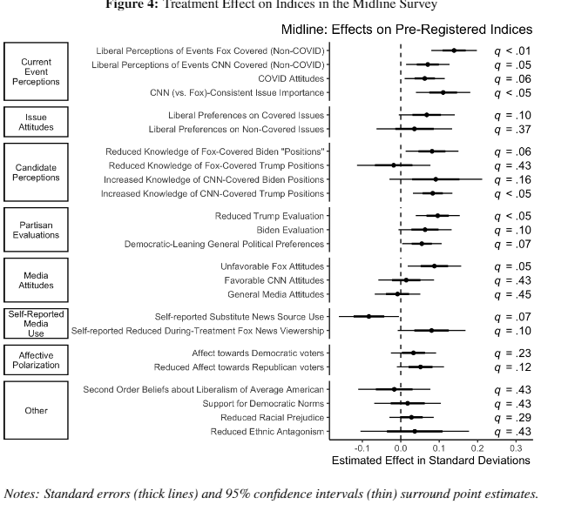
News media (Brookman & Kalla, 2022)
Fox news watchers incentivized to watch CNN for a month

Slide 16
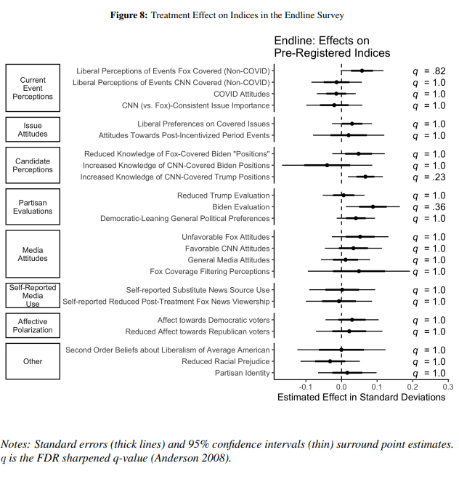
And 2 months later…

Slide 17
Frimer et al., 2022

Slide 18
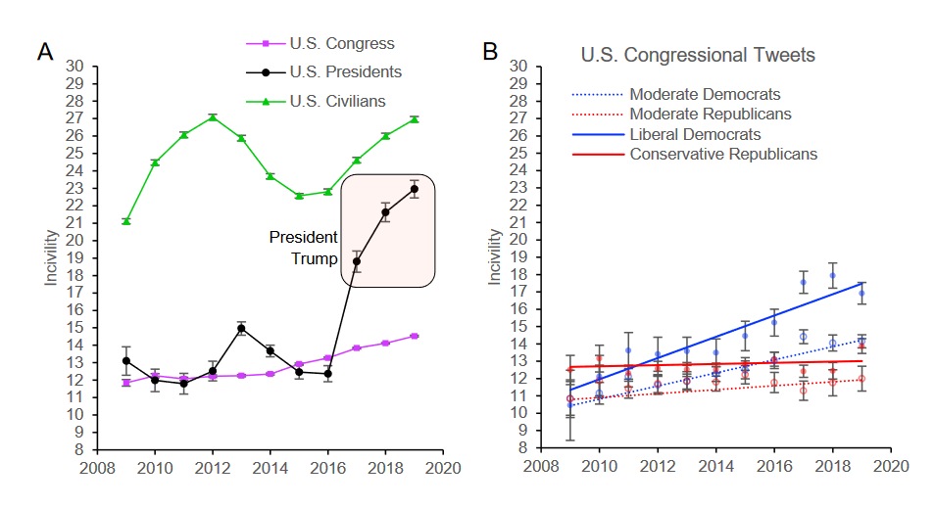

Slide 19
Perceived polarization

Slide 20
Lees & Cikara, 2021

Slide 21
How different are Rs and Ds? (Ahler & Sood, 2018)
Why do we visualize the “other side” as we do? (representativeness heuristic)
What does Table 1 show?
What are possible reasons for these results?
Follow the news
Expressive responding
Innumeracy
Ignorance of group base rates
Are there any other reasons you can think of?
Estimate the number of people in each group who are D or R
https://perceptiongap.us/the-perception-gap-quiz/

Slide 22
Visualize types of people
A person with a disability
A prison guard
A surgeon
A Muslim
An anti-abortion activist

Slide 23
What are the potential consequences of these incorrect perceptions? (Tables 3 and 4)
What helped reduce these incorrect perceptions?
Would it work for other groups?
How could you scale it up beyond the study?

Slide 24
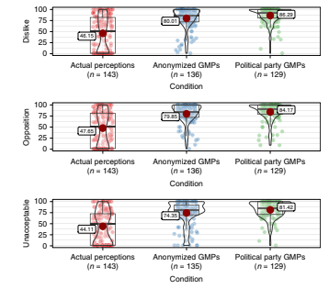
Lees & Cikara, 2020

Slide 25
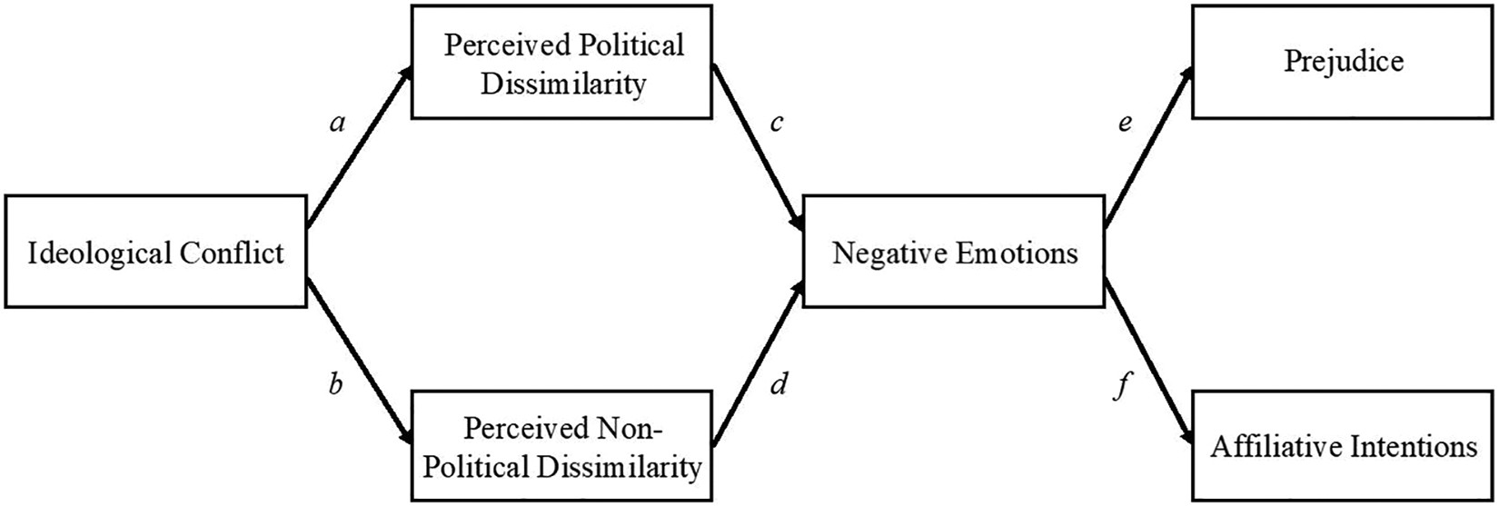
Stern & Crawford, 2020

Slide 26
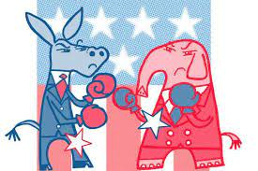
Consequences of Affective (and other) polarization
Does it matter?
What about consequences of other types of polarization?
Ideological
Perceived (Lees & Cikara, 2020)

Slide 27
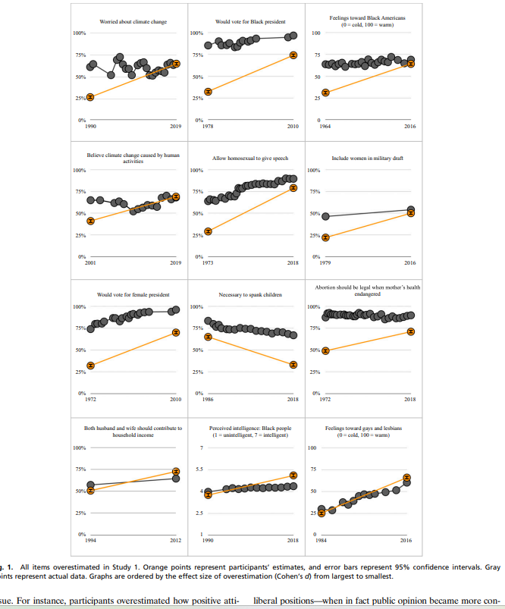
Do we also misperceive change?
What is the problem with misperceiving change in political attitudes?
What did Mastroianni & Dana (2022) do in their Study 1?
YOUR TURN: Whether someone is a man or woman is determined by sex assigned at birth vs. can be different from sex assigned at birth.
Estimate the % of Americans who said determined by SAAB in 2017 and 2022
What did M&D find? (Figures 1 and 2)

Slide 28
What did they do and find in Study 2?
Why do people misperceive attitude change over time? Are the causes the same or different from those of polarization?
What are the causes and effects of these within the political system?

Slide 29
Reducing affective (and other?) polarization
Making aware of misconceptions (Ahler & Sood, 2018; Lees & Cikara, 2020; Mastroianni & Dana, 2022)
Cross-party empathy (Santos et al., 2022)
Befriending meditation (Simmonson et al., 2022)
Common identities (Levindusky, 2018)
Intellectual humility (Krumrei-Mancuso & Newman, 2021)
Other ideas?
Would these work for other types of polarization?

Slide 30
Walter et al., 2019
What about fact checking?

Slide 31
Address causes
Renewing-American-Democracy-Navigating-A-Changing-Nation-Beyond-Conflict.pdf
Residential segregation and declining trust
Get cross-party engagement
Localize issues
Encourage contact
Info echo-chambers
Correct meta-perceptions
Complicate the narrative
Have media personalities model norms for civil discourse
Support local news
Change social media recommendations (Bisbee et al., 2022)
Ideological sorting
Expect outgroup interaction
Highlight overarching ids
Redefine “American”
Normalize disagreement
Reduce reliance on 2-party system

Slide 32
Sections 1-3 of Project due March 6
Cover page (APA style)—and whole paper in APA style
Title, centered, no label (Section 1): Define the problem and explain why it’s a problem. You will need to include some general sources here most likely (e.g., how common is this problem) as well as research that shows that this is a problem (e.g., linking it to negative outcomes). This section should contain several references and be about a page and ½ to 2 pages.
Theories (Section 2): Possible subheads by theory. Describe at least two theories that relate to how to solve the problem you defined. You’ll need at least a paragraph describing each theory, 1-2 paragraphs each that show general support for the theory, and a paragraph each that applies the theory specifically to your problem. This section should contain several references and be around 3 pages.
Past Interventions (Section 3): Evaluate previous research that has attempted to solve your problem. Provide a critical review of what we currently know about what does and does not work. This section should contain several references and be around 3 pages.
References--must match up to text and be in APA style

Slide 33
Next week
First part of Power of Us
Think Again people

