Slide 1
Think Again part 2
Adam grant

Slide 2
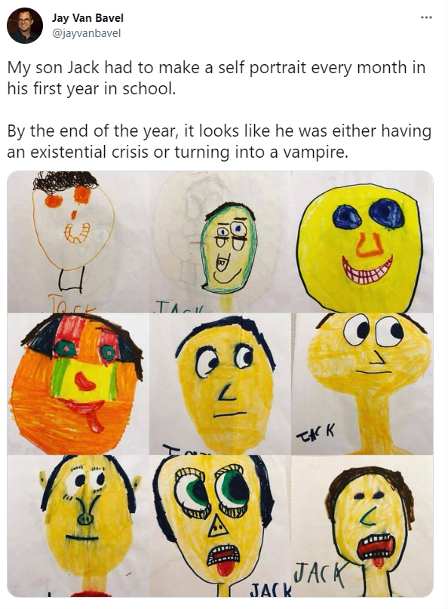
How does this relate to today’s readings?

Slide 3
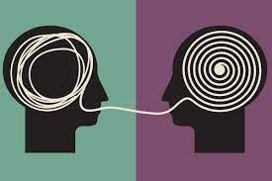
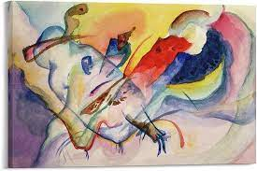
Motivational interviewing
What is motivational interviewing? Examples?
What makes it effective? (4 steps)
When might MI be more or less effective?
Wilson research on listing reasons
How does it differ from what typically happens in social media environments?

Slide 4
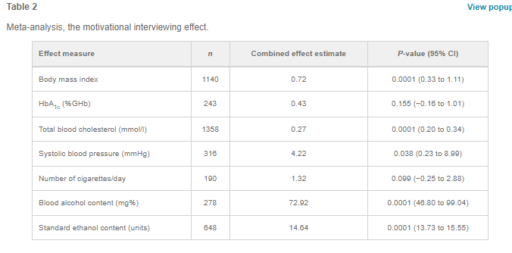
Psych/physicians > others
More effective if > 1 time

Slide 5
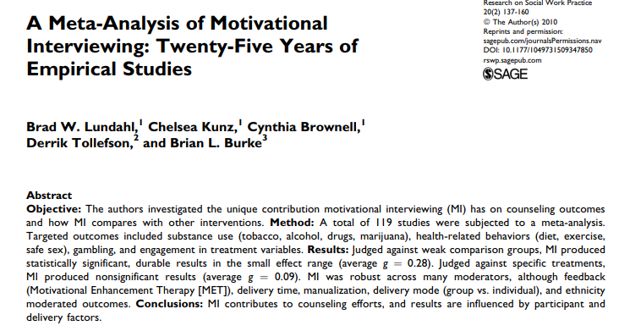

Slide 6
From the founders
https://www.youtube.com/watch?v=udWnupvMee4

Slide 7
Is it black and white or shades of gray?
What is the idea of Coleman’s Difficult Conversations Lab? (photo by Peter T. Coleman)
What are examples of when this might work better/worse?
Is there ALWAYS a shade of gray?
Integrative complexity
Positive>
Negative emotions
Tractable
Inquiry>
Advocacy

Slide 8
Perspective taking vs. seeking (vs. empathy)
What is the difference?
When will (and won’t) perspective taking work? Why?
Quote from a letter from Utah Governor Cox while
Vetoing a bill on transgender children’s participation in sports

Slide 9
Active learning vs. lecture; Freeman et al., 2014

Slide 10
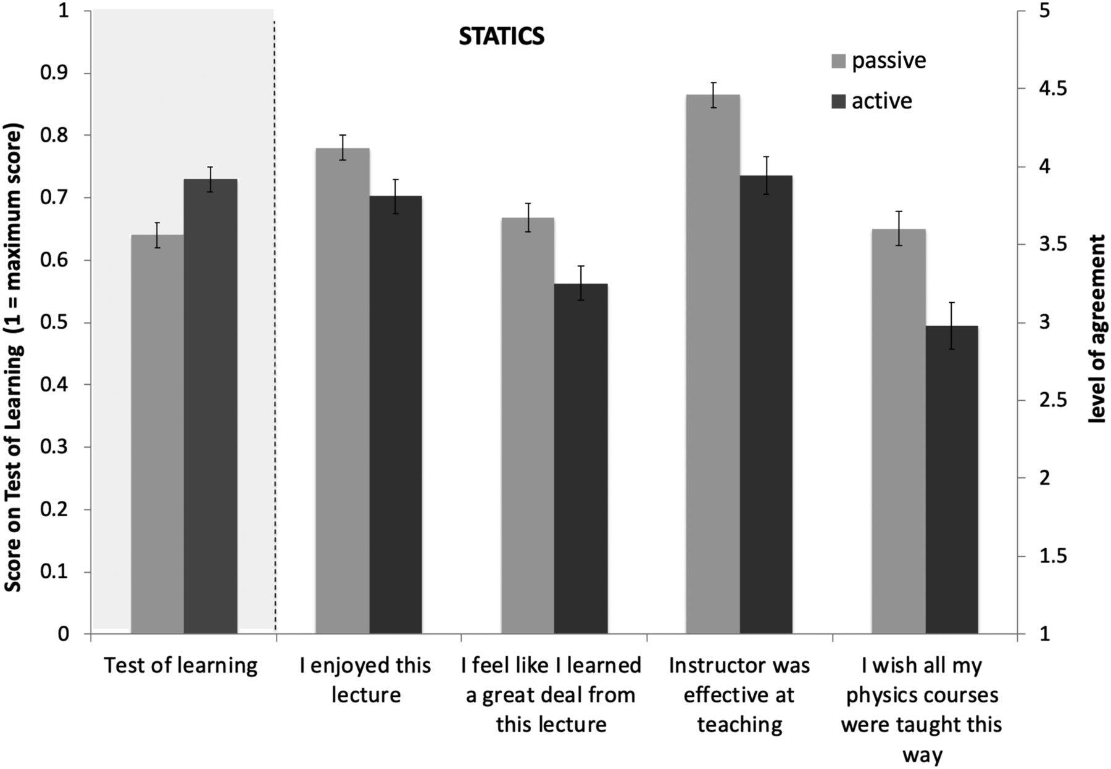
Deslauriers et al., 2019
Why do students think they learn more from lectures?
How could you use these findings and Grant’s ideas to improve college education?

Slide 11
Workplace application
Learning culture
Performance culture
Psychological safety
Outcome accountability
Process accountability

Slide 12
Goals
How does rethinking apply to goals?
How does the idea of escalation of commitment relate to changes post-COVID?
What does he suggest re: careers?

Slide 13
Oishi et al., 2021— Which is your ideal life?
Happy life
Meaningful life
Psychologically rich life

Slide 15
How does happiness relate to “rethinking”?

Slide 16
Epilogue
What did you think of Grant’s technique in the epilogue?

Slide 17
Theories/effects
Inoculation theory (McGuire)
Reactance theory (Brehm)
Binary bias (zero sum)
Awestruck/dumbstruck effect
Identity foreclosure
Sunk costs
Cognitive dissonance theory (Festinger)
System justification theory (Jost)

Slide 18
Action points
What are practical ways to implement these either in your own life or to your problem for this class?
Are some more important than others?
Would some have potential negative effects or caveats?

Slide 19
Next week
3 articles
Continue looking into psychological interventions that have been done to try to change/fix your problem
Make notes on what has been done and what they found
Use empirical sources

