Slide 1
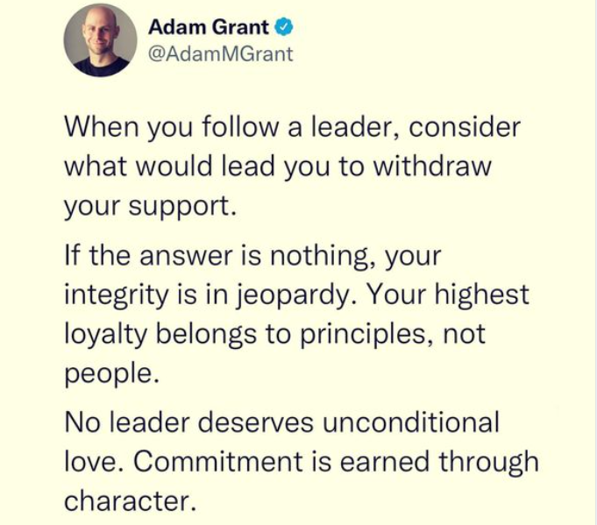
Think Again part 1
Adam grant

Slide 2
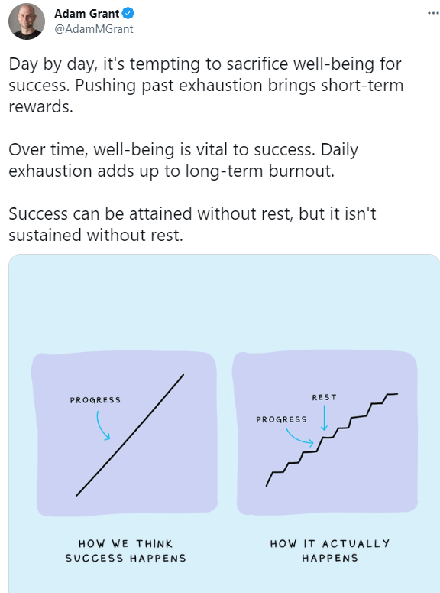
https://startswith.us/

Slide 3
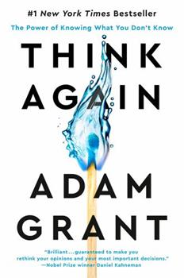
Background
Books as secondary sources
Reactions to book
What concepts from last week do you see reflected in the readings for today?
What areas of research that you’ve learned before in other classes do you see reflected here?
Take homes from the chapters

Slide 4
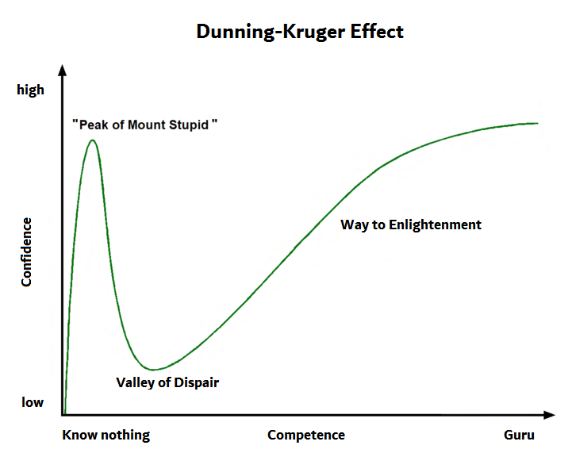
Fallacies—what, why, when
First instinct fallacy
Confirmation bias
Desirability bias
Not biased bias
Curse of knowledge
Dunning-Kruger effect
Belonging
Understanding
Controlling
Enhancing self
Trusting

Slide 5
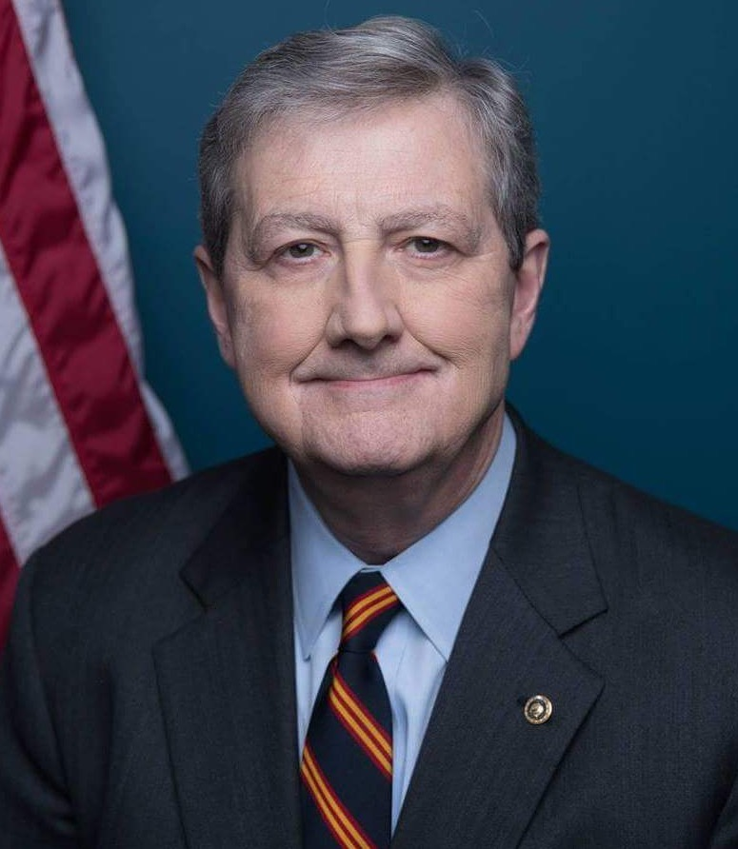
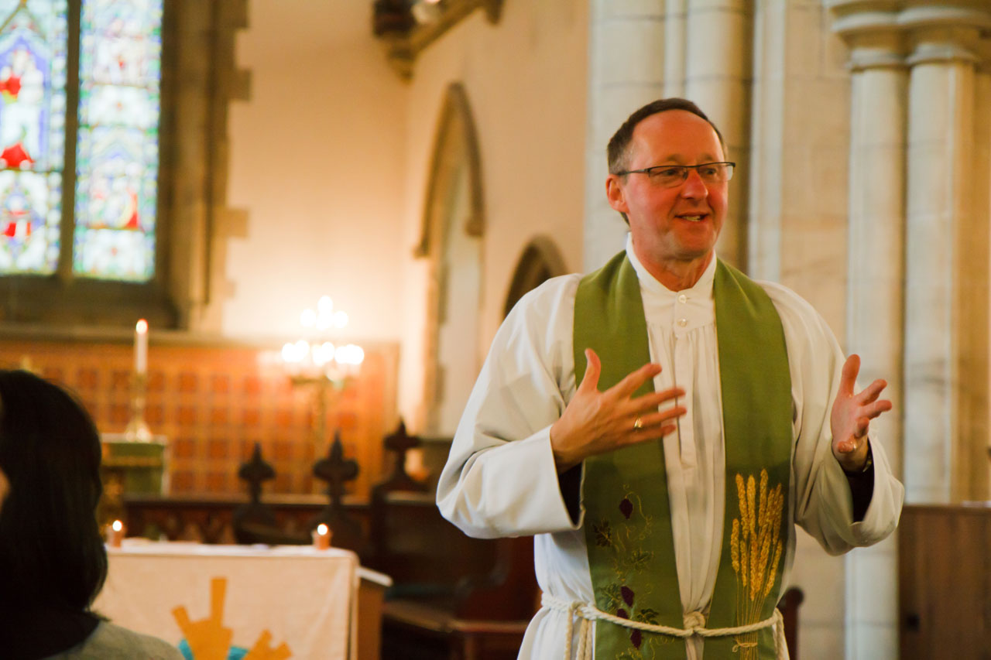
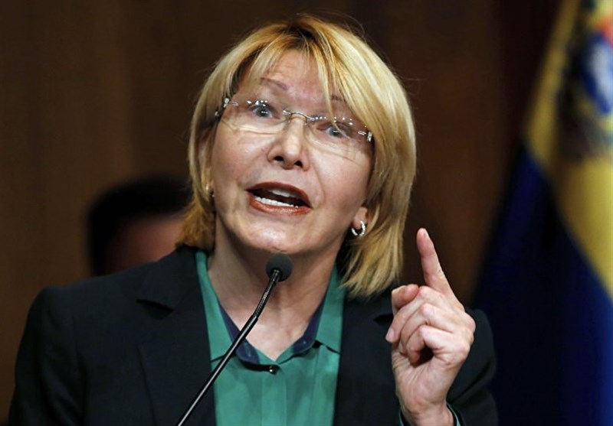
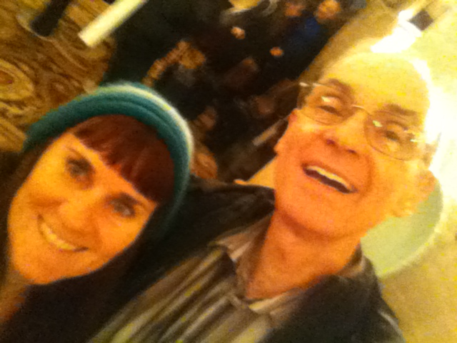
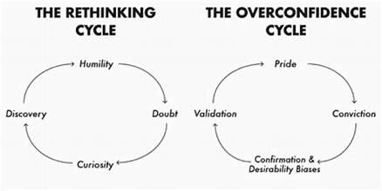
Tetlock’s (2002) ways of knowing
Politicians
When do people use each?
What are the motives for each?
Do scientists think like scientists?
This Photo by Unknown Author is licensed under CC BY
This Photo by Unknown Author is licensed under CC BY-SA

Slide 6
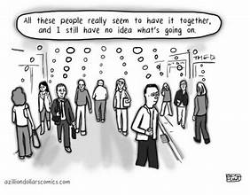
Thinking better
What sets apart better thinkers, according to Grant?
What are the metaphors of the armchair quarterback vs. the imposter?
When do we tend to do each?
Are these over or underestimations ever good?
What do you know a lot, a moderate amount, or a little about?

Slide 7
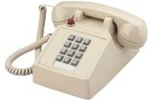
Protecting wrong ideas
Why do we hold false beliefs?
What makes ideas more likely to spread?
What happens as they spread?
What can we do to be more open to updating our beliefs?
What are some beliefs you updated based on evidence?

Slide 8
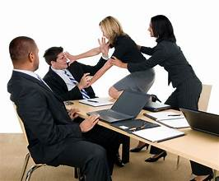
Challenging our ideas
What are task vs. relationship conflict, and when are they good vs. bad?
How can you seek out task conflict?
 | Disagree a lot |  |  |  | Agree a lot
Notices other people’s weak points | 1 | 2 | 3 | 4 | 5
Is helpful and not selfish with others | 1 | 2 | 3 | 4 | 5
Starts arguments with others | 1 | 2 | 3 | 4 | 5
Forgives others easily | 1 | 2 | 3 | 4 | 5
Usually trusts people | 1 | 2 | 3 | 4 | 5
Can be cold and distant with others | 1 | 2 | 3 | 4 | 5
Kind and considerate to almost everyone | 1 | 2 | 3 | 4 | 5
Is sometimes rude to others | 1 | 2 | 3 | 4 | 5
Likes to cooperate; goes along with others | 1 | 2 | 3 | 4 | 5

Slide 9
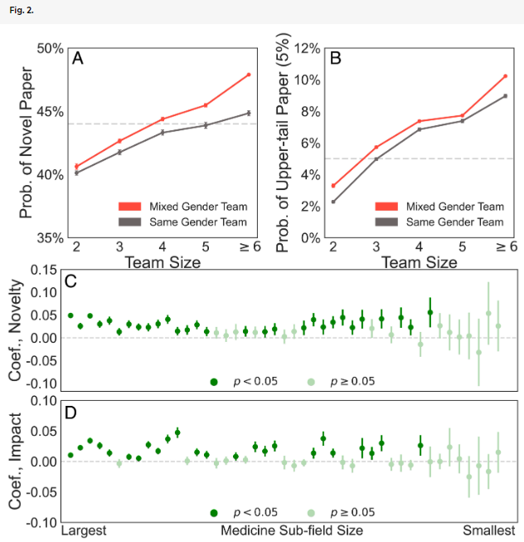
Yang, Tian, Woodruff, & Uzzi, 2022

Slide 10
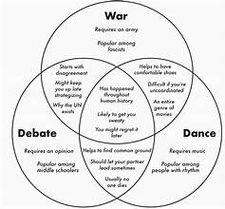
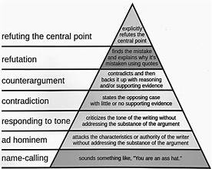
Debating convincingly
What does he suggest the best debaters/negotiators do?
When are these techniques going to be more or less important?

Slide 11
Elaboration Likelihood Model (Petty& Cacioppo, 1986)
Petty & Cacioppo, 1986; also see heuristic-systematic model (Chaiken & Eagly, 1989)

Slide 12
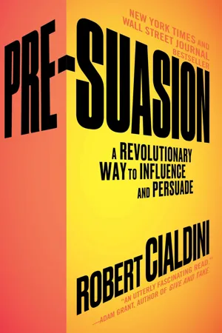
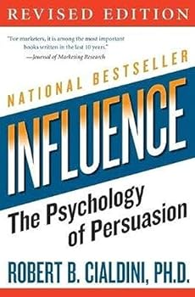
6 influence principles—Cialdini, 2006
What are examples of each?
When are they effective?
Why are they effective?
Reciprocity
Liking
Social proof
Authority
Scarcity (Reactance theory, Brehm)
Consistency (Cognitive dissonance theory, Festinger)
Unity (Social identity theory, Tajfel, Turner)

Slide 13
Stealing Thunder (Williams and others)
Stealing thunder—revealing negative information about yourself (or your client in a legal situation) before someone else does
Reduces impact of negative information
Why?

Slide 14
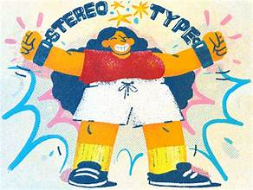
Breaking stereotypes and reducing prejudice
Why do we hold stereotypes about other groups?
How can we decrease stereotyping, according to Grant?
Simplified versions of relevant theories→ next slides

Slide 15
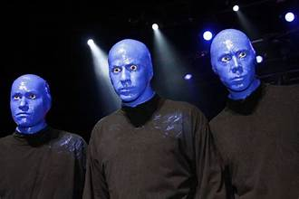
Social identity theory (Tajfel, Turner)
Our groups give us a sense of self-esteem
My group = good
Other groups = bad
Minimal group paradigm

Slide 16
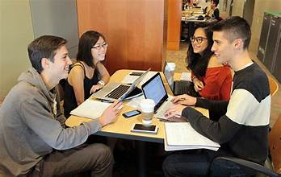
Group polarization
Become more extreme in group discussions because of
Social comparison
Persuasive arguments

Slide 17
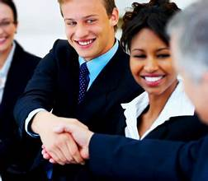
Contact hypothesis (Allport)
Equal status
Common goals
Cooperation
Support of authorities
Multiple exemplars

Slide 18
Common in-group identity model (Dovidio, Gaertner)
Reduce prejudice by using higher level categorizations
Eagles High School
Jocks
Brains
Stoners
Motorheads

Slide 19
Empathy altruism hypothesis (Batson)
Help only if rewards>costs
No Empathy
Empathy
Help regardless

Slide 20
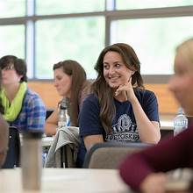
Paradoxical thinking (Bar-Tal)
Arguments that agree but are so extreme they make someone rethink

Slide 21
Back to that crazy uncle…

Slide 22
Next week
Finish Think again
That group should think about questions and get them to me by the next week (email)
Final topic due today

