Slide 1
Misinformation and Trust in science

Slide 2
Misinformation
Is it worse now? If so, why?
How has social media affected misinformation and its spread?
What about AI?
Why do people accept misinformation?
Societal factors
Individual factors
Motivational factors

Slide 3
How do you get others to change?
Who should engage?
How should you engage?
Debunking
Prebunking
https://www.youtube.com/watch?v=ER64qa_qnWg&t=1s
https://www.youtube.com/watch?v=BdlBHh0FOtw&t=101s
https://www.getbadnews.com/en
Nudges
Technocognition

Slide 4
Hornsey & Fielding, 2017
Look at roots of attitude behind rejection of science
Examples of each?

Slide 5
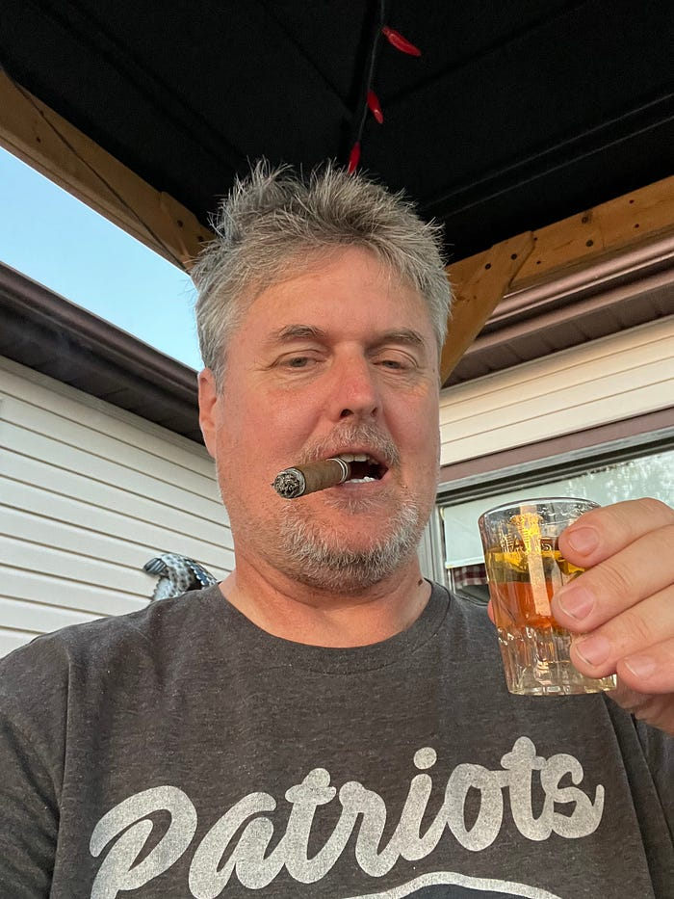
Crazy Uncle COnvo

Slide 6
Garrett and Bond, 2021

Slide 7
Do people trust science?
Do people trust science?
https://news.gallup.com/poll/352397/democratic-republican-confidence-science-diverges.aspx

Slide 9
https://www.pewresearch.org/science/2022/02/15/americans-trust-in-scientists-other-groups-declines/

Slide 10
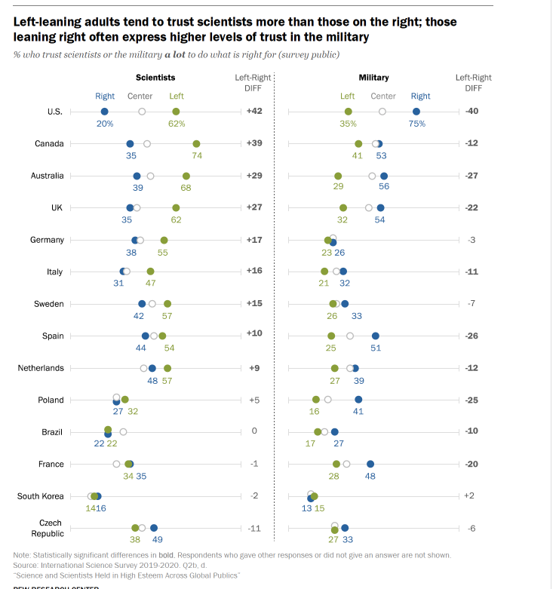
Pew research survey

Slide 11
Why do people not trust science?
Why are there political differences in trust in science?
What are possible relationships between political orientation and trust in science? (e.g., explanations offered in the article)

Slide 12
Nisbet et al., 2015
What did they do in this study?
What were some strengths and limitations?
What were the:
IVs
Covariates
DVs
Operational definitions

Slide 13
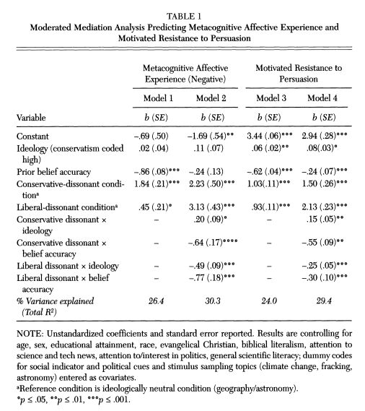
What related to more negative emotions and motivated resistance to persuasion?

Slide 15
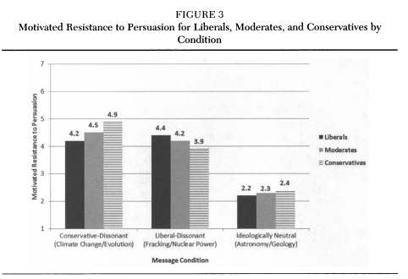

Slide 16
Pennycook, Bago, & McPhetres, 2022
4 rationales:
Politically motivated reasoning (emotion)
Identity-protective cognition (cognition)
Knowledge-deficit (don’t know about science)
Analytic thinking (don’t think analytically enough)
What would each of these explanations suggest should be correlated with accuracy of science beliefs?

Slide 17
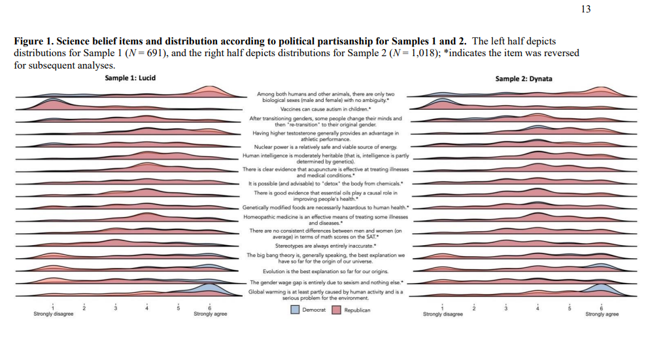

Slide 18
Findings
For issues on which the “liberal” viewpoint is supported by science, PO was more related to beliefs than was knowledge
For issues on which the “conservative” viewpoint is supported by science, it was opposite
Cognitive sophistication (+) and PO were correlated with beliefs on most issues, but cognitive sophistication only led to more polarization for climate change, big bang, and evolution
Their interpretation—political orientation matters, but basic knowledge and cognitive sophistication matter (maybe more?)
Implications?

Slide 19
Light et al., 2022

Slide 20
Should people trust science?
Had you heard of the replication crisis/reproducibility crisis/credibility revolution/Renaissance before?
What do you know about it?

Slide 21
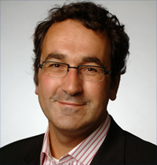
The Renaissance
2012: Stapel fraud
2011: Bem article
2011 researcher degrees of freedom or questionable research practices
(Simmons et al., 2011)
2012 Doyen et al. failure to replicate Bargh et al., 1996
2011-2012 Nosek developed OSF
2013 Center for Open Science
Fraud

Slide 22
Questionable Research Practices (QRPs)
“QRPs are the steroids of scientific competition, artificially enhancing performance and producing a kind of arms race in which researchers who strictly play by the rules are at a competitive disadvantage" (John, Loewenstein, & Prelec, 2012, p. 524)
Researcher degrees of freedom: All the little choices we make as we analyze a study that can have an effect on the outcome—e.g., treatment of outliers, analysis strategy, covariates. Becomes a QRP when you don’t decide ahead of time.

Slide 23
Examples of QRPs
Not collecting enough samples (relying on chance results)
Deleting some cases to make your research look better
Not reporting all measures
Stopping data collection when you have significant findings
Selectively reporting only the studies that “worked” (file drawer problem)
Analyzing the results different ways and reporting those that come out best (p hacking)
“Fishing” for results
Changing the hypothesis to fit your findings (HARKing)

Slide 24
How common are these behaviors?
Meta-analysis of surveys of scientists in various fields
72% | 34% | 14% | 2%
Have seen colleagues doing QRPs | Say they’ve done QRPs | Have seen colleagues committing fraud | Say they’ve committed fraud
Fanelli, D. (2009). How many scientists fabricate and falsify research? A systematic review
and meta-analysis of survey data. PLoS One, 4, e5738.

Slide 25
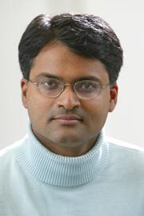
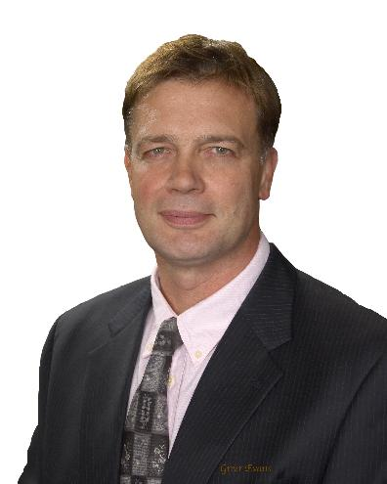
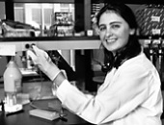
FRAUD is not just in psychology
Anil Potti, Duke University (cancer treatment research)
Andrew Wakefield (link between autism and MMR vaccine)
Bengu Sezen, Columbia University (organic chemistry)
Michael LaCour, UCLA (political science)
Fraud
Fraud
Fraud
Fraud

Slide 26
Replication is not just a psych problem
Only 11%-25% of drug studies replicated in private labs.
Only 59% of highly cited clinical research studies replicated.
Only 29% of cancer biology studies.
Only 44% of associations replicated in genetic studies.
Only 25-63% of studies replicated in economics (some using the same data!)
Only 39% subjectively rated as replicated in psychology, and 54% in the very top journals.
Prinz, Schlange, & Asadullah, 2011; Begley, & Ellis, 2012; Ioanndis, 2005; Lohmueller, Pearce, Pike, Lander, & Hirschhorn, 2003; Dewald, Thursby, & Anderson, 1986; Chang & Li, 2015; Open Science Collaboration, 2015; Klein et al., 2018; Errington, Iorns, Gunn, Fraser, Lomax, & Nosek, 2014.

Slide 27
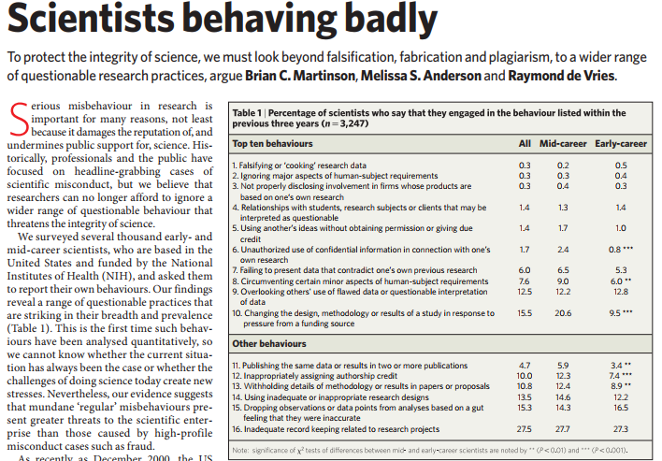
Nature, 2005

Slide 28
What does it mean if a study doesn’t replicate?
Maybe the first study was correct
Maybe the second one was
Maybe they both were!
Hidden moderators
What are the types of replication?
Direct replication (and can you ever do exactly the same study?)
Conceptual replication

Slide 29
Scientific method
Generate hypothesis
Design study
Collect data
Analyze and interpret data
Publish findings
Lack of replications
HARKing
Publication bias
Selective reporting
Low powered designs/small samples
p-hacking

Slide 30
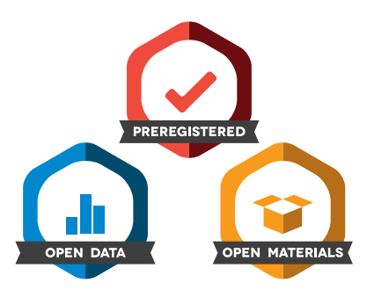
How can we increase trust in science?
What are some general ways to increase trust in science among people?
Open Science Movement—what is their approach?
How can you recognize possible Rdf in studies?

Slide 31
For next week
First half of Think Again
Project idea

