Slide 1
Interventions

Slide 2
The interventions you reviewed
5 of them

Slide 3
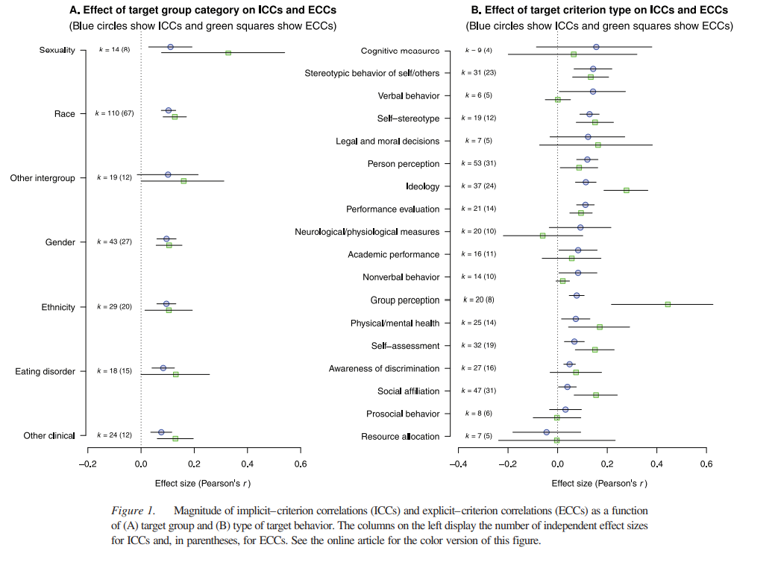
Kurdi et al., 2019 What is implicit bias?

Slide 4
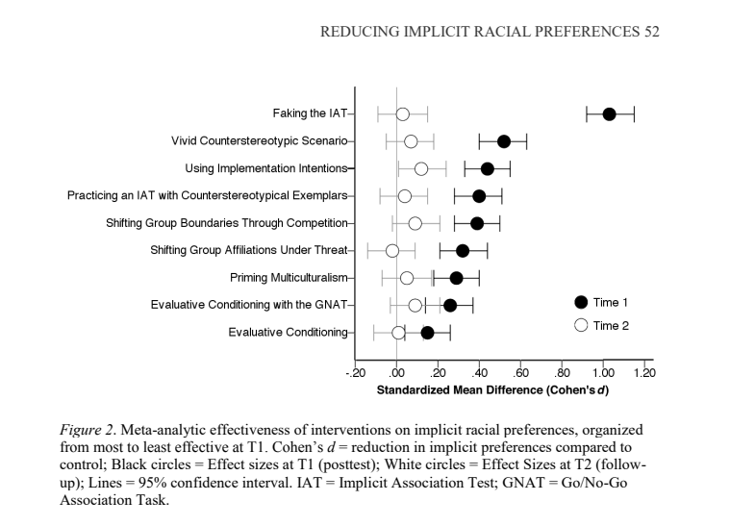
LAI et al., 2016

Slide 5
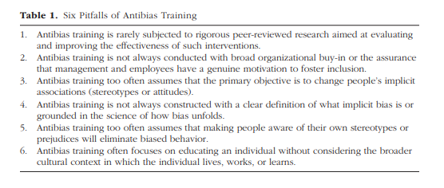
Pitfalls of bias training
Schmader et al., 2022 Table 1

Slide 6
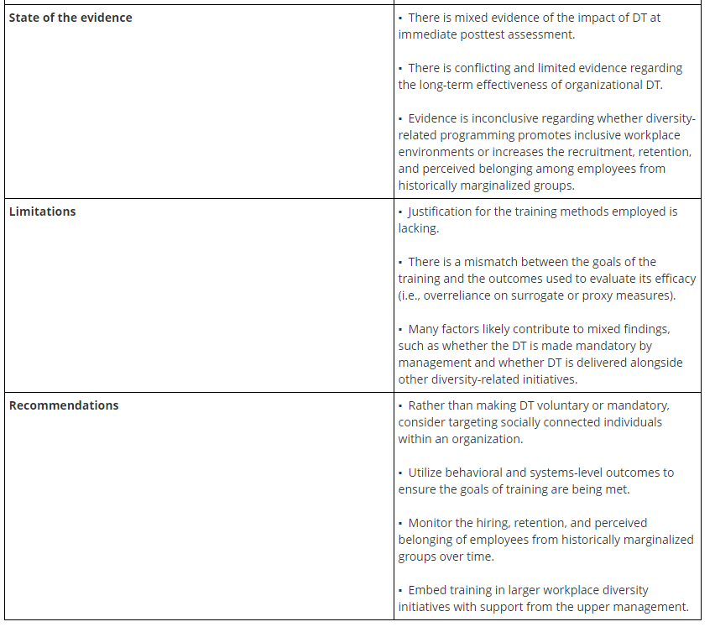
Devine & Ash, 2022

Slide 7
Schmader et al., 2022
What is their BIAS model?
Figure 1. What are examples of each type? Are there any that are left out?

Slide 8
Ways to decrease bias
What are some suggestions that Schmader et al. give?
How do these circle back to what we talked about last week?
Greenwald et al., 2022
Preventative
Governmental
Reparative
Curative

Slide 9
The interventions you reviewed
5 more

Slide 10
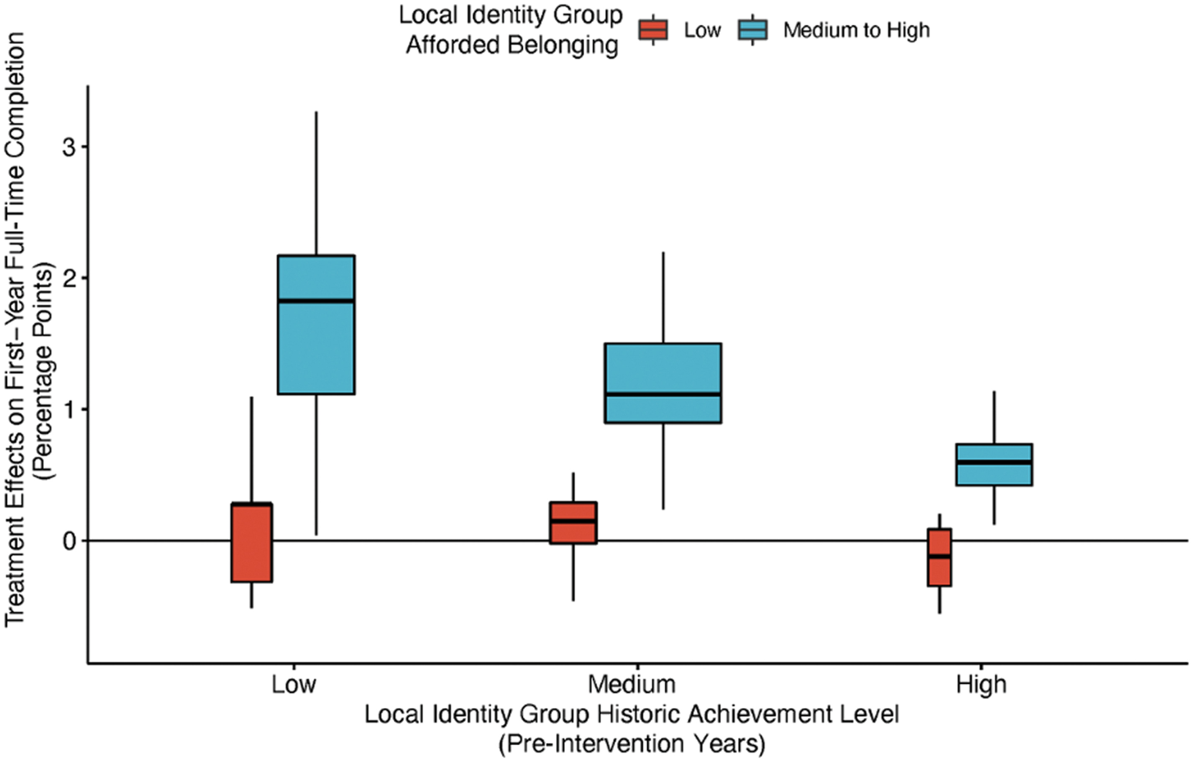
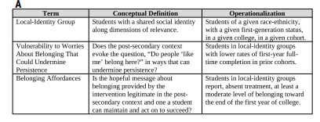
Belonging intervention
https://www.perts.net/programs/cb
What did they do and show?

Slide 11
Intervention materials
Current Students Survey: A Summary of Results.
This showed that, even as students broadly “reported a positive experience in college meeting other students, taking classes, and pursuing new opportunities” they also experienced common challenges: “in general, students from different backgrounds (e.g., gender, year in school, race, social class) reported many similar challenges and experiences.” For example, it indicated that “almost all” students “worried at first in college about whether they fit in and belonged…when they started college,” including worrying “about whether other students would include them and take them seriously in classes and coursework,” and “that other students might view their abilities negatively.” Yet “with time, students came to feel that they belonged in college,” including “feeling comfortable working with other students and interacting with professors,” and “Feeling confident that professors and other students viewed their abilities positively.” A summary statement noted that most students worry at first about whether they belong at [school name] but in time, they overcome these concerns and come to feel at home.

Slide 12
Sample stories
When I got into college, I was so excited about becoming a student at such a great school. But sometimes I also worried I might be different from other students. And when I got to campus, sometimes it felt like everyone else was right at home, but I wasn’t sure if I fit in. At some point, I realized that almost everyone comes to college unsure whether they fit in or not. It’s ironic—everybody comes to college and feels they are different from everybody else when, really, in at least some ways we are all pretty similar. Since I realized that, my experience at college has been almost one-hundred percent positive. - [matched to participating student gender/race-ethnicity]

Slide 13
Additional sample
I love college and I wouldn’t trade my experiences here for anything. I’ve met some close friends, I’ve had some fantastic experiences, and I’ve certainly learned a lot. Still, the transition to college can be difficult, and it was for me. My freshman year sometimes I didn’t know what I was doing—I made a lot of casual friends at parties and other places but I avoided interacting with professors in class or going to office hours. I think I was intimidated by them. I also got some low grades early on, which stressed me out. But these things all got better over time. I began to make good friends through classes. And my grades got better as I started working in study groups and asking for help from professors. I even got involved in research with a professor. Now I am happier than I have ever been at college. It is really rewarding for me to feel like I belong in the intellectual community here. - Junior, White female

Slide 14
Active written reflection
Reflect on the themes you just read about and describe how and why worries about fitting in and belonging are likely to be common when students first go to college, why students typically feel more at home on campus with time, and what students do to feel more at home, e.g., as they get to know friends and professors. Consider specific experiences you will have during your first year like living in a residence hall, meeting new people, joining student groups, interacting with professors, and taking college classes. Draw on your past experiences with other transitions like starting high school or going to a summer program and on the stories from the older students you just read. Your essay may be provided, anonymously, to incoming [school name] students in future years to help give them a better understanding of what coming to college is like. The more you can describe the challenges you anticipate facing in coming to college and how you can respond to these challenges over time, the more future students will benefit. Thank you for your time and effort.

Slide 15
Who benefited most from the intervention?
How can we increase belonging for all students?
https://www.iowaregents.edu/news/newsletter/board-of-regents-news/april-2024-meeting-preview/free-speech-survey-results#:~:text=The%20Board%20of%20Regents%20will%20receive%20a%20report,related%20to%20things%20they%20were%20studying%20in%20class.

Slide 16
The interventions you reviewed
The rest of them

Slide 17
Final exam
Due 7pm Wed.

