Slide 1
The power of norms

Slide 2
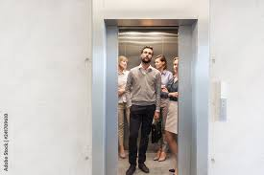
overview
What is (and isn’t) a norm?
How do norms affect us?
What was similar about the approaches you read about for today?
What was different?

Slide 3
Evolution of norms
Where do social norms come from?
Bottom up approaches (Sherif, Berger, Latané)
Ecological approaches (Schaller, Oishi, Gelfand)
How do they change over time?
Vandello & Cohen (2004) 4 stage model:
Adapt to environment
Norms develop to support behaviors
Behaviors become internalized, lose adaptive value
Compliance persists—cultural lag

Slide 4
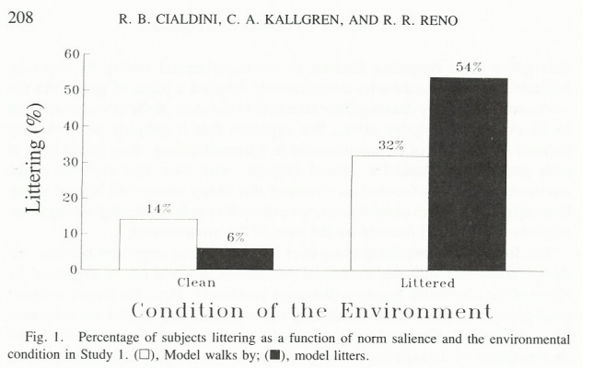
Social norms and influence
Focus theory of normative conduct (Cialdini et al., 1991)
Injunctive vs. descriptive norms
Attention/salience
Social identities
Social marketing campaigns
When is the descriptive norm not useful?

Slide 5
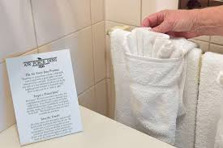
Goldstein et al., 2008
Which do you think would be most effective and why?
Help save the environment
Join your fellow guests in helping to save the environment (75% of guests…)
Join your fellow guests in helping to save the environment (75% of people in this room)
Join your fellow citizens in helping to save the environment
Join the men and women who are helping to save the environment

Slide 6
In small groups
What did they do and find in the article?
Walk us through the results of each figure
What is the take home message?
How does this study relate to norms?
Lead 2 discussion questions based on the article

Slide 7
Tankard & Paluck, 2017
What did Tankard and Paluck do and find?
Study 1 (Figure 1; Means; Moderators)
Study 2 (Figure 2; Means; Moderators)
What is the take home message of this article?
How does this study involve norms?
Discussion questions

Slide 8
Tankard & Paluck, 2017
Why might institutions affect beliefs?
Would you expect similar effects after the Dobbs ruling? Why or why not?
https://www.pewresearch.org/religion/fact-sheet/public-opinion-on-abortion/
https://news.gallup.com/poll/246278/abortion-trends-party.aspx
https://news.gallup.com/poll/321143/americans-stand-abortion.aspx
https://news.northeastern.edu/2022/07/27/abortion-support-post-dobbs/

Slide 9
Bursztyn et al., 2020
What did Bursztyn et al. do and find?
Perceptions of attitudes (Figure 2)
Job app (Figure 3)
Follow ups (Figure 4, Figure 5)
Figure 9
What is the take home message of this study?
How does this study involve norms?
Discussion questions

Slide 10
Pluralistic ignorance
Why do people misperceive norms?
How could pluralistic ignorance be used in explaining COVID responses?

Slide 11
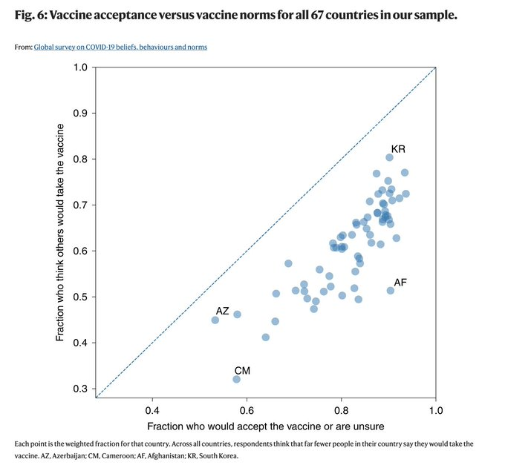
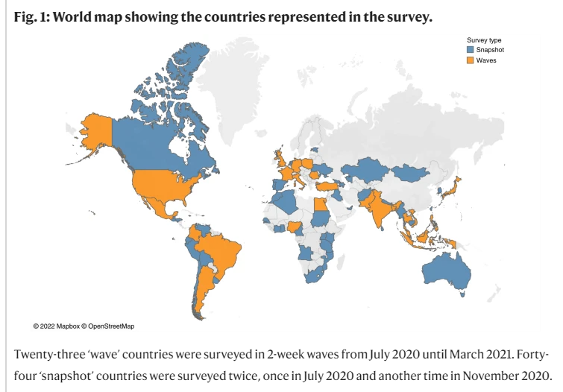
Collis et al., 2022
https://www.nature.com/articles/s41562-022-01347-1?utm_source=nathumbehav_etoc&utm_medium=email&utm_campaign=toc_41562_6_9&utm_content=20220921

Slide 12
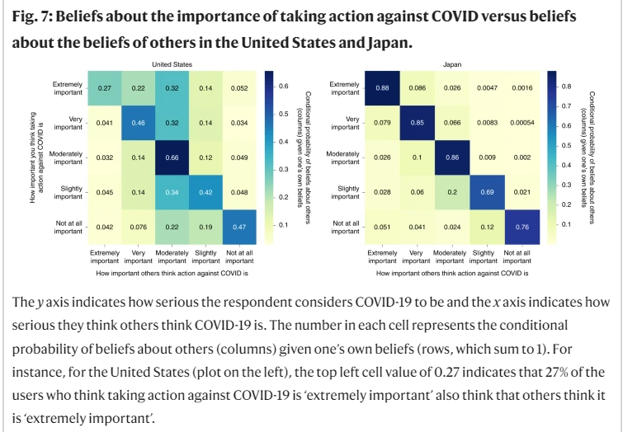

Slide 13
Bilali, 2022
What did Bilali do and find?
Table 1 (goals)
Figure 1 (procedure)
Table 3 (results)
What is the take home message of this study?
How does this study involve norms?
Discussion questions

Slide 14
Other examples
US radio programming on people in Mali, Chad, and Niger--+ behaviors, but no effect on attitudes (Aldrich, 2012)
DRC radio drama---mixed effects—felt closer to other side but also less belief that contact will help (Bilali & Vollhardt, 2015)
Video dramas in Uganda led to more willingness to report and violence toward women and less of it in the communities (Cooper et al., 2020)
Rwanda radio soap opera for 12 months changed perceived norms of open expression and local responsibility changed, attitudes not so much (Paluck, 2009)
Royal Pains and more supportive attitudes toward transgender individuals and policies (Gillig et al., 2018)
Watching positive sitcom of Muslim Canadians less prejudiced toward Muslims 4 weeks later (Murrar & Brauer, 2018)
Telemundo soap opera scenes positive toward the census affected attitudes of US Latinos (Trujillo & Paluck, 2010)
Mexican government educational soap opera in 70s led to millions of illiterate adults going back to school

Slide 15
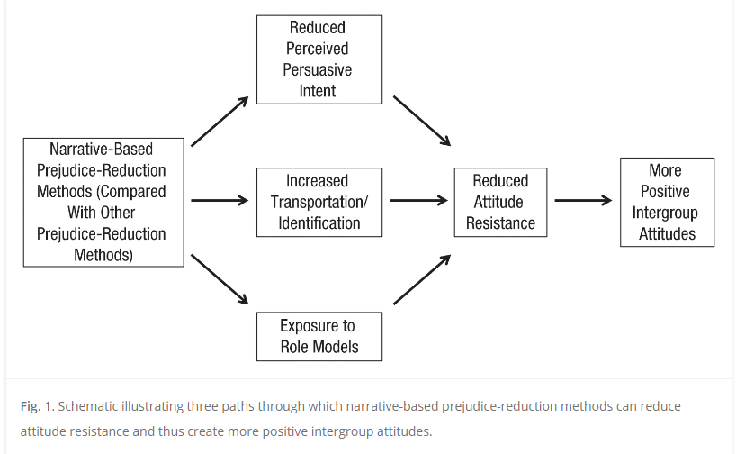
Bilali, 2022
Why are narrative interventions useful?
Why do they affect perceptions of norms more so than attitudes?
How does this relate to efforts to ban books or regulate what can and can’t be taught?
Murrar & Brauer, 2019

Slide 16
Using norms to change behaviors
Institutional changes
Making people aware of others’ attitudes
Narratives
Get people to stop using their phones when they drive
Get people to have their children vaccinated for HPV
Get people to treat unhoused people with more dignity
How could you use each approach to solve the problem?
Which do you think would be most effective?
Would one work better than another for some people, places, situations, etc.?

Slide 17
Next week
Read 2 articles plus
Tell us about an intervention you’re interested in (what it is, how it’s been evaluated, what effects it had)
Project due today
Final exam in 2 weeks

