Slide 1
Belonging

Slide 2
Belonging in schools
What could UNI do better?

Slide 3
Questions from last week or this week

Slide 4
Chapter 3
Tajfel’s (1970) minimal groups
Zimbardo (1971) prison study
Kruglanski (Kruglanski et al., 2013)—threat to belonging and extreme groups
Social media bullying study with kids
Programs that sound good can have unintended effects

Slide 5
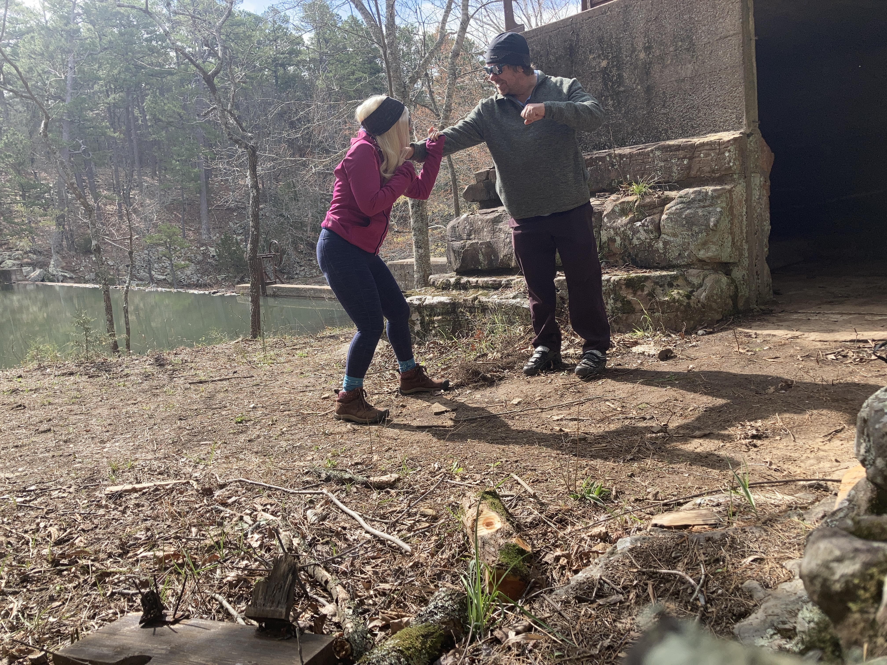
Chapter 4
Prejudice
Realistic threat
Symbolic threat
Interpersonal anxiety
Negative stereotypes
Robber’s Cave (Sherif, 1954)
Geographic separation
Ben Franklin effect
Integrated threat theory
(Stephan & Stephan, 2000)
Jigsaw classroom (Aronson)
Power of stories (Paluck)

Slide 6
Chapter 5
Fundamental attribution error (Ross, 1977) and actor-observer effect (Jones & Nisbett, 1971)
Self-fulfilling prophesy (Rosenthal & Jacobson, 1968)
Dweck (2006) fixed vs. growth mindset
Myers-Briggs (not supported)
Value affirmation
Perceiver’s beliefs
Perceiver’s actions
Our behavior
Perceiver’s beliefs
confirmed

Slide 7
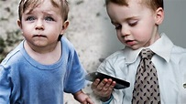
Chapter 6
Low SES kid study (Darley & Gross, 1983)
Aversive racism (Dovidio & Gaertner, 2004)
Ways to make acting on stereotypes less likely

Slide 8
Chapter 7
Stereotype threat (Steele & Aronson, 1995)
Self-handicapping (Baumgardner & Brownlee, 1987)
Situational cues
Fear of confirming stereotype
Poor performance

Slide 9
Chapter 8
Aron et al. (1997) experimental induction of closeness
Bias blind spot
Humility
Empathy
Communication

Slide 10
Belonging at work
What are some things that make people feel less welcome at work?
Gender bias and STEM

Slide 11
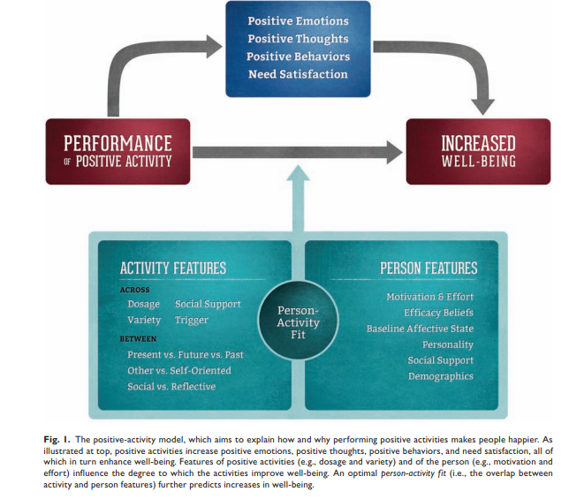
Belonging and health
Belonging and stress
Importance of purpose
Lyubomirsky research on increasing happiness
Lyubomirsky & Layous, 2013

Slide 12
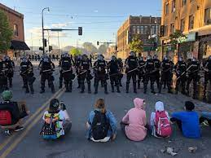
Belonging and the police
People take more personal responsibility when treated with dignity and respect

Slide 13
Belonging and politics
Deep canvassing (Broockman & Kalla)
p. 314-315--Do people do these things?

Slide 14
Applications
In class discussion
Key takeaways

Slide 15
Next week
Presentations
Group videos and questions
Program for last week

