Slide 1
Influence: Harnessing psychology to create a better world

Slide 2
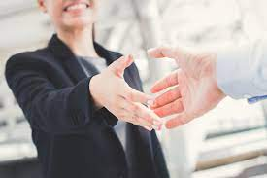
Introductions
Your name
Something interesting (or not) about you

Slide 3
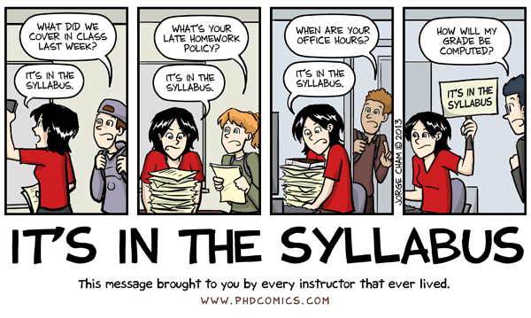
Syllabus
www.uni.edu/harton/honors24s.htm
How to take notes
How to participate in discussions
How to do well in the course

Slide 4
Questions
On syllabus or about me

Slide 5
Critical thinking
What is critical thinking?
Why is it important to think critically?
Why do people sometimes not think critically (do logical fallacies)?
What do we need to think critically about?

Slide 6
True or False?
Being placed in daycare has negative effects on children’s development.
Eyewitness testimony is the most reliable type of evidence in a criminal trial.
People learn better when they are provided information in a format that fits their learning style.
People only use about 10% of their brains.
It takes 7 years to digest chewing gum.
The Great Wall of China is the only man-made structure visible from space with the naked eye.
Vikings wore horned helmets in battle.
You should walk at least 10,000 steps per day for your health.

Slide 7
Associations
Urban violence tends to increase in the summer.
Juvenile delinquents tend to watch more TV, especially violent TV.
Higher amounts of antibiotic use are associated with a greater risk of breast cancer.
Bar employees are more likely than other employees to have alcohol abuse problems.
Women who say that their house isn’t cluttered report less stress and anxiety.

Slide 8
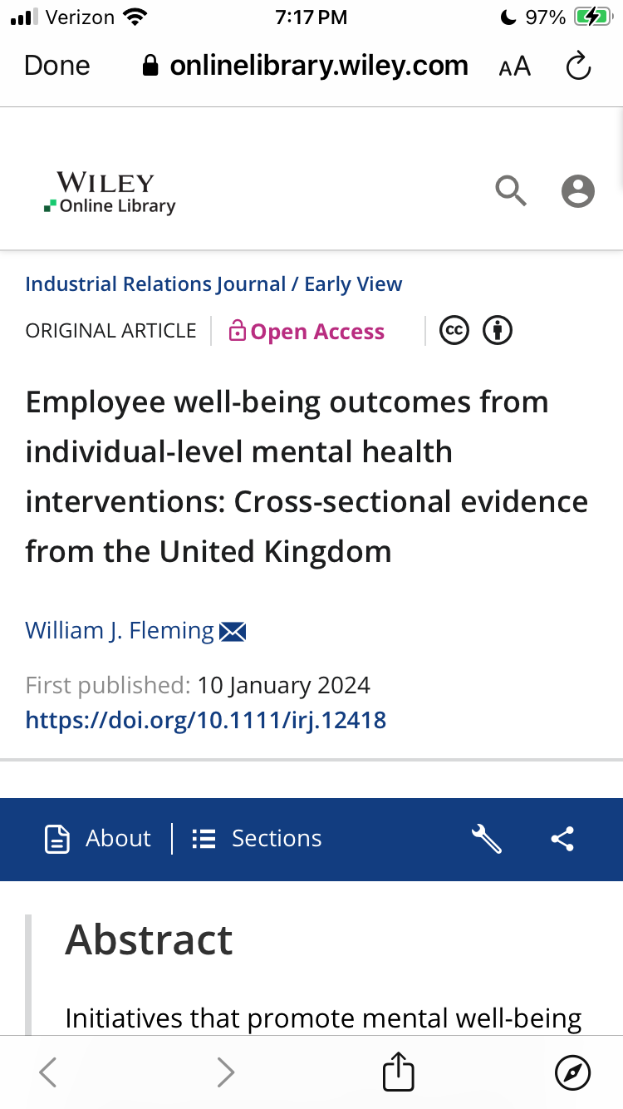
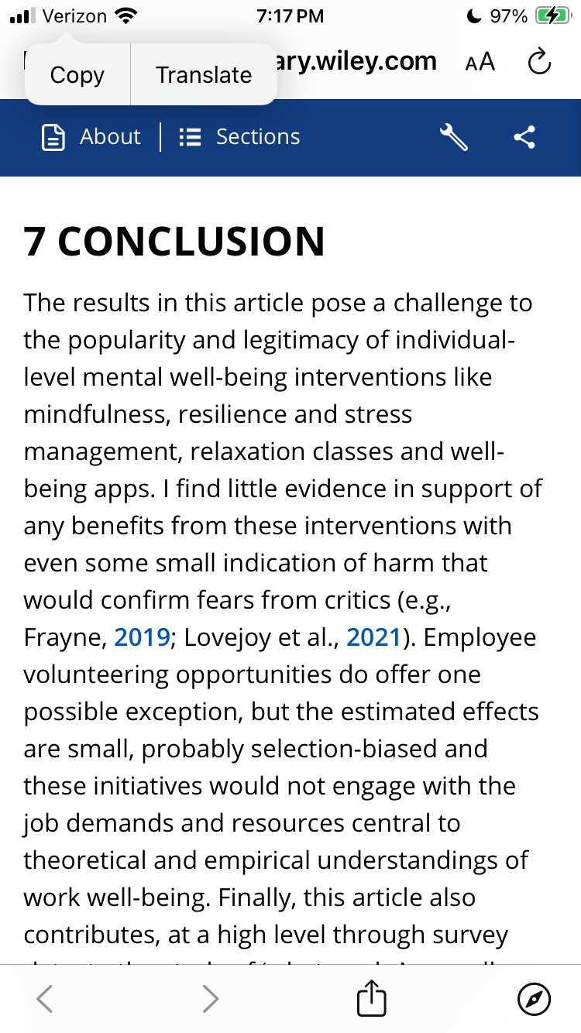
Example

Slide 9
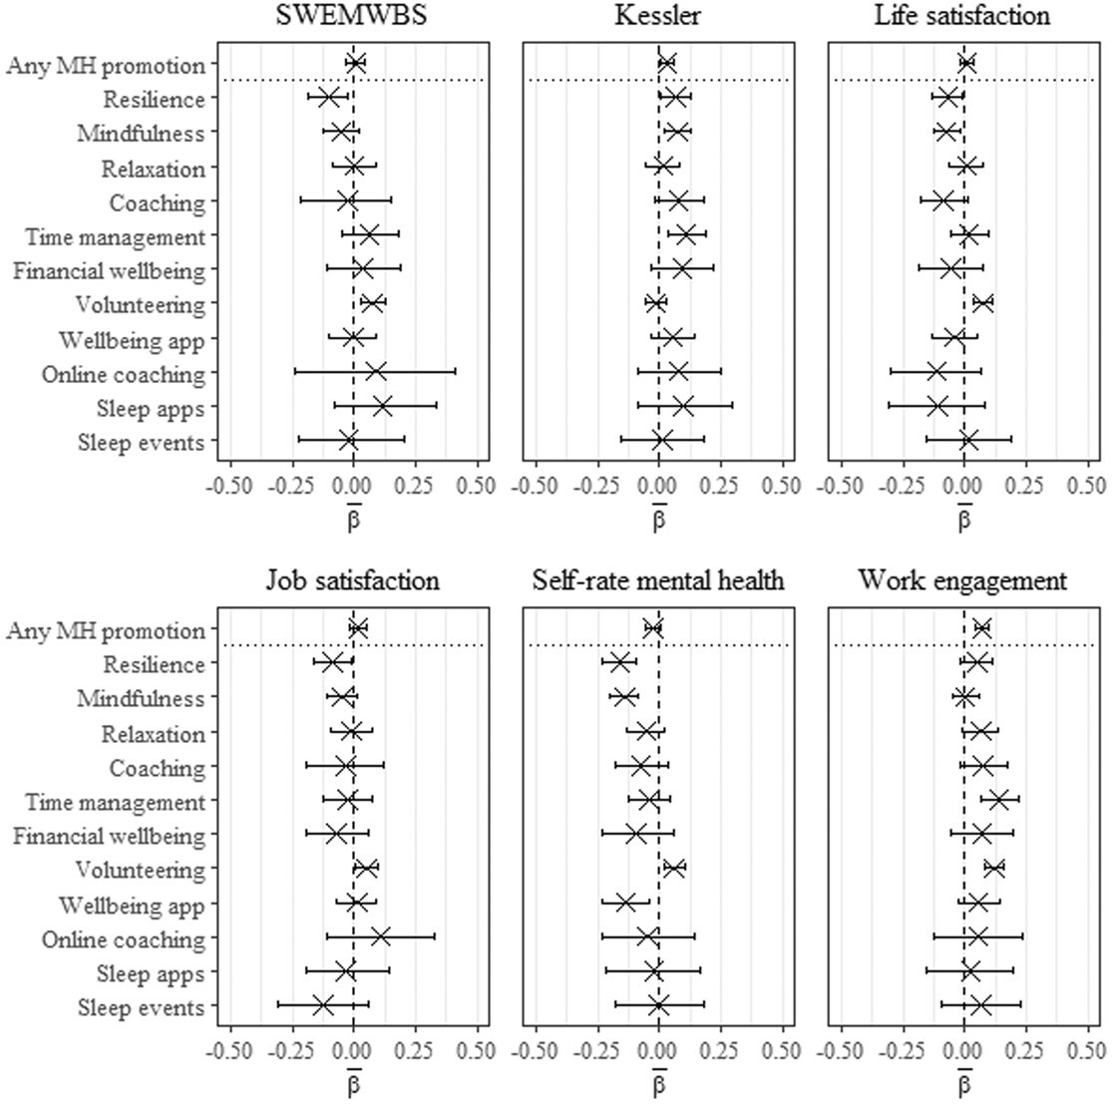
Employee well‐being outcomes from individual‐level mental health interventions: Cross‐sectional evidence from the United Kingdom
Industrial Relations Journal, First published: 10 January 2024, DOI: (10.1111/irj.12418)
https://onlinelibrary.wiley.com/doi/pdf/10.1111/irj.12418

Slide 10
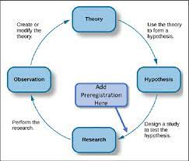
Research review
What is a theory?
What makes one good?
What is a hypothesis (and a testable one in particular)?
Why aren’t anecdotes (experience) good evidence for a theory?
What does it mean to say that research is probabilistic?

Slide 11
Definitions
Variable
Independent (measured vs. manipulated)
Dependent
Control variable/constant
Levels
Confound
Conceptual vs. operational definition
Frequency vs. association vs. causal claims
4 types of validity

Slide 12
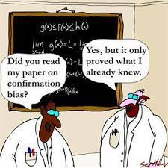
Biases in intuition
Good story
Availability heuristic
Present/Present bias
Confirmation bias
Bias blind spot

Slide 13
More logical fallacies
Non sequiter
Zero-sum or fixed pie
Invalid disjunction
Argumentum ad verecundium/ad hominem (halo)
Naturalistic
Ad notivatem/ad antiquitatem
Bandwagon (ad populum)
Ignorance (ad ignoratiam)
Composition
Representativeness heuristic
Gambler’s fallacy
Regression fallacy
Conjunction fallacy
Assimilation bias
Belief perseverance/Sleeper effect
Naïve realism
Overinference from small samples
Correlation<>causation
Magical thinking
Law of similarity
Hindsight bias
Curse of knowledge
Sunk costs

Slide 14
Others
Just world hypothesis
Placebo effect
Bystander effect
Spotlight effect
In-group bias
Barnum effect
Groupthink
Negativity bias
Anchoring
Declinism
Framing effect
Fundamental attribution error
Dunning-Kruger effect
Optimism/
pessimism bias
Self-serving bias
Backfire effect

Slide 15
Finding information
Empirical journal article
Primary vs. secondary source
PsycINFO
Google Scholar

Slide 16
For next week
Podcast, article, and APA publication
Submit up to 3 ideas for your project issue

