Slide 1
The “new” statistics

Slide 2
Archival data presentation

Slide 3
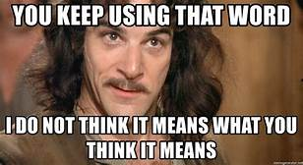
Definitions (what does it mean?)
Frequentist
Bayesian
https://www.youtube.com/watch?v=My6DMRmqwQk
NHST
Confidence interval
Credibility interval
p-value

Slide 4
What is a p and what does it mean? (Laken, n.d.; Anderson, 2019)
Dance of the p values
Why p=.06 doesn’t mean null is true
Why p<.05 doesn’t mean null is false
Why a sig p <> an important effect
Why a sig finding doesn’t mean that Type I error likelihood is 5%
Why the p value doesn’t tell you about replicability
Why d=.80, p = .035 isn’t necessarily a good thing
Why sometimes the likelihood of the null is greater even when p<.05

Slide 5
p advice
Always report exact p’s
Adjust p if multiple tests
p-curve as a possible indicator of replicability/QRPs

Slide 6
NHST
What are the problems with NHST/frequentist analyses?
If they have problems, why do we keep using them?
“It does not tell us what we want to know, and we so much want to know what we want to know that, out of desperation, we nevertheless believe that it does” (Cohen, 1994, p. 997, as cited in Anderson, 2019)

Slide 7
How can we deal with NHST problems?
Do CIs
Don’t do CIs
Just change alpha to .005
Justify your alpha
Do Bayesian stats
Quit using “statistically significant”
Use graphs and flexibility in models (turn your brain on)
**note that many of these are mutually exclusive!

Slide 8
Solution #1: Use CIs (Cumming, 2014)
What is Cumming’s argument?
Table 1
Comments/questions?
What is similar/different in his approach to others’?
What do you think of these suggestions?

Slide 9
How to change to the “new stats”
Rethink hypotheses—avoid dichotomies
Identify what effect you want to measure
Pre-specify your study
Calculate estimates and CIs
Make figures using CIs as error bars
Interpret ES and CI in write up
Use meta-analytic thinking
Make report and raw data available

Slide 10
Interpreting confidence intervals
What is the advantage of using CIs?
Ways to interpret
Think of what interval means/includes
83% CI for replication ES
Margin of error tells about precision
Cat’s eye graphs
Relate to NHST
Figure 4 (p. 19)
CIs for means vs. differences between them vs. ES

Slide 11
Other recommendations/info
Planned comparisons instead of overall test (make sure you pre-register)
CI for correlations (and d’s) are asymmetric
Problems of calculating ES using online calculators
Power or precision

Slide 12
Solution #2: Don’t use confidence intervals (Morey et al., 2016)
Confidence interval definition (p. 104)
Confidence procedure vs. interval
Fundamental confidence fallacy (p. 104)
Precision fallacy (p. 105)
Likelihood fallacy (p. 106)
Suggestions:
Use Bayesian credibility intervals
Be careful about how you interpret CIs
Report how you calculated the CIs

Slide 13
Solution #3: Explore small, confirm big (Sakaluk, 2016)
Do NHST and exploratory analyses in small study
Replicate with larger study, pre-registering, etc.

Slide 14
Solution #4: Redefine statistical sig (Benjamin et al., 2017; Vazire and Wagenmakers videos)
p<.005
p<.05 to p<.005 = suggestion
More replicable
Easy change
Need 70% more people
Harder to p-hack

Slide 15
Solution #5: Justify your alpha (Lakens et al., 2018; Lakens video)
Problems with .005
May not fix things
Importance of type 1 to type 2 error
May be less replication
More research on convenience samples; less hard to reach
Emphasizes p
Instead
Justify your alpha
Pre-register
Educate people
Don’t say “statistically significant”

Slide 16
Solution #6: Bayesian stats
How do Bayesian stats differ?
Why use them?
What is a critique of Bayes?
What are best practices?
Jamovi

Slide 17
Solution #7 Use your head (Fife, 2020)
NHST is one tool of many—pick the best tool
Quantpsych videos
https://www.youtube.com/c/QuantPsych/videos

Slide 18
Other approaches
Data exploration/visualization
Robust methods (no assumption of normality)
Resampling/Bootstrapping (Process uses this)

Slide 19
So how do I decide what to do?
Use your head—think through what works best for your study and goals
Look to JARS
https://psycnet.apa.org/fulltext/2018-00750-002.pdf

Slide 20
Further notes on study steps

Slide 21
Data analysis steps
State a strong and supported hypothesis
Design your study well (4 types of validity)
Pilot test
Preregister (Open Science Framework; AsPredicted)
Collect data
Clean data (and document the cleaning)
Test for appropriate assumptions
Examine descriptives
And only THEN….
Do inferential statistics

Slide 22
Don’t just learn enough to be dangerous….
Always look into what the programs you’re using are doing
And remember that data come from PEOPLE

Slide 23
Pilot studies
Things to look for in a pilot study:
Make sure people are answering questions correctly
Check for ceiling or floor effects
Check for any other problems or misunderstandings
See if your manipulation works
See how long the study effects last
Check for reliability and validity of measures
How can these issues be addressed during collection?
Talk with participants after the study
Have a comment box

Slide 24
Other data-related concerns during study
Pretest multiple times
Have other people look at it
Make sure you hit publish and remove pretests if using Qualtrics

Slide 25
Cumming’s suggestions for planning research
Use good measures
Think about participant selection
Use RM
Use control variables
Keep it simple
Use larger n
Use more than one measure and average or use as latent variable

Slide 26
Steps of data analysis (Fife, 2020; Table 1) integrated with my own
1. State your hypotheses
Map them to specific stat tests
Make them specific
State your decision criteria
2. Examine psychometrics of measures and manipulations

Slide 27
2.5 Data entry and cleaning
Data entry:
Do double entry or random checks
Keep a log with experimenters, times, sessions, notes, etc. or times you sent out invitations (and add that information to your data file)
Add participant numbers to study
Data cleaning:
Do frequencies to look for duplicates or impossible scores
Check IP addresses
Check time stamps (DON’T use +/- std deviation—use an actual time range for exclusion, at least with electronically collected data)
Check attention checks
Check criteria for inclusion/exclusion

Slide 28
Missing values:
Deal with missing values (according to your pre-reg—look at notes from before)
Declare missing values (and make sure it can’t be a real value)
Labeling:
Add value labels and label all variables
Do recodes in syntax or into new variables
Do computes in syntax and describe them with value labels
Clearly label your datafiles so you know which is which (make a file with info on the study and data)
Delete “extra” files
Keep clear notes on what you did and who you dropped at each step (raw vs. clean data file)

Slide 29
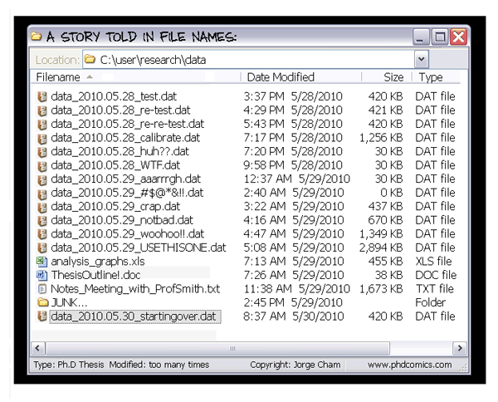

Slide 30
Other common data management problems
When you recode categories, make sure your recodes make sense
Do reliability item analyses to check for poor items and to see if there are ones that should have been recoded and weren’t
Be purposeful in how you do calculations and know what they actually do

Slide 31
3. Graph your univariate variables (get to know your data!)
Do frequencies and look at the distributions and ranges
Look at the means and SDs and think about what those really mean (measures of central tendency and variability)
Std deviation vs. variance vs. std error
Do histograms or other plots
Graph data, not summaries of data
What information will this give you?

Slide 32
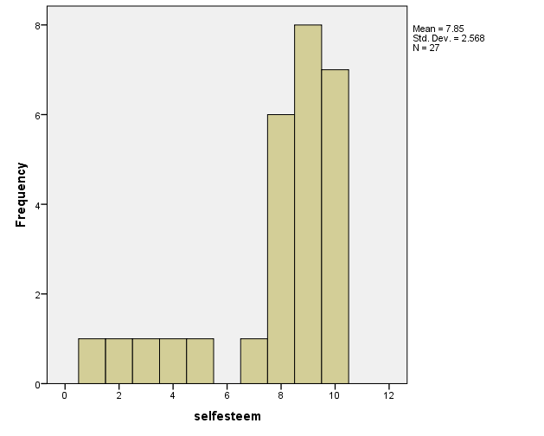
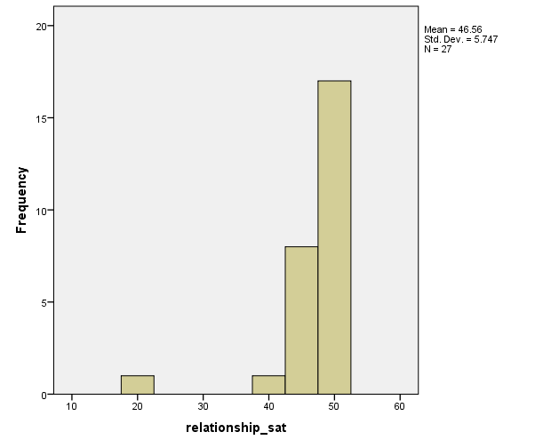
What do these graphs tell you?

Slide 33
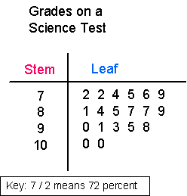

Slide 34
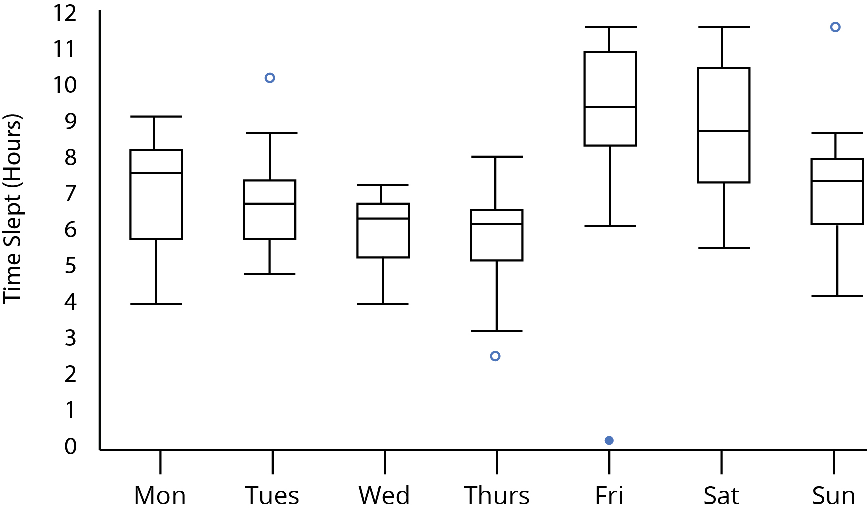

Slide 35
4. Graph your hypothesis
Do crosstabs (what test would go with these?)
Do scatterplots and other graphs
https://mode.com/blog/violin-plot-examples/
Check out Edward Tufte’s books
Look for outliers—why do you get them and how can you find them?
Look for nonlinearity
Understand your data before you test it

Slide 36
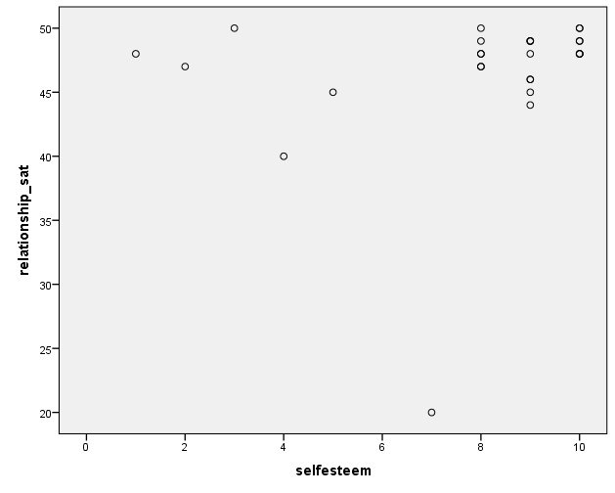

Slide 37
5. Study your residuals/test assumptions
Normality
Univariate and multivariate
Skew and kurtosis
Histogram of residuals
Linearity
Multivariate
Scatterplots
Graphing residuals
Residual dependence or scale location plot
Homoscedasticity
Homogeneity of variance at univariate level (Levene’s test)
Scatterplots
Box’s M at multivariate level
Residual dependence or scale location plot
Independence (talked about last class)
What can you do if there are violations?

Slide 38
6. NOW you’re ready to analyze

Slide 39
What tests should you do?
Nonparametric tests
Chi square
Cramer’s V
Mann Whitney U
Wilcoxon signed ranks
Sign test
Kruskal Wallis

Slide 40
General linear model
t-test
ANOVA (random vs. fixed factors, nested designs)
ANCOVA
MANOVA
Regression (linear vs. logistic; stepwise, hierarchical, enter)
Factor analysis (eigenvalues, exploratory vs. confirmatory, scree plot)
Multidimensional scaling
Discriminant function analysis
HLM
SEM

Slide 41
What can bias correlations?
Sample size
Outliers
Truncated range
When do you want to use categories or dichotomies instead of continuous data?
Do sensitivity analyses and report them
Distinguish between exploratory and confirmatory analyses
Always double check analyses (2 people, until you agree)
Use statcheck.io
Report test statistic, df, p value, effect size, confidence intervals, means, variability

Slide 42
7. Draw your conclusions (if you can)
8. Replicate with new data
Add in paper:
1 or more graphs of the main analyses
How you determined that assumptions were met
Parameters, ES, CI, etc. (see APA manual)
Supplemental materials—graphs, sensitivity analyses

Slide 43
Meta-analysis
Forest plot Figure 6
Small meta-analyses within your own research
Heterogeneity
Fixed vs. random models
BRING this article next week

Slide 44
Pre-registration
What information must be pre-registered?
How do you pre-register?
What are the advantages of pre-registering?

Slide 45
Writing about statistics
State your results in words
Tell what the relationship is (e.g., instead of X is correlated with Y say People who reported more X also reported more Y)
Be careful about using causal language for correlational results
Use tables and figures that complement rather than repeat the text

Slide 46
Due today
Methods assignment 3

Slide 47
Coming up next week
Meta-analysis and effect sizes
Bring Cummings
Field and Gillett
Other articles on meta-analysis methods, effect sizes, and how to evaluate effect sizes
March 29—exchange
April 3—feedback to peer
April 10—final paper, bibliography, response to review
LOOK AT INFORMATION LINKED FROM SYLLABUS

Slide 48
Peer review partners
Daria and Alexa
Kenzie and Monty
Kate and Kalsang
Taylor and Christiana

