Slide 1
Research Design

Slide 2
Course overview
Course goals
Readings
Requirements
Topics
http://www.uni.edu/harton/ResDes23.htm
Open science movement
Sign-up sheets

Slide 3
Basic background
Independent variable
Dependent variable
Confounds
Operationalization/operational definition
Cross-sectional vs. longitudinal
Reliability
Validity
Positive vs. negative relationship
Third variable problem

Slide 4
More background
Qualitative vs. quantitative research
Induction vs. deduction

Slide 5
Stats review
Types of data: nominal, ordinal, interval, ratio
Normal distribution
Mean, median, mode
Range, SD
Skew, kurtosis
Effect size
Confidence interval
Mediation vs. moderation

Slide 6
Stats review
Correlation
T-test (independent and paired t)
Anova
Manova
Linear regression
Logistic regression
Factor analysis (exploratory/confirmatory)
Chi square
Structural equation modelling
Hierarchical linear modelling

Slide 7
Theory in psychology

Slide 8
Theory
What do theories do for us?
How can they be bad/not useful?
What makes a good theory?
What makes a good hypothesis?
Merton’s scientific norms:
Universal
Communal
Disinterested
Skeptical
How is psychology doing on these?

Slide 9
Good operational defs and hypos
What do you have to have to have a testable hypothesis?
Write three possible operational definitions of mania
Write a testable hypothesis related to group size

Slide 10
Meehl, 1990
What is the main point of the Meehl article?
What is a weak theory, and why is one a problem?
What happens to a theory with no support, according to Meehl?
Do what areas does he apply his critiques?
Are other areas of psychology doing better?
Are other methods doing better?

Slide 11
Meehl’s 10 factors
“loose derivation chain” (Kenzie)
“problematic auxiliary theories” (Monty)
“problematic ceteris paribus clause” (Christiana)
“experimenter error” (Daria)
“inadequate statistical power” (Megan)
“crud factor” (Kate)
“pilot studies” (Kalsang)
“selective bias in submitting reports” (Alexa)
“selective editorial bias” (Taylor)
“detached validation claim for psychometric instruments”

Slide 12
Meehl, 1990
What are the implications of his points for the field?
Are these issues more of a problem in psychology than in other fields?
Are we just doing “a bunch of nothing” (p. 230)?
What are some ways we can address these issues?
Are there some things we just don’t have the tools to study?

Slide 13
Debrouwere & Rosseel, 2021
What is the main point of this article?
How are the recommendations and critiques here similar or different to those of Meehl?
What do they suggest we do?
Do you agree with their points?

Slide 14
Other problems in psychology

Slide 15
HARKing (Kerr, 1998)
What is HARKing? What is the alternative?
How can you tell when people are HARKing?
How often do you think it occurs?
Have you ever seen or done it?

Slide 16
Why does HARKing happen?
What are the costs of HARKing?
How can we decrease it?

Slide 17
The Renaissance
Replication crisis and aftermath
1960-2010: Meehl, Rosenthal, Cohen, Kerr, and others shouting into the wind
2011: Bem article
2012: Stapel fraud
2011 p-hacking (Simmons et al., 2011)
2012 Doyen et al. failure to replicate Bargh et al., 1996
2011-2012 Nosek developed OSF
2013 Center for Open Science

Slide 18
Nelson, Simmons, & Simonsohn, 2018
What do they mean when they say that this is not a file drawer problem, but p-hacking one?
What are some ways p-hacking occurs?
Why does it happen?
How do you know if something replicates?
What does a failure to replicate mean?

Slide 19
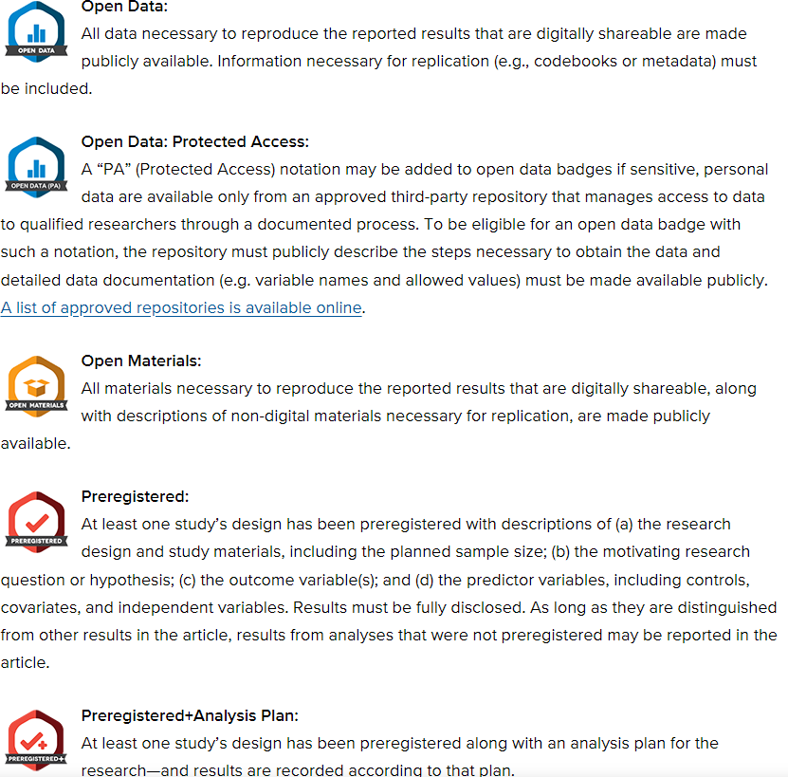
How can p-hacking be reduced?
How can you find errors in single studies?
How can you find errors in groups of studies?
What doesn’t work and why?

Slide 20
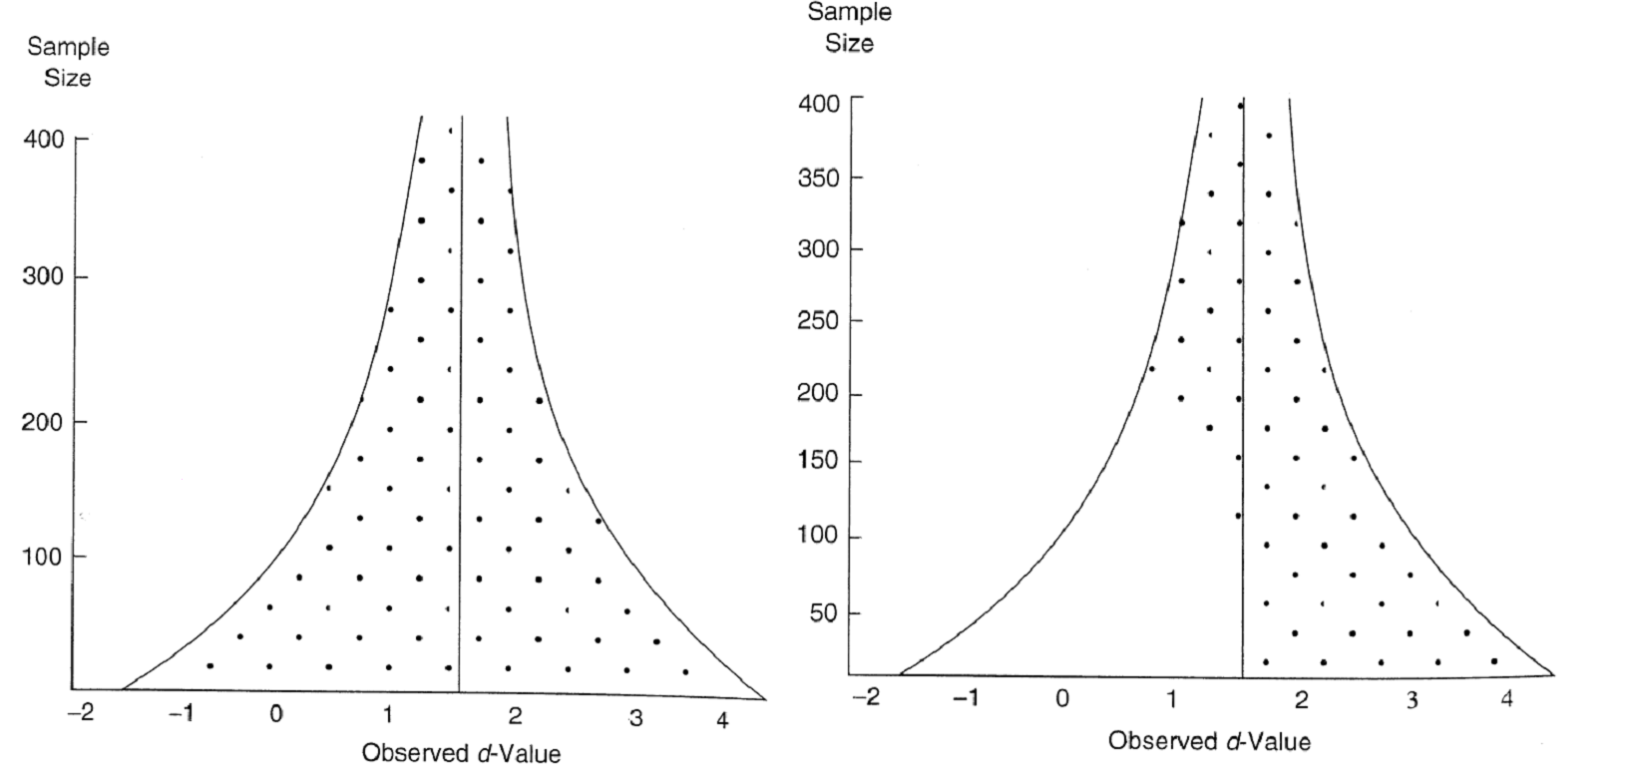
Tools
Funnel plots
p-curves
GRIM
http://statcheck.io/
Post materials
Badges (open data, open materials, preregistration)
Audits
Meta-analyses
“p-value bashing”

Slide 21
From Simonsohn, Nelson, & Simmons, 2016

Slide 22
How are you feeling about psychological research?

Slide 23
Ways to fix things
Preregister (NSS, Lindsay, Simons, & Lilienfeld, 2016, Vazire, 2018)
Be more precise in specifying theories (effect size predictions) (Meehl, 1990, LeBel & Peters, 2011; Fried, 2020)
Make null hypotheses really alternatives (LB&P)
Use more than just NHST (LB&P)
Make hypotheses falsifiable (M, LB&P)
Test multiple hypotheses (M, K)
Use stronger methods so that failures to support can’t be put off on methods (LB&P)

Slide 24
Do more to check R/V in studies (invariance across conditions, measures of comprehension, noncompliance) (M, LB&P)
Report pilot studies (M, LB&P)
Require replication (M, K, LB&P, NSS, V—especially direct)
Report everything (BvW, NSS, V)
Share data and materials (NSS, V)

Slide 25
Set power at .90 or higher/ increase sample sizes (M, BvW)
Report power and power analyses in articles (M)
Report confidence intervals, means, and variance (M)
Report overlap stats (M)
Report negative results (M)
Look at multiple measures and see whether you get the same effects across them (M, BvW, D&R)

Slide 26
Educate students on HARKing and negative practices (K)
Address in codes of ethics (K, NSS)
Reject HARKing articles (K)
Make exploratory/post-hoc research okay (K, BvW)
Use and value nonexperimental approaches (D&R)

Slide 27
Learn more math (M, F)
Change the system (pubs=everything) (M, K)
Reviewers should be more critical of lit (M, K)
Realize that not everything can be tested (M)
Train theoretical psychologists (F)
Do interdisciplinary research (F)

Slide 28
Writing
What is a reference manager and why should you use one?
Zotero
Endnote

Slide 29
Notes on articles
What should be on your notes?
How do you take notes?

Slide 30
Coming up with good ideas (Gray & Wegner, 2013)
Get ideas from life
Choose ideas that are counterintuitive to the lay person
Think about feasibility issues
Use involving studies
Use simple stats
(think about power and ability to interpret)

Slide 31
Next week
Thought papers due by noon Tuesday (address all readings; 3-4 good points)
Ethics—for researchers and participants (background article; 2 chapters, one website—Belmont Report, 2 articles)
Proposal topics due. Paragraph on what you plan to do.
Sign up for methods presentations and proposal presentations

